Slide 1
Generate SDMX files

Slide 2
Is it a hard process?

Slide 3
No!!!

Slide 4
Keep calm… and generate SDMX

Slide 5
With SDMX Converter

Slide 6
With SDMX RI

Slide 7
SDMX Converter, from files…

Slide 8
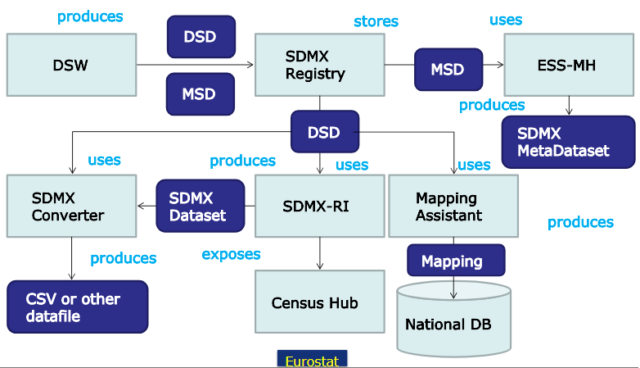
SDMX Converter components

Slide 9
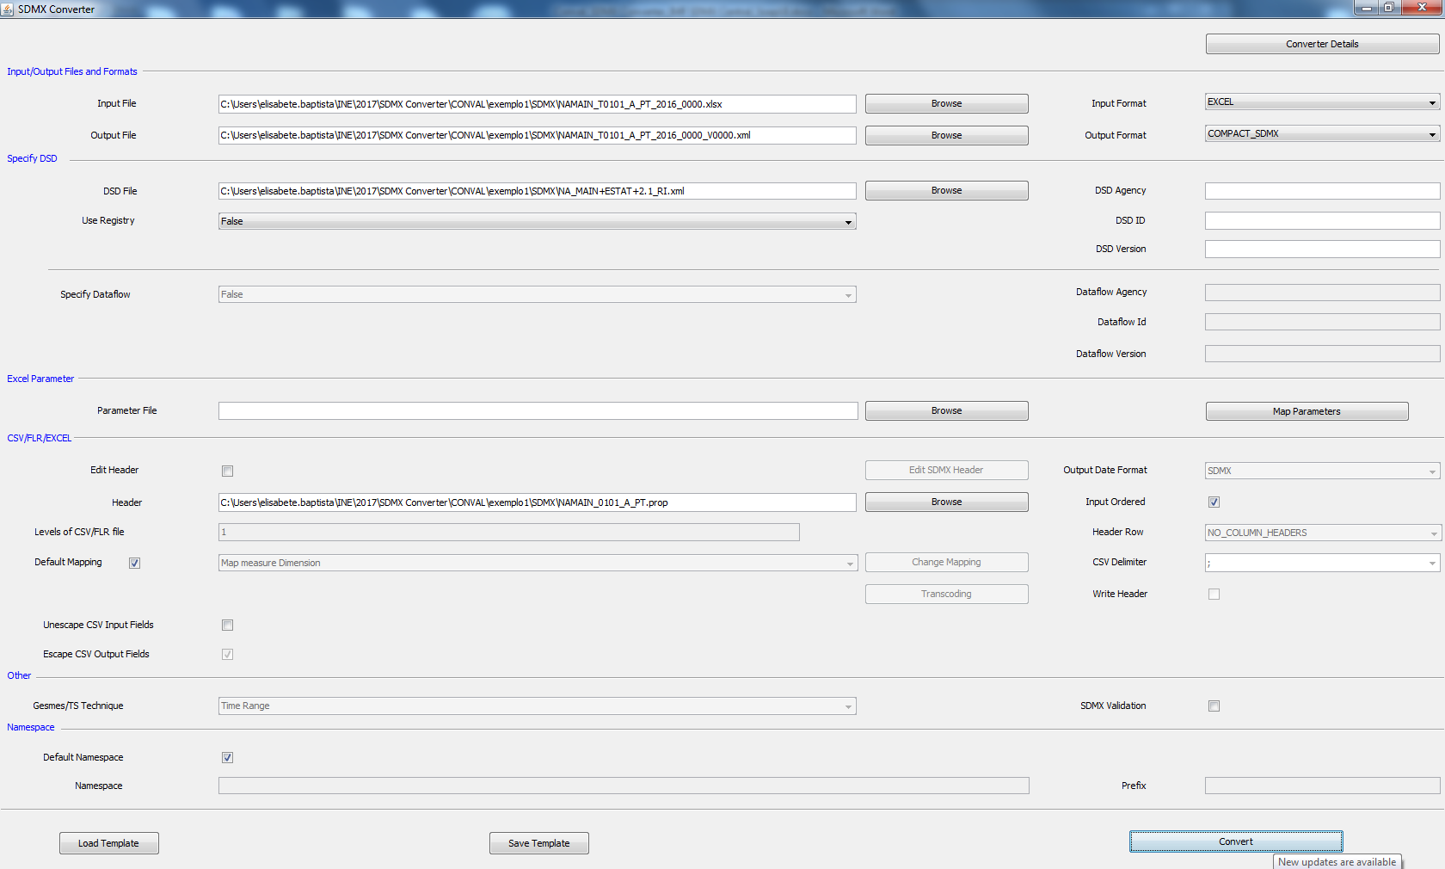
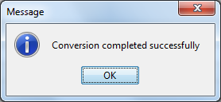
Using SDMX Converter

Slide 10
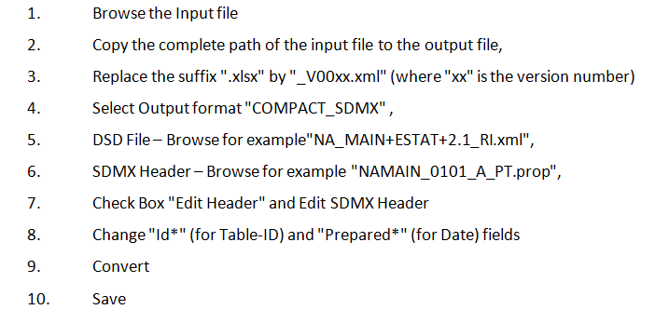
Ten steps for every file…

Slide 11
Manual effort

Slide 12
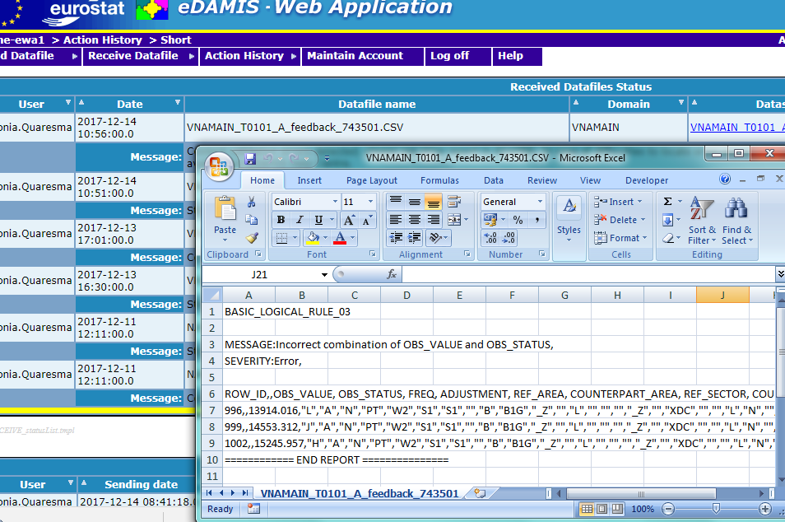
Beware that column order does not follow the DSD

Slide 13
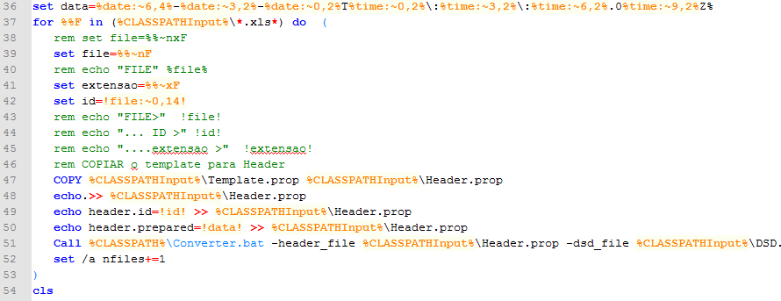
It’s possible to automate
the process

Slide 14
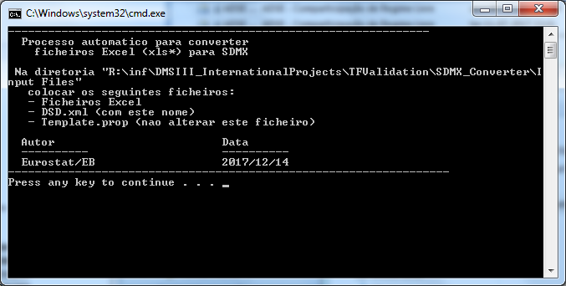
The essnet on validation made this available
Excel files with the desired name
Header file (with sender and so on)
DSD File in XML

Slide 15
With SDMX RI

Slide 16
From the database…

Slide 17
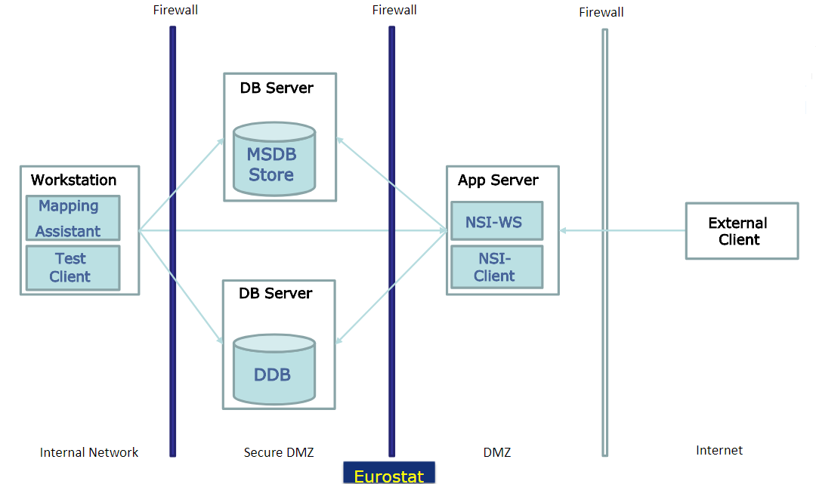
SDMX RI components

Slide 18
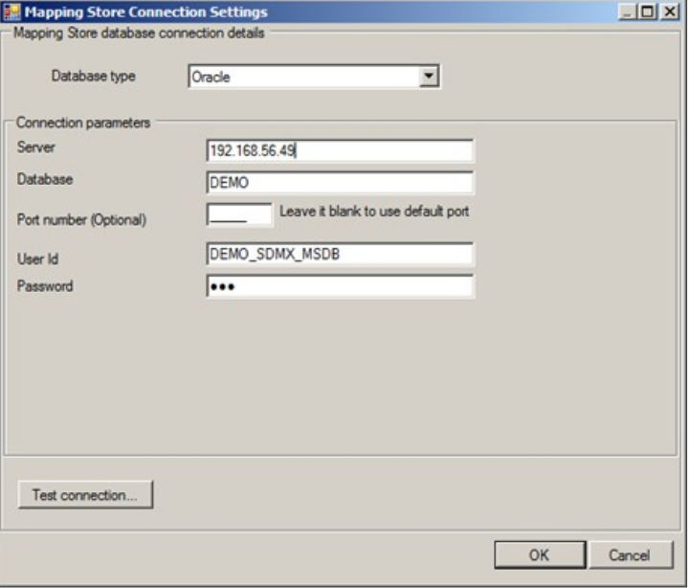
Initial setup and mapping assistent

Slide 19
Speeds things a bit, only do the mapping once!

Slide 20
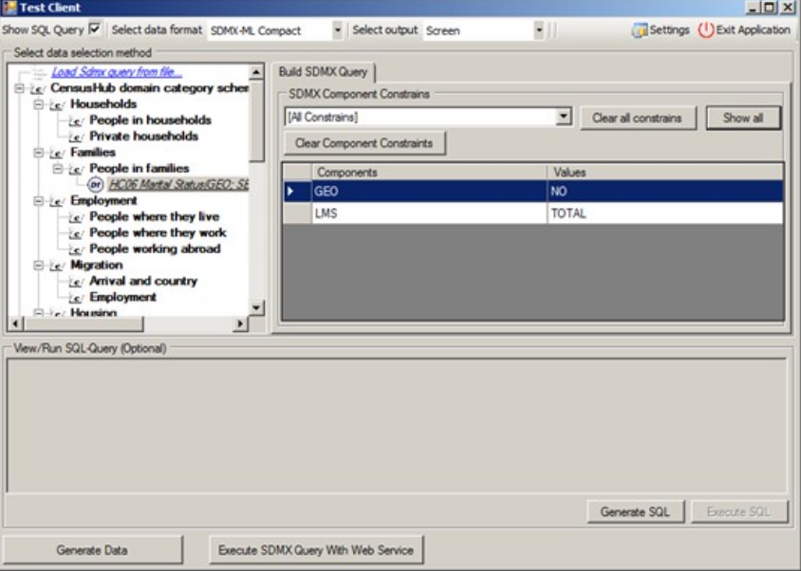
Composing SDMX Query

Slide 21
Generating and Executing SQL

Slide 22
And that’s it!

Slide 23
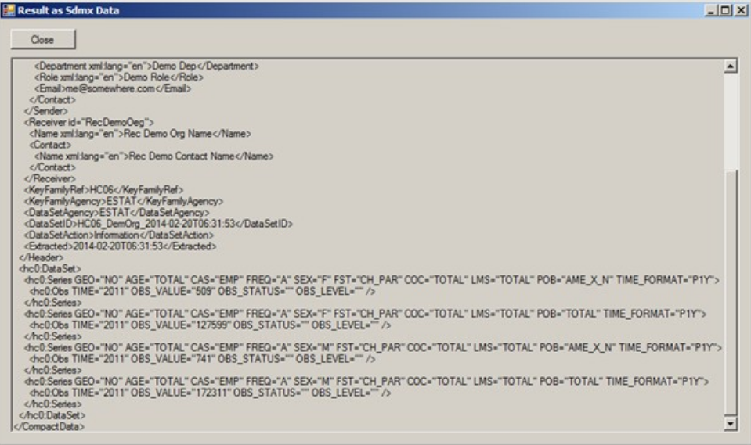
Generate Data

Slide 24
We can use the Querya as Web Service

Slide 25
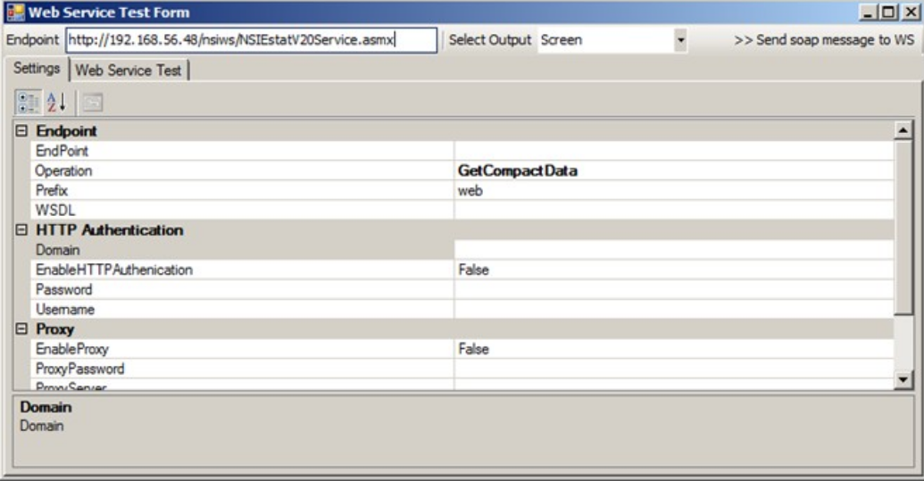
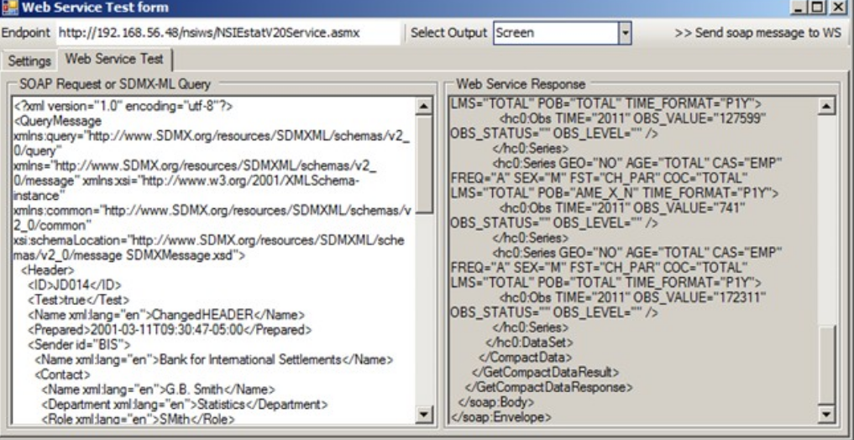
Execute Query with Web Service

Slide 26
We were trying this…

Slide 27
creative
commons
Thanks to Validation ESSnet
https://ec.europa.eu/eurostat/cros/content/essnet-validat-integration_en
Thanks to Eurostat SDMX RI – Unit B3 – IT and standards for data and metadata exchange
http://slideplayer.com/slide/9306432/
Thanks to Eurostat SDMX Converter – Unit B3 – IT and standards for data and metadata exchange
http://slideplayer.com/slide/9310274/

