Slide 1
Working time, underemployment and overemployment: two different data sources with contradictory results
Dr. Martina Rengers, Federal Statistical Office FSO, Germany, martina.rengers@destatis.de
June 28, 2018
Speed Talk Session 9

Slide 2
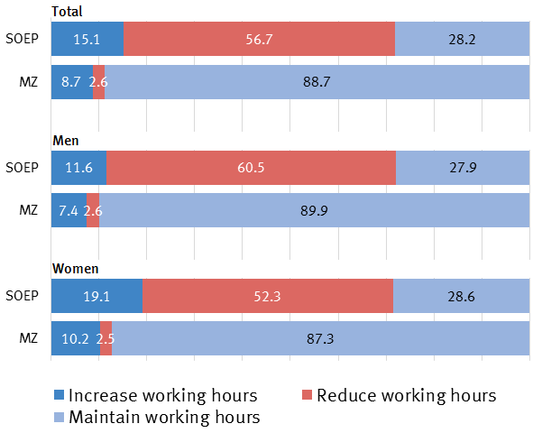
Longer or shorter working hours?
Working-time preferences 2015 in %
answers in the microcensus (MZ) and Socio-Economic Panel (SOEP) for 2015
persons in employment aged 20 to 64 years, after microcensus-SOEP adjustments
MZ
representative household survey of Federal Statistical Office Germany (Destatis)
approximately 1% of population selected every year
in 2015: 691,000 persons in 342,600 households were interviewed
SOEP
longitudinal household survey of German Institute for Economic Research (DIW Berlin)
currently 30,000 respondents in 11,000 households are interviewed

Slide 3
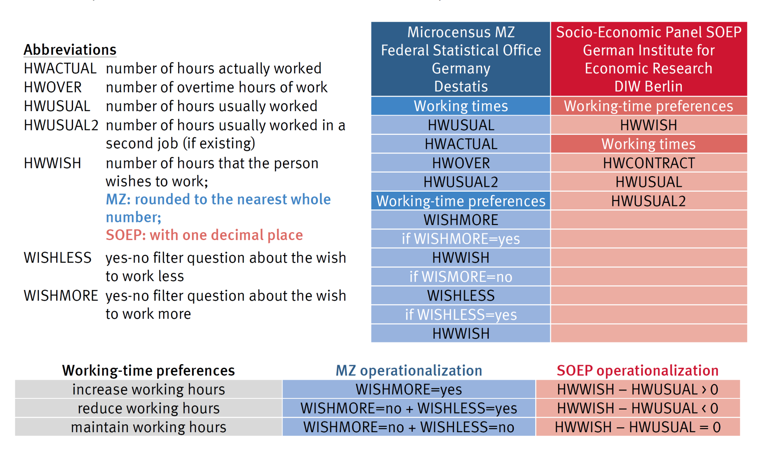
Different questionnaires: MZ vs. SOEP
Order of questions about working time and working-time preferences (2015)

Slide 4
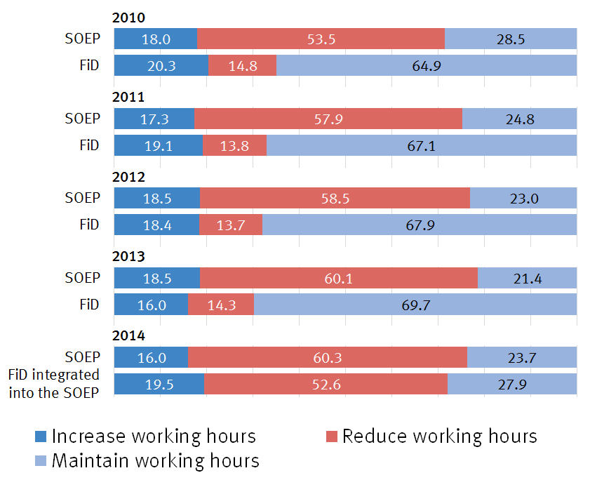
Main reasons of contractictory results (1) – preceding filter question –
SOEP questionnaire direct question about the desired working hours without a preceding filter question
FiD questionnaire from 2010-2013 with the following preceding filter question: If you could choose your own working hours, taking into account that your income would change according to the number of hours: Would you rather reduce, increase or maintain your working hours?
maintain
reduce
increase
FiD in 2014 without a preceding filter question: FiD survey was integrated into the SOEP with identical wording as in the SOEP questionnaire

Slide 5
Main reasons of contractictory results (1) – preceding filter question –
SOEP questionnaire direct question about the desired working hours without a preceding filter question
FiD questionnaire from 2010-2013 with the following preceding filter question: If you could choose your own working hours, taking into account that your income would change according to the number of hours: Would you rather reduce, increase or maintain your working hours?
maintain
reduce
increase
FiD in 2014 without a preceding filter question: FiD survey was integrated into the SOEP with identical wording as in the SOEP questionnaire

Slide 6
Main reasons of contractictory results (2) – other important aspects –
Sequence of questions and recording of different working hours
asking for hwusual after hwcontract can lead to an overestimation of hwusual and, as a result, lead to a higher share of overemployment when calculating working-time wishes by the difference hwwish – hwusual
in the SOEP survey the ratio of overemployment to underemployment in all persons with working time discrepancies changed from 80:20 to 55:46 by using hwwish – hwcontract
Explicit reference to changes in earnings
previous studies in the microcensus MZ showed that the wording “with a corresponding increase in earnings” encourage people to formulate a desire to work more hours
before 2008 this explicit reference to a corresponding increase in earnings was not included; the change in the question wording lead to an increase of underemployment
no studies about a corresponding effect for overemployment as the question was incorporated only in 2008 and has included an explicit reference to a corresponding loss in earnings from the beginning

Slide 7
Working time, underemployment and overemployment: two different data sources with contradictory results
Dr. Martina Rengers, Federal Statistical Office FSO, Germany, martina.rengers@destatis.de

