Slide 1
IMPROVED QUALITY IN STATISTICAL PRODUCTION BY USING STANDARD PROCESSES IN PHASES DESIGN, BUILD AND COLLECT
Biljana Ristevska Karajovanovic, State Statistical Office of the Republic of Macedonia (SSO), biljana.karajovanovic@stat.gov.mk
Valentina Todorova Hristovska, State Statistical Office of the Republic of Macedonia (SSO), valentina.todorova@stat.gov.mk
28 June
Speed Talk Session 9

Slide 2
Web Data Collection
No costs for administrative and field work
Real-time data transfer and immediate access to results
Real-time validation and increased response quality
Reduced constraints of time and place of surveying
Ease of reaching a large number of potential respondents
Broad range of supported ICT devices
Establishment of Metadata repository

Slide 3
eSTAT – system for single standardization production line for all surveys
Web forms based on metadata
On-line data collection process
Elementary variable-single response
Multidimensional variable-set of answers
Code lists and classifications
Standardized validation rules
Organization of the collection process-Statistical Task
List-based web surveys
Automated communication with respondents

Slide 4
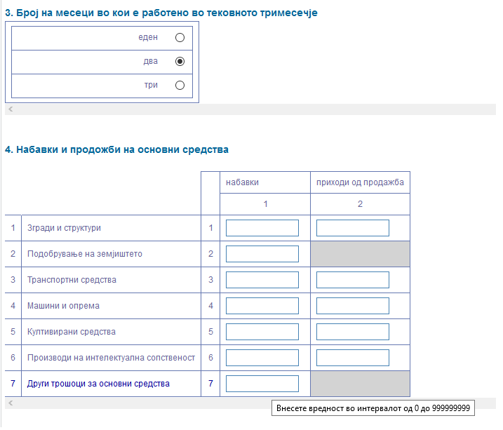
Elementary and Multidimensional Variable
elementary
multidimensional

Slide 5
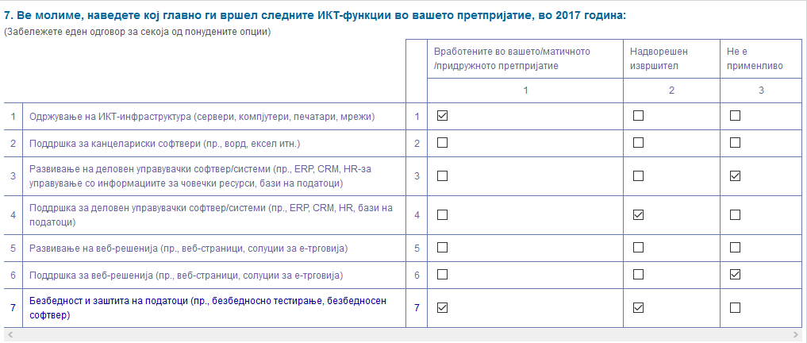
Two-dimensional Matrix

Slide 6
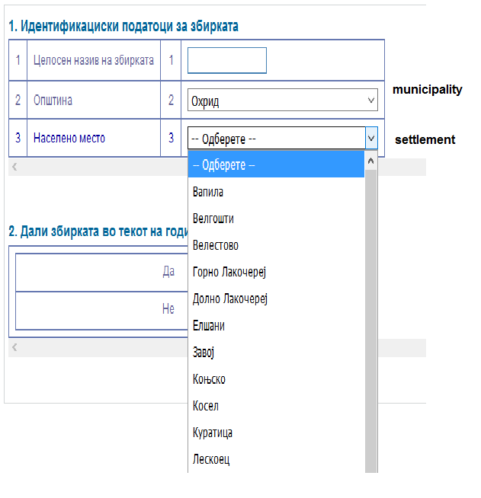
Validation Rule - Hierarchical Relationship

Slide 7
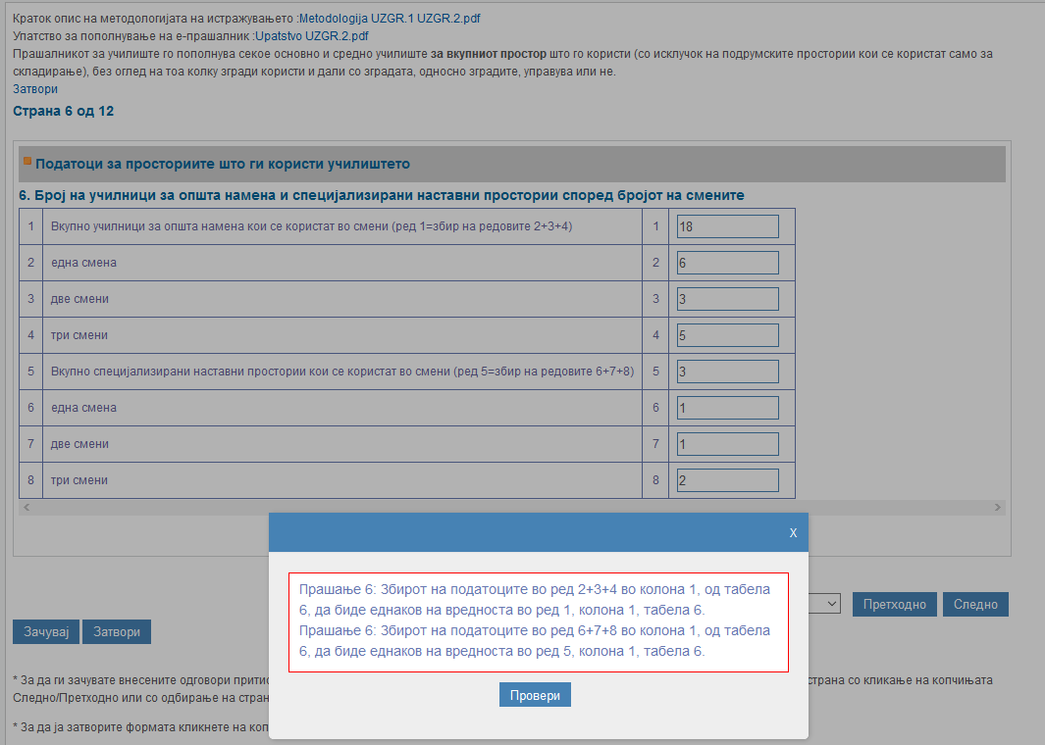
On-line Validation Rules
error message

Slide 8
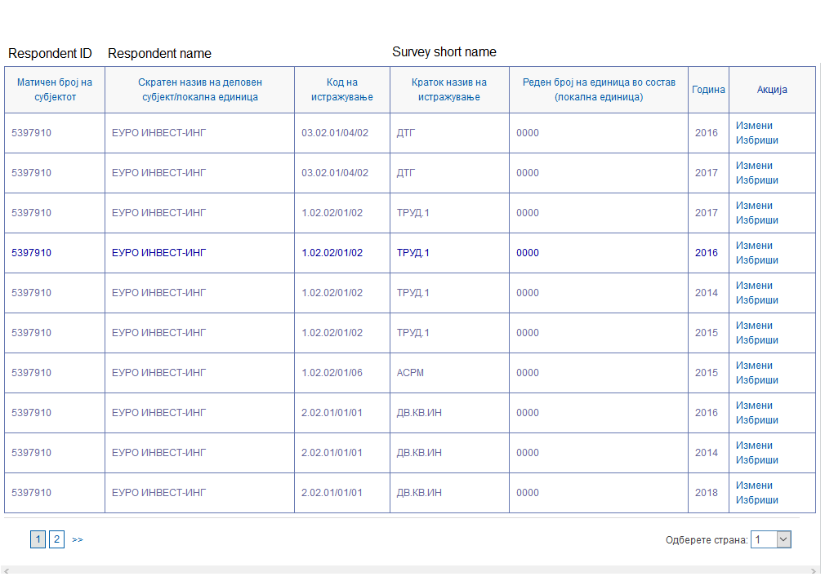
Participation of Respondent in Surveys

Slide 9
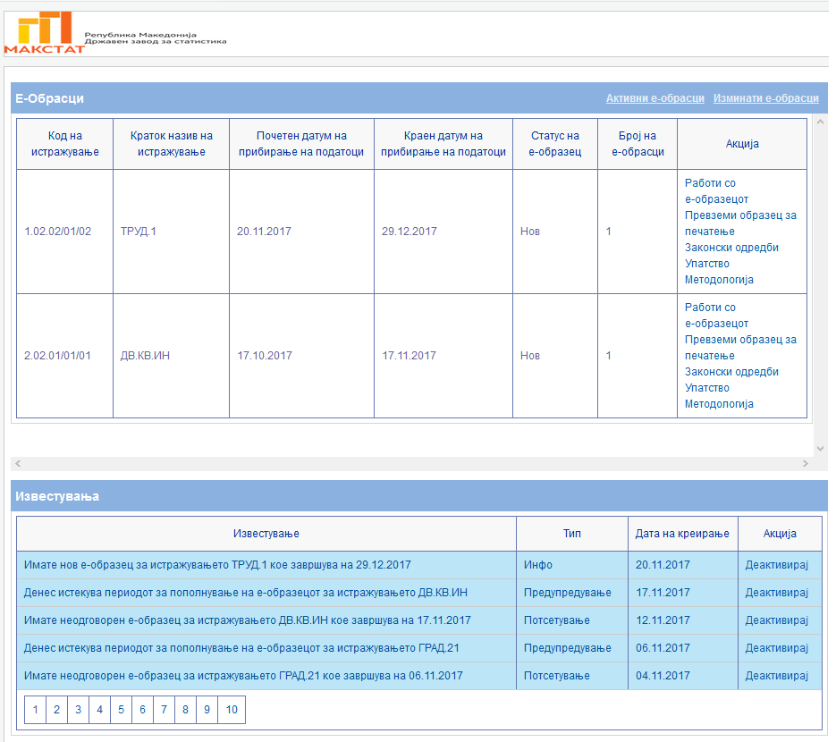
Respondent Dashboard
web questionnaires
notifications

Slide 10
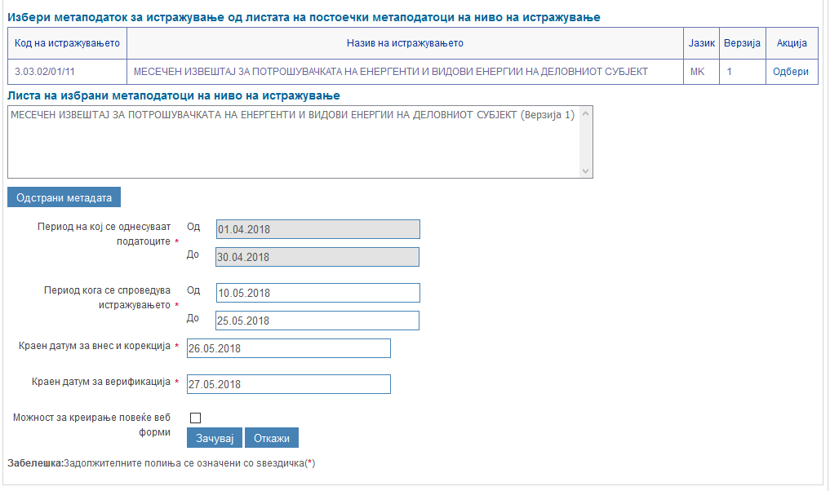
Conducting the collection process according to defined dates

Slide 11
Conclusions
Improve the eSTAT system with updated and additional functionalities
Extend web survey data collection to encompass different user needs
Continuous work on standardization of metadata
Keep in line with new ICT developments and challenges addressed by web-based surveys

Slide 12
IMPROVED QUALITY IN STATISTICAL PRODUCTION BY USING STANDARD PROCESSES IN PHASES DESIGN, BUILD AND COLLECT
Thank You for Your Attention!
Biljana Ristevska Karajovanovic, State Statistical Office of the Republic of Macedonia (SSO), biljana.karajovanovic@stat.gov.mk
Valentina Todorova Hristovska, State Statistical Office of the Republic of Macedonia (SSO), valentina.todorova@stat.gov.mk

