Slide 1
BoP quality management in Poland
Paweł Michalik, Narodowy Bank Polski, pawel.michalik@nbp.pl
June 27, 2018
Session 08

Slide 2
BoP Quality: Data Collection
NBP
Sanctions on nonreporting agents
Clarity of reporting forms
Close personal contact with reporters
Training provided to reporters
Forms
Reporter

Slide 3
BoP Quality: Cooperation on Data Gathering
President of Statistics Poland
Working Group on
ROW and BoP
Statistics Poland
NBP
NA
External Trade
and Services
Other
Ministry of Finance
Extrastat/Custom
Intrastat
Other

Slide 4
BoP Quality: Compilation Process
Multisource statistics
Different approach to different data source
Banks and other entities collected directly by NBP requires special care
Other sources
Statistics Poland
Ministry of Finance
Other
Current account
Financial account + income
Agregated data
Securities
BoP
Statistical Products
NBP Sources
Banks
Investment Funds
Other entities
Foreign A & L

Slide 5
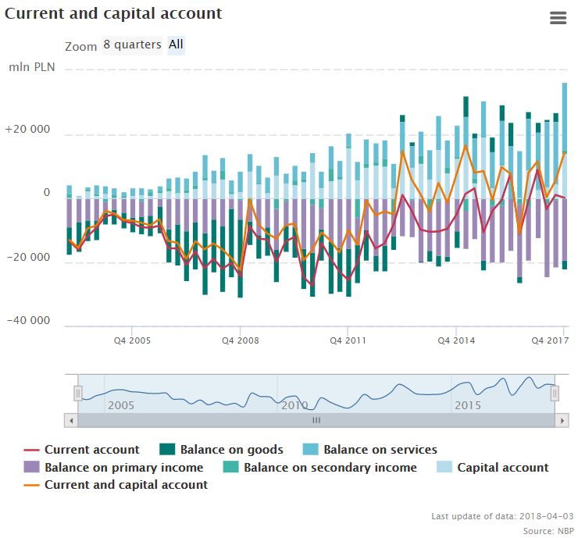
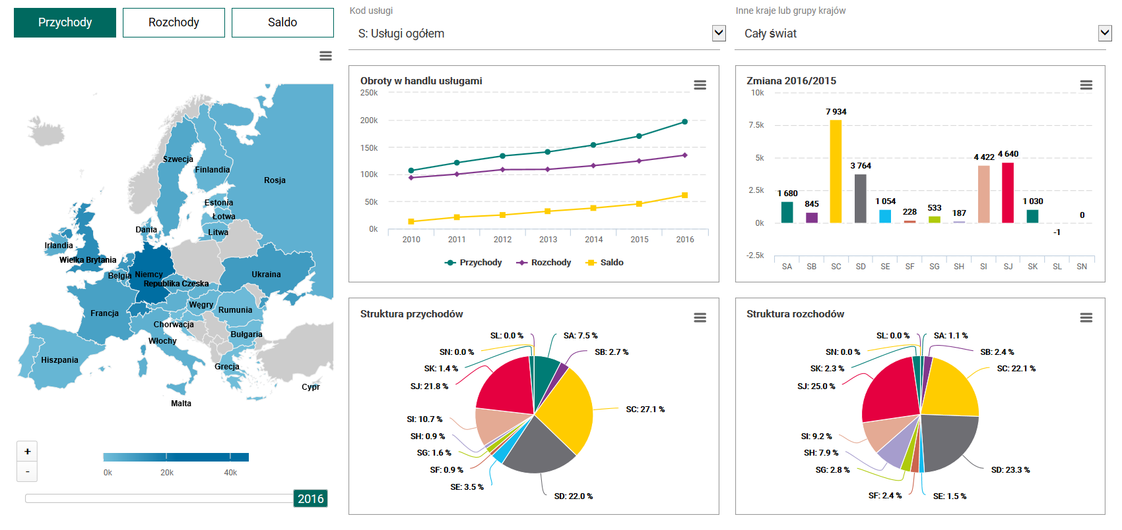
Dissemination tools and feedback from users
External and internal users (different set of data is disseminated)
Feedback:
Relevance (FDI)
External Consistency (National Accounts)
Errors and omissions

Slide 6
BoP quality management in Poland
Paweł Michalik, Narodowy Bank Polski, pawel.michalik@nbp.pl

