Slide 1
Improving official statistics with credit and debit card data. Some insights on selection bias
María Valdivieso-Anívarro. Applied Economics. University of Oviedo. ma.valdivieso@outlook.com
María Rosalía Vicente. Applied Economics. University of Oviedo. mrosalia@uniovi.es

Slide 2
Credit/Debit Card Transaction Records versus Survey-Based Statistics
ADVANTAGES
Survey-based statistics: Does the respondent proper and accurately recall what he has purchased and how much he has spent?
Transaction records: No measurement errors
LIMITATIONS
Transaction records: Self-selection bias

Slide 3
Credit/Debit Card Transaction Records
Table 1. Sample Credit/Debit Card Detail Records
client | date | district | province | age | income | sex | amount | shop_district | exp_520 | exp_521
Aaaa | 24/02/2017 | district 1 | province 1 | 28 | 1691 | M | 20 | shop_d1 | 0 | 20
Bbbb | 1/10/2016 | district 2 | province 2 | 50 | 3341 | F | 11 | shop_d2 | 11 | 0
Cccc | 14/04/2017 | district 3 | province 3 | 61 | 2250 | F | 89 | shop_d3 | 89 | 0
Dddd | 20/06/2016 | district 4 | province 4 | 36 | 5258 | M | 148 | shop_d4 | 0 | 148
EXP_XXX: Expenditure categories (35):
Grocery Stores. Supermarkets
Eating Places. Restaurants
Service Stations
Drug Stores and Pharmacies
Tax Payments - Government Agencies
Book Stores
…

Slide 4
Table 2. Self-reported average monthly incomes in capital city in 2016
Decile | Self-reported monthly individual income
1st | 853
2nd | 1200
3rd | 1525.63
4th | 1880.5
5th | 2314.22
6th | 2912.56
7th | 3811.33
8th | 5185.67
9th | 7753
Source: Own calculations from credit/debit card records database.

Slide 5
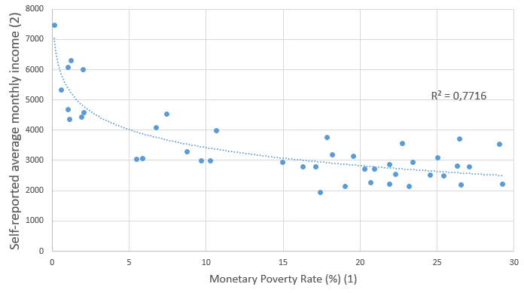
Figure 1. Monetary poverty rates and self-reported average monthly incomes (2016) by capital city districts
Notes: (1) Monetary poverty rates are defined as % of people whose expenditure is below the basic consumption basket (2) Credit/debit card records database

Slide 6
Improving official statistics with credit and debit card data. A cautionary tale
‘Big data’ has arrived, but big insights have not. The challenge now is to solve new problems and gain new answers — without making the same old statistical mistakes on a grander scale than ever.’
Hartford (2014)
Thanks
María Valdivieso-Anívarro. Applied Economics. University of Oviedo. ma.valdivieso@outlook.com
María Rosalía Vicente. Applied Economics. University of Oviedo. mrosalia@uniovi.es

