Slide 1
Mobility Survey on Metropolitan Areas – Innovation on Methods and Procedures
C. Neves; R. Calheiros; P. Leitão
Statistics Portugal, Lisbon, Portugal
cristina.neves@ine.pt; rute.cruz@ine.pt; porfirio.leitao@ine.pt
27 June 2018
Speed Talk Session 4

Slide 2
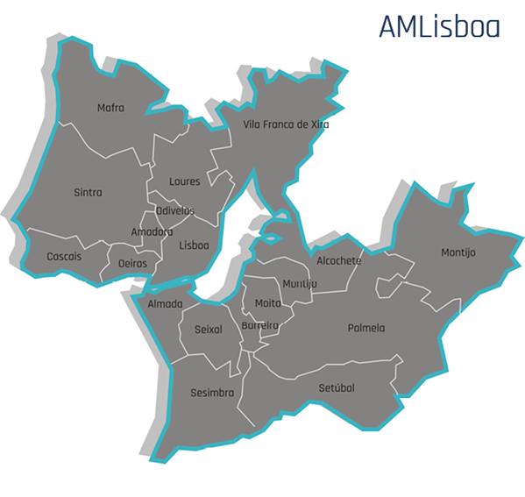
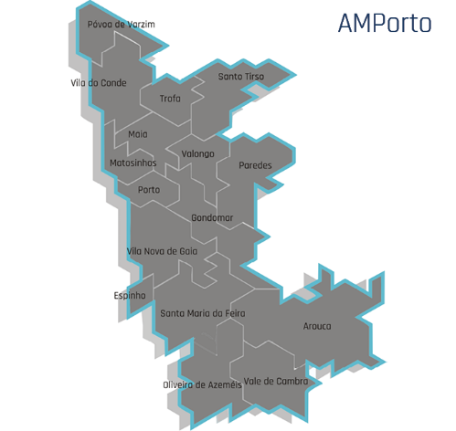
Mobility Survey on Metropolitan Areas
Main goals:
  Why MA Porto and Lisboa?
    44% of the total population from Portugal
    Porto: NUTS III region; 16.7% of population;
    MA Lisboa: NUTS III and II region; 27.2% population.

Slide 3
Mobility Survey on Metropolitan Areas
Study on territorial division (Unit for Coordination of Territorial Statistics)
Census data about the population and commuting (proportion of population working/studying in an different municipality, main means of transport, durations, …)
Geographic data about transport infrastructure:
Rail and metro stations
Main road intersections
Inland waterways connections
Buffers on their influence
Definition of homogeneous accessibility areas

Slide 4
Mobility Survey on Metropolitan Areas
Buffers by means of transport, MA Porto and Lisboa

Slide 5
Mobility Survey on Metropolitan Areas
Cluster analysis to group parishes with similar characteristics
Output: 38 and 49 groups (zones) for MA Porto and Lisboa

Slide 6
Mobility Survey on Metropolitan Areas
Sampling:
Stratified 2 stage sampling, systematic sampling selection:
  1st phase: CAWI sample
  2nd phase: sub sample from the 1st phase – for CAPI
Reference indicator: share of trip-makers among the respondents in each zone

Slide 7
Conclusions:
Combination of both data collection methods was positive, and a final response rate of 20% in CAWI and around 70% in CAPI was achieved, higher than the initial expectations for CAWI.
The usage of CAWI data collection in statistics based in households are now a reality, and subsequent implementations of this data collection method by Statistics Portugal are underway.
The potential of combining geospatial and statistical data to derive relevant indicators to better capture territory-based dimensions, such as mobility and access to transport is also a specific objective of this survey, and the results so far achieved are very positive and enthusiastic.
Results by metropolitan homogenous mobility areas below the municipality level are now being compiled, and will be of great usefulness for both metropolitan areas, in order to allow them to establish and update the local public transport network.

Slide 8
Mobility Survey on Metropolitan Areas – Innovation on Methods and Procedures
Thank you for your attention!
Cristina Neves, Statistics Portugal, cristina.neves@ine.pt

