Slide 1
45-day flash estimates of a PEEI: the Italian job vacancy rate – methods, revisions, cyclical properties
Diego Chianella, ISTAT, chianella@istat.it
Giuliano Latini, ISTAT, latini@istat.it
Annalisa Lucarelli, ISTAT, anlucare@istat.it
Emila Matera, ISTAT, ematera@istat.it
Marina Sorrentino, ISTAT, mrsorren@istat.it
27 June 2018
Speed Talk Session 04

Slide 2
The Italian job vacancy rate (JVR) flash estimates: procedure
Italian JVR estimates are produced and disseminated
by 45 and 70 days after the end of the reference quarter
in coherence with the relevant EU Regulations.
Sources:
two direct business surveys (10-499, 500+ employees)
admin based source for E&I and calibration.
Differences between final and flash estimations:
smaller sets of respondents to direct surveys
calibration to known totals for (t-4) rather than t.

Slide 3
A comparison between flash and final JVR estimates
year | quarter | Industry and services
 |  | vacancy rate (absolute) | vacancies (%) | jobs (%) | calibration populations (%)
2014 | 1 | 0.0 | -1.9 | 0.8 | -1.48
 | 2 | 0.0 | -6.8 | -0.6 | -1.89
 | 3 | 0.0 | 1.7 | 0.3 | -2.14
 | 4 | 0.0 | -10.0 | 0.4 | -3.00
2015 | 1 | 0.0 | -9.5 | -0.6 | -2.38
 | 2 | 0.0 | -5.9 | -1.7 | -3.29
 | 3 | 0.0 | -3.2 | -0.5 | -4.35
 | 4 | 0.0 | -9.5 | -1.1 | -5.21
2016 | 1 | 0.0 | -7.8 | -2.5 | -8.63
 | 2 | -0.1 | -13.1 | -0.9 | -7.58
 | 3 | 0.0 | -8.6 | -1.6 | -7.88
 | 4 | 0.0 | -10.8 | -2.1 | -7.87
2017 | 1 | 0.0 | -1.8 | -0.7 | -6.20
 | 2 | -0.1 | -6.3 | -0.8 | -6.38
 | 3 | 0.0 | -3.0 | -1.8 | -7.65
 | 4 | 0.0 | -10.0 | -1.6 | -6.38

Slide 4
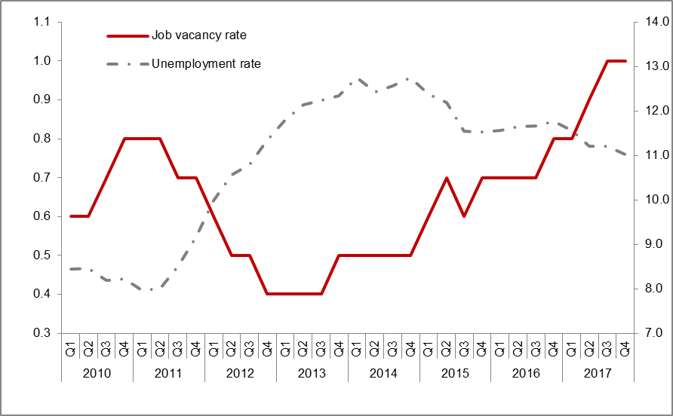
JV and unemployment rates: negative correlation and lead

Slide 5
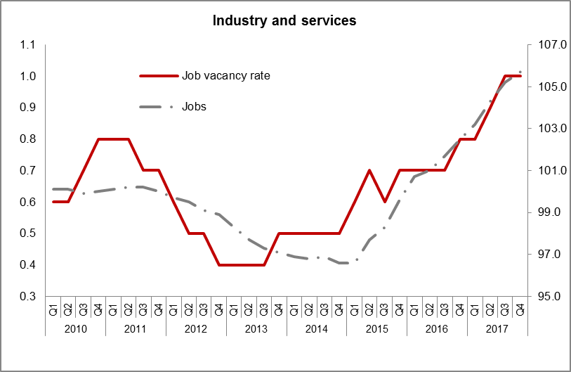
JVR and jobs: positive correlation and lead

Slide 6
Concluding remarks
Revisions between flash and final JVR estimates are mostly zero.
Both flash and final estimates show a good capability to describe and anticipate labour market dynamics.

Slide 7
45-day flash estimates of a PEEI: the Italian job vacancy rate – methods, revisions, cyclical properties
Diego Chianella, ISTAT, chianella@istat.it
Giuliano Latini, ISTAT, latini@istat.it
Annalisa Lucarelli, ISTAT, anlucare@istat.it
Emila Matera, ISTAT, ematera@istat.it
Marina Sorrentino, ISTAT, mrsorren@istat.it

