Slide 1
A Framework for Assessing the Quality of Banking Supervision Data
Gregorio Guidi, ECB, Gregorio.Guidi@ecb.europa.eu
Francesco Donat, ECB, Francesco.Donat@ecb.europa.eu
Iulia Tintea, ECB, Iulia.Tintea@ecb.europa.eu
Luis Suarez Tumi, ECB, Luis.Suarez_Tumi@ecb.europa.eu
27 June 2018
Speed Talk Session 1

Slide 2
From the ECB Statistics Quality Framework…
X=__?
Y=__?
Accessibility

Relevance
Clarity
Comparability
Cost-effectiveness
Consistency
Accuracy
Efficiency
Plausibility
Independence
Reliability
Completeness
Coordination
X=312
Y=785

Objectivity
Timeliness
Punctuality
Confidentiality
Available at: https://www.ecb.europa.eu/pub/pdf/other/ecbstatisticsqualityframework200804en.pdf

Slide 3
… to the Supervisory Reporting Framework.
CET1=__?
RWA=__?
?
Other users / Publication of Banking Statistics
CET1=1.2M€
RWA=9.3M€
Banking Supervision
Based on Commission Implementing Regulation No 680/2014 (ITS on Supervisory Reporting), Decision ECB/2014/29 and Decision EBA/DC/2015/130.

Slide 4
… to the Supervisory Reporting Framework.
CET1=__?
RWA=__?
Accessibility
Relevance
Clarity
Comparability
Accuracy
Plausibility
Consistency
Completeness
Other users / Publication of Banking Statistics
Reliability
CET1=1.2M€
RWA=9.3M€
Timeliness
Punctuality

Confidentiality
Banking Supervision
Based on Commission Implementing Regulation No 680/2014 (ITS on Supervisory Reporting), Decision ECB/2014/29 and Decision EBA/DC/2015/130.

Slide 5
A Framework for Supervisory Data Quality
Validation rule, soft checks, …
Punctuality:
Compliance with remittance deadlines.
Reliability:
Values not significantly revised during a reporting cycle.
Completeness:
Availability of the all the expected information.
Accuracy:
Absence of mistakes. Validation rules, soft checks, …
Plausibility:
Statistical methods, outlier analysis, …
1st objective:
Check whether the available risk and financial data is suitable for informing supervisory decisions.
2nd objective:
Contribute to the Supervisory Review and Evaluation Process (SREP).
Check risk data aggregation and reporting capabilities (compliance with BCBS 239 principles).

Slide 6
A Framework for Supervisory Data Quality
Validation rule, soft checks, …
Punctuality:
Compliance with remittance deadlines.
Reliability:
Values not significantly revised during a reporting cycle.
Completeness:
Availability of the all the expected information.
Accuracy:
Absence of mistakes. Validation rules, soft checks, …
Plausibility:
Statistical methods, outlier analysis, …
From granular to aggregated information
Warning: …
Error: …
Error: …
Error: …
Data quality metrics

!
1
3
Banking Supervision
Data quality scores

Slide 7
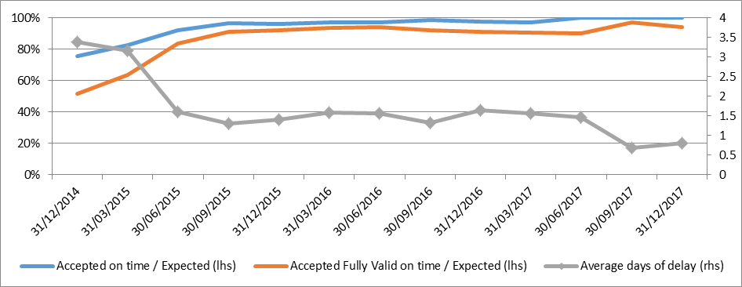
Examples
Trends in punctuality.
percentage of reports received on time and average delay

Slide 8
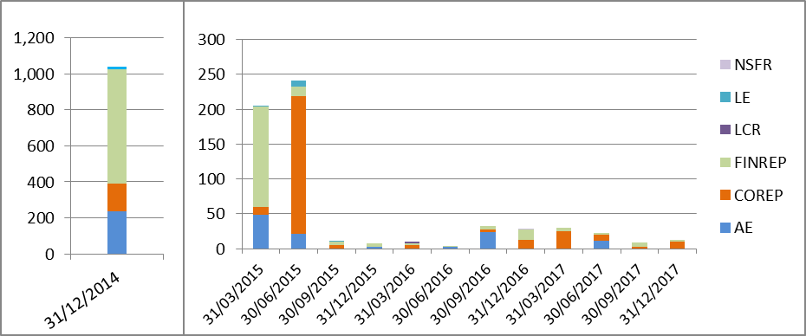
Examples
Trends in accuracy. Based on a fixed sample of validation rules.
Validation rule errors by reference period and report type (NSFR: Net Stable Funding Ratio; LE: Large Exposures; LCR: Liquidity Coverage Ratio; FINREP: Financial Reporting; COREP: Common Reporting; AE: Asset Encumbrance).

Slide 9
A Framework for Assessing the Quality of Banking Supervision Data
Thank you for your attention
Gregorio Guidi, ECB, Gregorio.Guidi@ecb.europa.eu
Francesco Donat, ECB, Francesco.Donat@ecb.europa.eu
Iulia Tintea, ECB, Iulia.Tintea@ecb.europa.eu
Luis Suarez Tumi, ECB, Luis.Suarez_Tumi@ecb.europa.eu

