Slide 1
Quality Assurance and the GSBPM Adoption at INEGI, Mexico
Gloria M. Rubio, Quality Assurance Director, INEGI
June 27, 2018
Speed Talk Session 1

Slide 2
Implementation milestones
2014
Code of Practice and Quality Assurance Norm approval
2016
Adaptation of the GSBPM to country context
NSS strategic objectives centered around quality principles
2017
Standardization of processes, quality indicators and reporting
OECD Peer Review
2015
Quality assurance governance body established
Adoption of UN Quality Assurance Framework

Slide 3
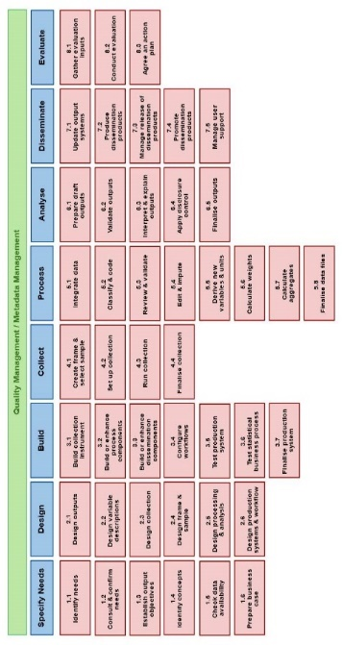
Quality Assurance Program 2017-2019
2. Systematic quality assessment
1. Quality control in standardized and documented processes
3. Protocols for implementing improvement actions
Improvement actions
Quality reports for users

Slide 4
Challenges Ahead
Promoting a process and evidence-based quality assurance culture.
Senior management continuous buy-in and commitment.
Showing concrete short-term results.
Implementing a communication strategy and targeted training activities.
Scaling up to the NSS.
Exploiting synergies with other initiatives, including data management and enterprise architecture.
Openness
Privacy
Notes:
INEGI’s operation and structure is functional, not process-oriented.
A process oriented mind and culture has been created from scratch.
Transforming the culture in siloed data-generating units.
Obtaining stakeholders buy-in and commitment.
Creating multidisciplinary teams that evangelize and help achieve the transformation. (Knowledgeable in strategy, organization, documentation, processes and data).
Avoiding preconceptions that position the transformation as contingent to the IT department.
Selecting actions that show concrete results in 2-4 months.

Slide 5
Quality Assurance and the GSBPM adoption at INEGI, Mexico
Gloria M. Rubio, INEGI, gmrubio@inegi.org.mx

