Slide 1
Making census statistics more relevant – towards geo-enabled statistics
Adam Wroński
David Thorogood
Fabian Bach
Eurostat
Q2018

Slide 2
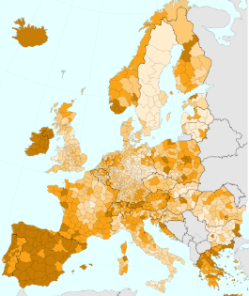
The content
The challenge
Census – relevance - small area data
The opportunity
Admin data – INSPIRE – geospatial data
The 2021 population census round
Data – confid – INSPIRE
Post-2021 census
Conclusions

Slide 3
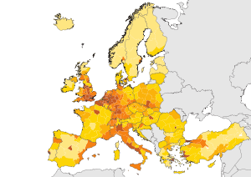
Population census and its relevance
Main distinctions of census (relevance)
Small geo-detail
Universality
But …
LAU2 evolve quite fast
Timeliness
Expensive
How to overcome these issues?
Is there an opportunity?

Slide 4
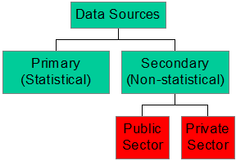
Administrative data
Used for long time
Takes long time to integrate into official statistics
Technology (data processing, transmission)
Budgetary cuts
Recent years can be seen as a breakthrough
E.g. for geo-referencing of dwellings / geolocalisation

Slide 5
INSPIRE directive
Spatial data infrastructure for the EU
common standards (for metadata and services, e.g. grid)
applies to statistics, too
Long implementation process from 2007 till 2021
From 2021 obligatory for statistics

Slide 6
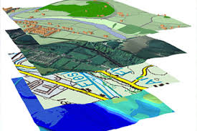
Geospatial data
Population distribution needed
more spatial data – satellite, aerial
exposure, risks, availability and cost of services
grid offers no changing boundaries
ESS
territorial typologies such as urban & rural regions, border, coastal areas make direct use of 1km² grid
Budapest Memorandum -set of census-related geo-referenced data
value of merging geospatial data with official statistics

Slide 7
2021 round - EU population census
Standardised
Regulation in the making
Can be seen as pilot for
census
sampling
EU Structural & Investment Funds -35% of EU budget
emergency management plans
Assessing access to public and other services
How many people live in a flood zone? Etc.

Slide 8
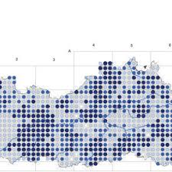
Statistics geo-coded to the 1km² grid
total population (end 2022)
sex (males, females)
age (under 15, 15-64, 65 and over)
employed persons (to be included only if available nationally)
place of birth (in the reporting country, in another EU country, outside EU)
usual residence 12 months before (unchanged, within reporting country, outside of the reporting country)
(no x-tabs by March 2024)

Slide 9
Statistical disclosure control
Principal issue for official statistics
non nested classifications (geographic differencing)
most cells sparsely populated
(2% cells -> 50% pop., 10% cells -> 480M people)
preservation of true unpopulated cells
Harmonised protection of census data in the ESS
developed by a group of NSIs
recommended but voluntary
record swapping + tabular noise
better than suppression due to geographic differencing

Slide 10
Compliance with INSPIRE directive
sharing using defined data models
download service for the census grid data
a map view service to display the grid data
INSPIRE metadata
Implementation
Standards (format, grid, etc.)
SDMX model
Central dissemination - Census Hub
pan-European, cross-border grid statistics

Slide 11
Post-2021 census strategy of the ESS
Evaluate 2021 census round
Repeat for post-2021 census
Annually
In longer term incrementally improve w/ MSs capacity
500m grid in urban regions
timelier
more demographic and socioeconomic characteristics
housing

Slide 12
Conclusions
Geo-referenced data novelty at international level
Enablers: INSPIRE, technology and admin data
Census best placed for implementation
Opens new opportunities for regional detail
Opens new analytical opportunities
Challenge: disclosure control
2021 round of censuses
Post-2021 censuses

