Slide 1
ESS surveys and mobile device data collectio
Barry Schouten, Karen Blanke, Dag Gravem and Vivian Meertens
June 28, 2018
Session 34

Slide 2
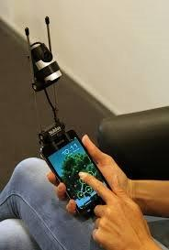
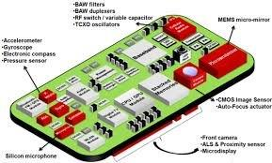
Outline
Objectives of MIMOD WP5;
ESS surveys under consideration;
Mobile device fitness criteria;
Sensors in mobile devices;
Discussion;

Slide 3
Objectives
WP5 has three main activities:
Explore the mobile device option in ESS surveys;
Elaborate mobile device style sheets for two ESS surveys;
Explore the use of mobile device sensors in ESS surveys;
Partners: CBS (coordinator), DESTATIS, and SSB

Slide 4
ESS surveys in MIMOD
Labor Force Survey (LFS)
Survey on Income and Living Conditions (EU-SILC)
Europeans Health Interview Survey (EHIS)
ICT Survey (ICT)
Household Budget Survey (HBS)
Time Use Survey (HETUS)
Adult Education Survey (AES)
EU-SILC has a separate ESSnets. HBS and HETUS have a task forces exploring IT innovation, in particular apps.

Slide 5
Outcomes of MIMOD survey among NSI’s
Inventory of smartphone option in ESS surveys by the 31 NSI’s
Survey | No web option | Smartphone blocked | Smartphone possible
 |  |  | Q not adapted | Q slightly adapted | Q profoundly adapted
LFS | 25 | 1 | 5
EU-SILC | 24 | 2 | 4 | 1
EHIS | 20 | 1 | 10
AES | 21 | 1 | 8 | 1
ICT | 16 | 3 | 10 | 2
HBS | 26 | 2 | 3
HETUS | 31

Slide 6
Fitness of ESS surveys for smartphones
Disparity of modes:
Presence of an interviewer:
Sensitivity of survey topics;
Assistance for complex terminology and wording;
Motivation for longer surveys;
Pace/speed of the interview;
Presentation (oral, visual);
Timing of the interview;
In MIMOD WP5, the focus is on the last two features, i.e. assuming that the surveys can be done without an interviewer.

Slide 7
Fitness of ESS surveys for smartphones
Three dimensions are considered in the assessment:
Screen size: Smartphones have a wide variety of screen sizes, but are typically much smaller than traditional devices:
Navigation: Screens are used for presentation as well as for navigation;
Duration: Since smartphones can be used for multiple purposes simultaneously, can be used anywhere and anytime, and have smaller screen sizes, it is conjectured that length is an issue;

Slide 8
Fitness criteria
Dimension | Criterion | Operationalization
Screen size | Introductions | Number of items with introductions
 | Grid questions | Number of grid questions Average number of items per grid
 | Question text | Number of items with > 20 words (excluding introduction text)
 | # answer cat’s | Number of items with > 5 answer categories
 | Filter questions | Number of (anticipated) filter questions with follow-up questions on the same screen
Navigation | Open question | Number of open questions
 | Many answers | Number of items with > 25 answer categories
Duration | # of items | Total number of items Average number of items asked per respondent
 | Household | Is survey a household survey? Yes/no
 | Database | Does survey require interaction with a database? Yes/no
 | Complexity | Number of (anticipated) items that require calculations by a average respondent Number of (anticipated) items that require consultation of personal documentation by a average respondent
 | Enj-Rel-Bur | Response rate to traditional online devices

Slide 9
Fitness of ESS surveys for smartphones
Experiences so far:
ESS survey model questionnaires or guidelines leave a lot of room for implementation;
Length is likely to be an issue for most ESS surveys;
Implementation as household or individual questionnaire is a major point for discussion
A deliverable will be completed end of July

Slide 10
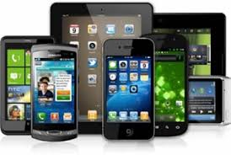
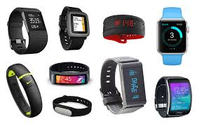
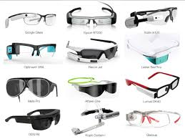
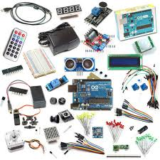
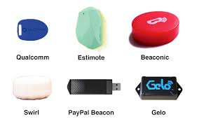
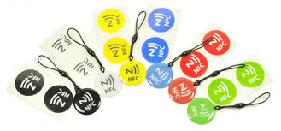
Mobile device sensors
Mobile device sensors include motion/acceleration/vibration, camera, audio, GPS, Wi-Fi, GSM, Near Field Communication (NFC), magnetic field, humidity, pressure, proximity, ambient light and can be instigated by NFC, blue tooth.

Slide 11
When is sensor data useful?
Sensor data are especially interesting for (survey) topics that:
Require strong cognitive effort or recall - time use or budget expenditure
Require detailed, esoteric information – travel & tourism, living/work conditions
Cannot be answered directly by questions – health and life style

Slide 12
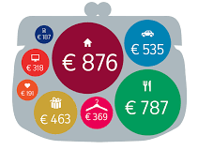
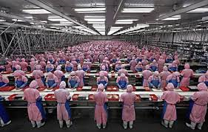
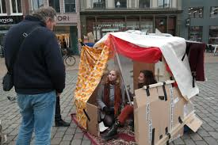
Promising sensor data topics
Expenditure, health, time use, working conditions, travel and living conditions

Slide 13
Mobile device sensors
Challenges for use of mobile device sensors
Diversity and evolution of devices, browsers and platforms
App or browser-oriented
Respondent participation and consent
Utility of apps for respondents outside official/statistical use
Quantitative versus qualitative sensor measurements
Data analysis (data mining)

Slide 14
Discussion
Is a mobile device a separate mode when applied to ESS surveys?
Does accepting mobile device response imply shortening of survey questionnaires or the use of advanced techniques such as split questionnaire/modular survey designs?
Is coverage of mobile devices sufficient across ESS countries to stimulate sensor measurements?
Shall/must we consider the Smartphone in the close future as the “first mode” and thus the ultimate focus, leading perspective?
How to find the balance between high quality, but expensive, and relatively inexpensive sensor data that are available in larger quantity?
Do sensor data measurements have ethical and privacy consequences beyond those of online data collection, and how does this vary across ESS countries?

Slide 15
ESS surveys and mobile device data collectio
CBS: Barry Schouten, bstn@cbs.nl
DESTATIS: Karen Blanke, karen.blanke@destatis.de
SSB: Dag Gravem, dag.f.gravem@ssb.no

