Slide 1
AIS: Defining a ship’s journey and sea traffic analysis
Christina Pierrakou, Hellenic Statistical Authority (ELSTAT), Greece, c.pierrakou@statistics.gr
Tessa CJ de Wit, Statistics Netherlands, tcj.dewit@cbs.nl
Marco JH Puts, Statistics Netherlands, m.puts@cbs.nl
Anke J.M. Consten, Statistics Netherlands, a.consten@cbs.nl
June 29th 2018
32

Slide 2
Overview
ESSnet BIGD – WP4: AIS data
Defining a ship’s journey
Sea traffic analysis
Conclusions
AIS data – Quality aspects

Slide 3
ESSnet BIGD – WP4: AIS data
Real-time measurement data of ship positions (AIS) can be used to:
improve quality of current statistics
make new statistics relevant for the ESS

Slide 4
AIS data
Automatic Identification System (AIS)
automatic tracking system on ships to identify and locate vessels by electronically exchanging data with nearby ships, AIS base stations, and satellites
Contributes to
- safety of navigation
- traffic management
International voyaging ships with gross tonnage => 300 and all passenger ships regardless of size transmit AIS every 2 – 10 sec (identity, position etc.)
Terrestrial Stations, Coast Guards and Satellites receive AIS data, which has the same structure worldwide

Slide 5
AIS messages
FIELD | DESCRIPTION
TIMESTAMP | Time of ship position detection / reception (in UTC)
MMSI | Ship's MMSI number sent with the AIS notification
Lat | Latitude of the ship position (in decimal degrees), 9 digits
Lon | Longitude of the ship position (in decimal degrees)
Speed over ground | Speed over ground (in knots)
Course over ground | Course over ground (in degrees)
Heading | True heading (in degrees (0-359))
IMO number | Ship's IMO number sent with the AIS notification 7 digits: 6 digits + check digit (e.g. 9074729: (9*7) + (0*6)+(7*5)+…=139
Shipname | Ship's vessel name sent with the AIS notification
Callsign | Ship's Callsign sent with the AIS notification
Type of ship | Ship type
Draught | Maximum Present Static Draught (in meters)
Destination | Destination

Slide 6
AIS data – Quality aspects
Receivers on land: signals ̴40 sea miles
Ships can turn off their AIS transponder and information entered by hand not always reliable
Data does not contain time of reception of the receiver, timestamp not always reliable
Receivers have limited timeslots
AIS is a radio signal subject to meteorological or magnetic factors

Slide 7
Defining a ship’s journey & sea traffic analysis
Useful for:
Ports a ship visits, intra-port traffic
Distance travelled
Fast economic indicator
Emissions
Disruptions

Slide 8
Defining a ship’s journey: port visits
Algorithm dealing with glitches and stops:
Select ships in area using reference frame of ships
Median filter over 10 mins
Define block of visit (connect intervals)
Speed <0.2 knots
10 mins
10 mins

Slide 9
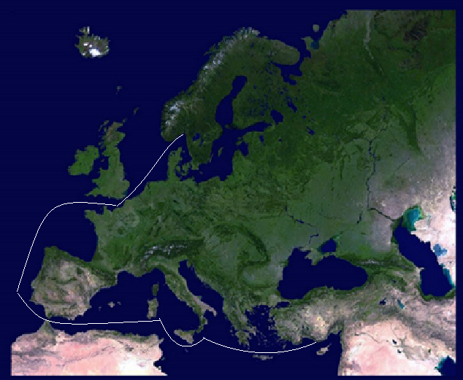
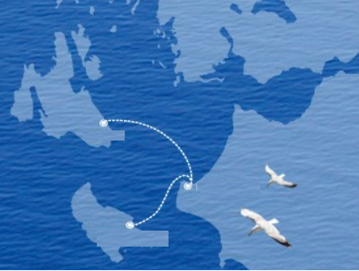
Defining a ship’s journey – complete algorithm
Port visit algorithm
Port depart = start journey
Finish journey: other port, anchor & outside coverage area (not strictly finish)

Slide 10
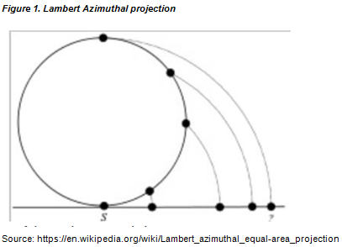
Sea traffic analysis - defining the grid
Selecting the coordinate system (WGS1985)
Projecting method

Slide 11
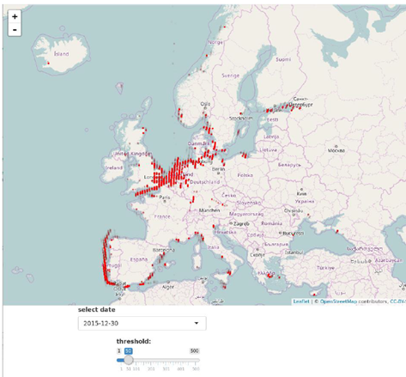
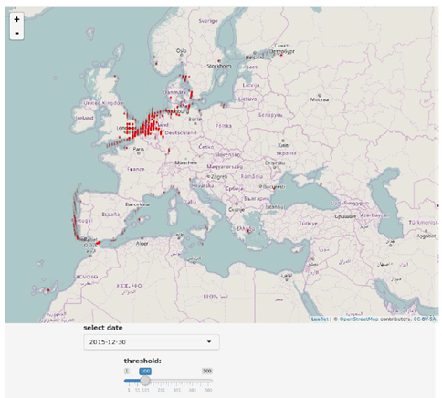
Sea traffic analysis: visualising
Shiny & Leaflet
https://mputs.shinyapps.io/AISspeed/

Slide 12
Conclusions
AIS can be useful source to
improve current statistics
port visits
calculate and visualise the intensity of sea traffic
compose new statistics
intra-port traffic,
detecting disruptions,
fast economic indicator
emissions
More information:
Wiki: https://webgate.ec.europa.eu/fpfis/mwikis/essnetbigdata/index.php/WP4
Github: https://github.com/mputs/WP4/locations

Slide 13
AIS: Defining a ship’s journey and sea traffic analysis
Thank you very much
Discussion/Questions
Christina Pierrakou, ELSTAT Greece, c.pierrakou@statistics.gr

