Slide 1
Mixed Mode Effects of Web and Telephone Surveys on Measuring Employment Status
Joachim Schork, STATEC Luxembourg, joachim.schork@statec.etat.lu
Cesare A. F. Riillo, STATEC Luxembourg, cesare.riillo@statec.etat.lu
Johann Neumayr, STATEC Luxembourg, johann.neumayr@statec.etat.lu
27.06.2018
Session 26

Slide 2
Motivation
Increasing challenges for traditional data collection
Less fixed-line telephone numbers
Decreasing response rates
High response burden for small Luxembourgish population
Implementation of mixed mode (web/phone) in STATEC surveys
LFS since 2015
Tourism since 2017
ICT since 2018
Differences in composition of web and telephone samples

Slide 3
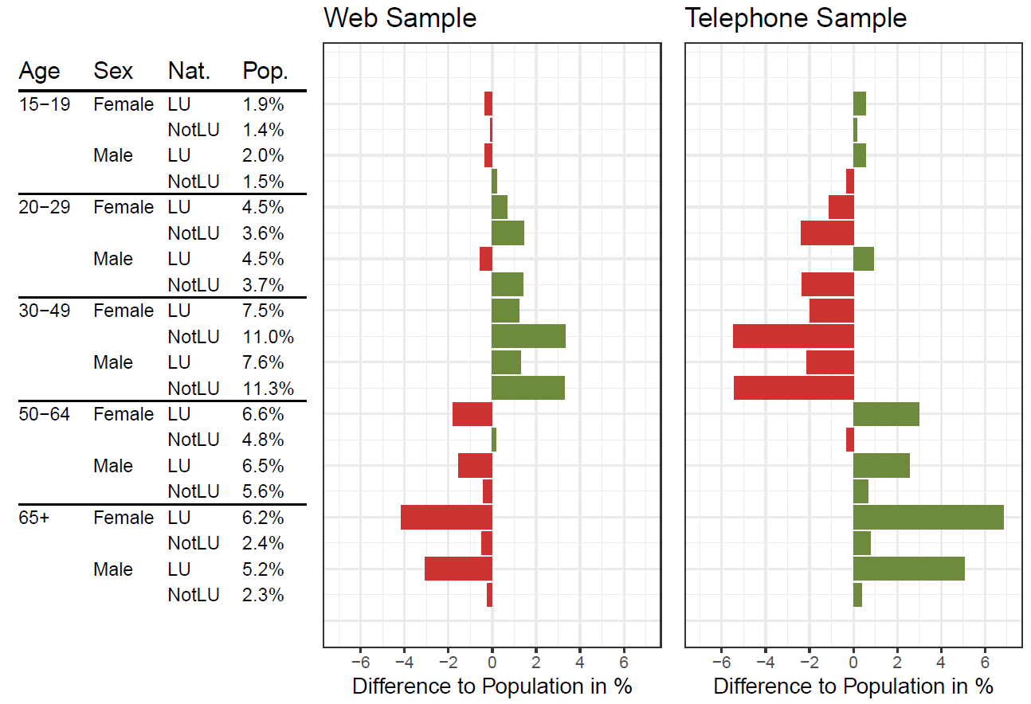
Sample Composition LFS 2017

Slide 4
Sample Composition LFS 2017

Slide 5
Sample Composition LFS 2017

Slide 6
Sample Composition LFS 2017

Slide 7
Mode-specific Differences
Three sources of differences (Schouten & van der Laan, 2014)
Mode-specific coverage
Mode-specific nonresponse rates
Mode-specific measurement bias
1) and 2) are handled by weighting
Is there mode-specific measurement bias?

Slide 8
Coarsened Exact Matching
Coarsened Exact Matching (Iacus et al., 2012)
Creates strata based on coarsened auxiliary variables
Retains units of strata, in which both web and phone respondents are present
Assigns weights to adjust for unequal sample sizes within strata
→ Approximation of randomized experiment
– Sample size is reduced
– Matched sample is not representative
+ Sample composition is harmonized across modes
Differences of samples can be interpreted as measurement bias
Application to combined data of LFS 2015, 2016 & 2017
n = 57,566
60% web; 40% telephone

Slide 9
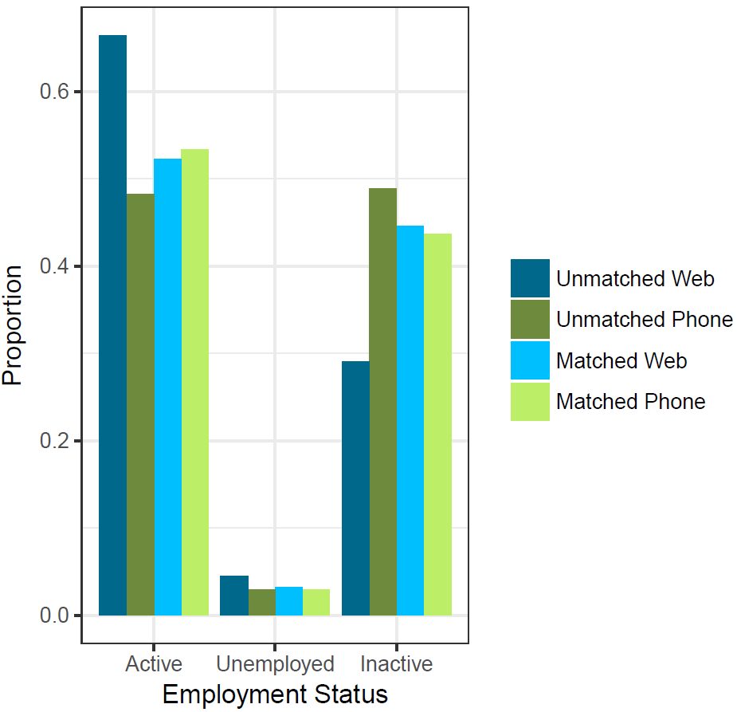
Mixed Mode Effects on Employment Status
Before matching:
Web sample is more often active
Web sample is more often unemployed
Web sample is less often inactive
After matching:
No differences between web & telephone
→ Differences due to coverage/nonresponse
→ No measurement bias

Slide 10
Mixed Mode Effects on Employment Status
Before matching:
Web sample is more often active
Web sample is more often unemployed
Web sample is less often inactive
After matching:
No differences between web & telephone
→ Differences due to coverage/nonresponse
→ No measurement bias

Slide 11
Mixed Mode Effects on Employment Status
Before matching:
Web sample is more often active
Web sample is more often unemployed
Web sample is less often inactive
After matching:
No differences between web & telephone
→ Differences due to coverage/nonresponse
→ No measurement bias

Slide 12
Objective vs. Subjective Variables
Employment status is an objective variable
Clear definition according to the ILO-classification of employment
Is there measurement bias in subjective variables?
Self-assessment
Investigation on 2 subjective variables:
Wage adequacy: My salary is adequate for the work I do.
Job satisfaction: I am satisfied with the situation at my current work.

Slide 13
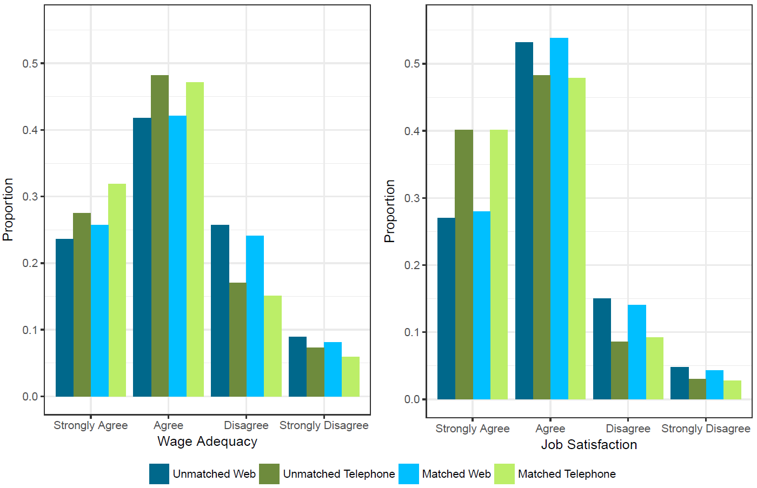
Mixed Mode Effects on Subjective Variables

Slide 14
Mixed Mode Effects on Subjective Variables

Slide 15
Mixed Mode Effects on Subjective Variables

Slide 16
Conclusion & Outlook
Support for collecting employment status via mixed mode
Subjective variables seem to be affected by measurement bias
Broader overview is needed
→ Investigation on other surveys (Tourism, ICT)
Open questions:
Which mode leads to the smallest measurement bias?
How could mode effects be reduced?
What is the impact of different weighting schemes?

Slide 17
References
Iacus, S. M., King, G., and Porro, G. (2012). Causal inference without balance checking: Coarsened exact matching. Political Analysis, 20(1):1-24.
Schouten, B. and van der Laan, J. (2014). ESSnet deliverable WPIII: Mode effect decompositions for the Dutch Labour Force Survey. Deliverable for work package III of the ESSnet on Data Collection for Social Surveys Using Multiple Modes.

Slide 18
Mixed Mode Effects of Web and Telephone Surveys on Measuring Employment Status
Thank you for your attention!
Joachim Schork, STATEC Luxembourg, joachim.schork@statec.etat.lu
Cesare A. F. Riillo, STATEC Luxembourg, cesare.riillo@statec.etat.lu
Johann Neumayr, STATEC Luxembourg, johann.neumayr@statec.etat.lu

Slide 19
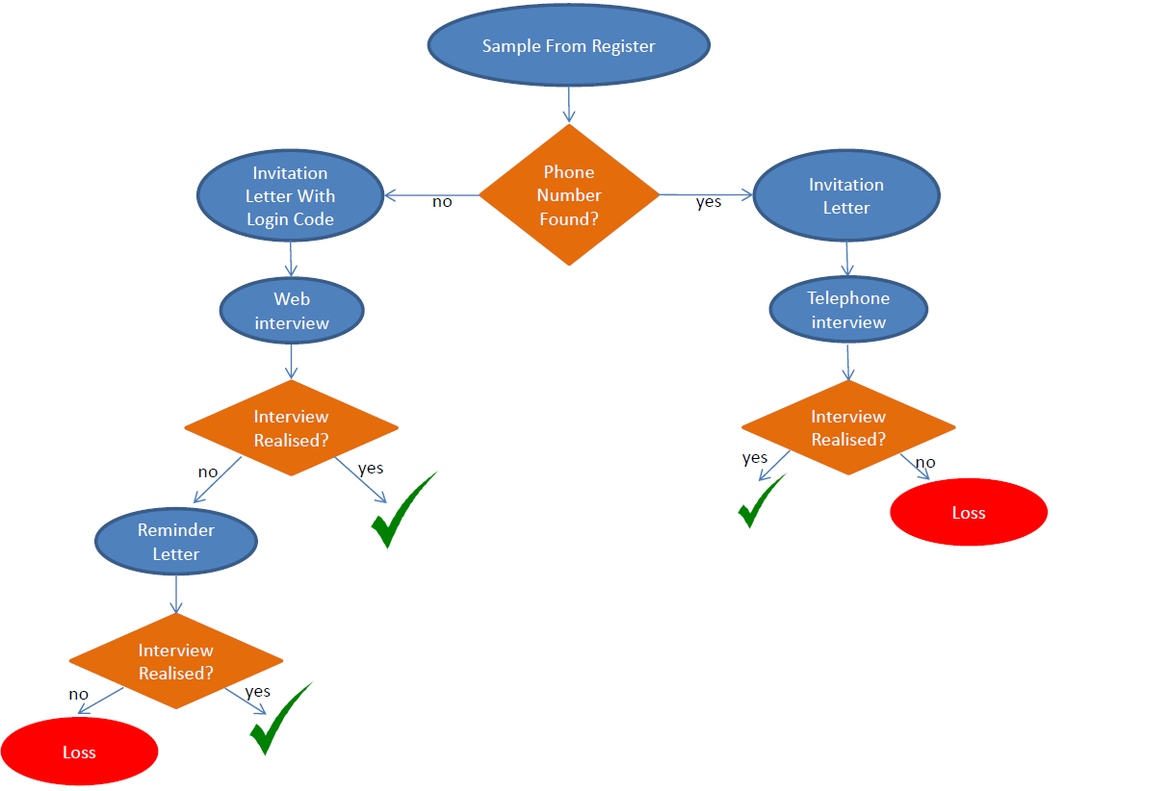
LFS Data Collection

Slide 20
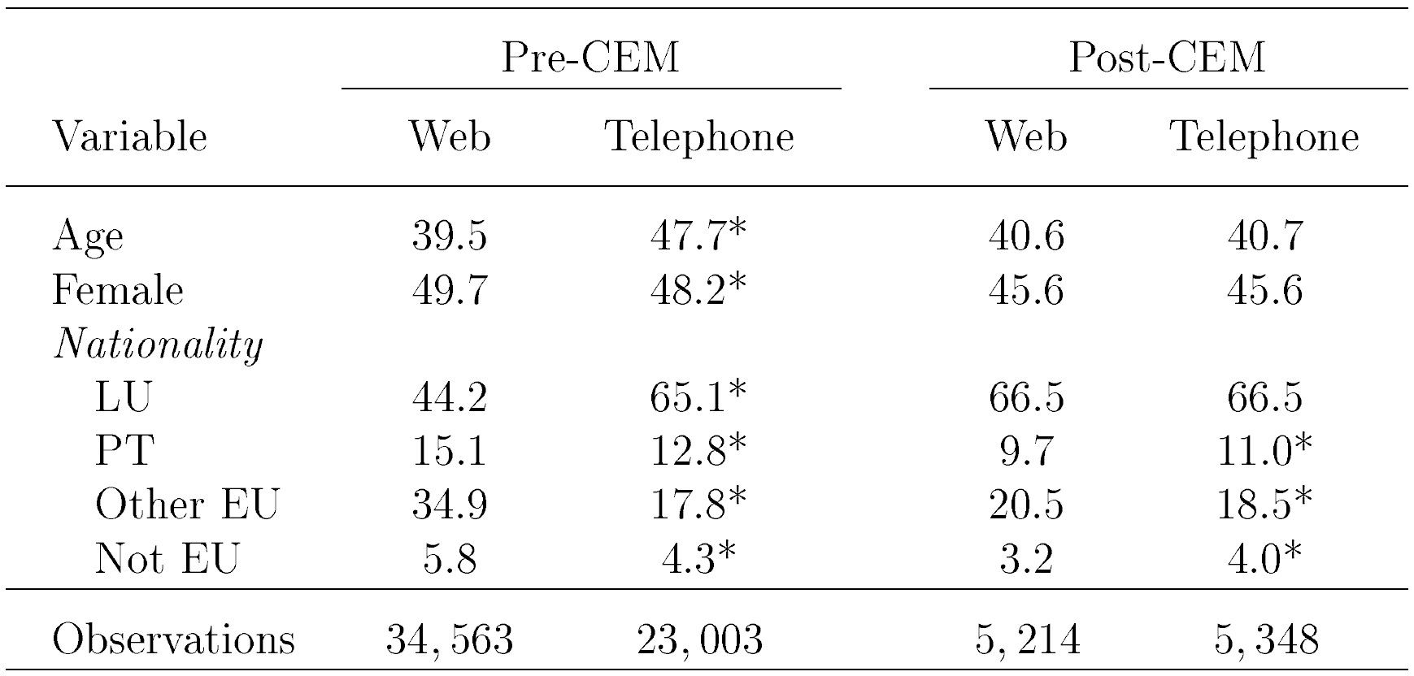
Matching Variables Pre/Post Matching

