Slide 1
Modernizing Data Integration Systems at Istat
P.D.Falorsi, falorsi@istat.it
R. Radini, radini@istat.it
M. Scannapieco, scannapi@istat.it
L.Tosco, tosco@istat.it
Italian National Institute of Statistics, Directorate for Methodology and Statistical Process Design
29/06/2018
Session 24

Slide 2
Outline
The Integrated System of Statistical Registers (ISSR)
ISSR Data Architecture
ISSR Process Architecture
Quality of the ISSR
Conclusions
Notes:
We’ve divided our presentation into 6 parts:
In the first part We will introduce shortly the Integrated Statistical System of Registers
And its data architecture. We will also briefly explain data access (x) through ontologies approach.
We will then move on to the core of our presentation which will aim at showing how we believe we can integrate the system of registrers as an OBDM system
Also, we will dedicate some time to the data virtualization approach In order to identify a unified view of data sources
We will end our (aur) talk with some example of our ontologies and open questions which are in the paper submitted to the board.

Slide 3
Italian Integrated System of Statistical Registries (ISSR)
Modernization programme started in 2016
significant revision of statistical production processes
based on an Integrated System of Statistical Registers (ISSR)
IBR: Individual Base Register
TBR: Territory Base Register
PUBR: Production Unit Base Register
LTR: Labor Thematic Register
Single logical environment to support the consistency of statistical production processes
Identification and estimation for the whole integrated system of units and variables

Slide 4
TBR: Territory Base Register
IBR: Individual Base Register
PUBR: Production Unit Base Register
LTR: Labor Thematic Register
Address of the Place of Work
LTR
IBR
Id_individual
Id_address
TBR
Id_address
Residential Address
Id_address
Id_prod_Unit
Address of the Legal Place
PUBR

Slide 5
Design of the ISSR
Requirements:
Need to integrate concepts belonging to different thematic areas
Adoption of the ontology-based data management (OBDM) approach for accessing, integrating and managing heterogenous data sources
Main advantages:
Industrialization of processes.
Semantic data integration.
Data quality control.
Flexibility in adding new sources or modifying existing ones.

Slide 6
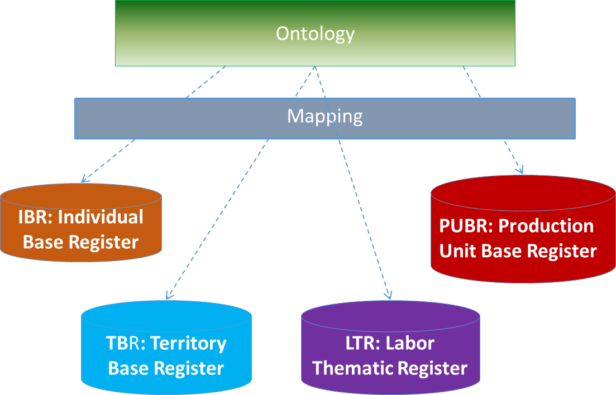
Data Architecture (OBDM approach)
Based on three layers architecture:
Ontology: formal, shared and explicit representation of the conceptualization of the domain of interest expressed through the formal language which makes it "machine-actionable
Mapping: rules expressing the correspondence between data and concepts/attributes of the domain of interest
Data sources: sources heterogeneous both semantically and technologically
Notes:
we will now explan how we think that an OBDM approach is the rigth one to realize our System of Registers.
This approach allows us to access, integrate and manage different data sources, both semantically and technologically, through a conceptual representation of the domain via (vaia) a computational ontology

Slide 7
Data Stack
Raw Data Area
Ontology for:
Semantic Data Integration
Data Quality Check
Data Access
Working Data Area
Validated Data Area
ISSR
Ontology for:
Semantic Data Integration
Data Access

Slide 8
Data Architecture
DATA
CONSUMPTION
M2M
LOD
Semantic Layer (Ontology)
DATA VIRTUALIZATION
Macrodata Layer
Integrated Micro Layer
Physical Integration
IBR: Individual
Base Register
LTR: Labor Thematic Register
TBR: Territory Base Register
PUBR: Production Unit Base Register

Slide 9
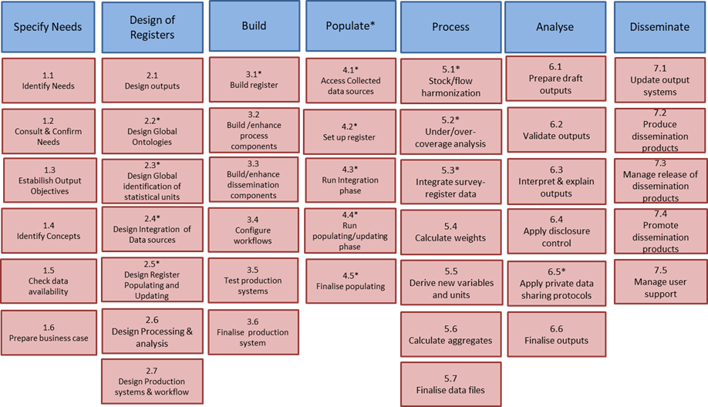
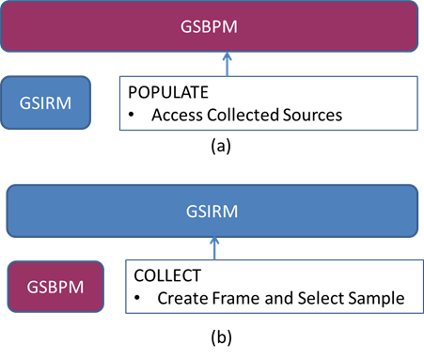
Process Architecture: Generic Statistical Integrated Registers Model
GSBPM and GSIRM are complementary
a) Populate of GSIRM accesses sources collected via GSBPM;
b) Collect of GSBPM access registers created via GSIRM

Slide 10
Quality of the ISSR
Usage of International Standards for the design of the data architecture and the process architecture (GSIM, GSBPM, EARF, W3C)
Usage of the OBDM approach: Metadata “coupled” with data, metadata not only limited to a “documentation” role, “governance” of the data integration step ensuring high quality of integrated data, check of conformity of data stored in the system to it through the ontology
Standard production process for all registers within ISSR: Generic Statistical Integrated Registers Model (GSIRM)
Evaluation of quality indicators: allowing systematic analysis and monitoring of the process, possibility to apply improvement actions
Timeliness of ISSR different versions of the registers are defined: initial version, current version, consolidated version
Accuracy of the ISSR: accuracy of the statistics obtained as aggregation of the register values, subject to uncertainty with respect to both units and variables

Slide 11
Conclusions
Design efforts to build the Integrated System of Statistical Registers
Focus on data and process architectures designed according to standards and with quality as first concept:
Active metadata
Process quality indicators
Timeliness
Accuracy
Next steps:
Continue ongoing development efforts
Build on the current experience in a quality improvement feedback loop

Slide 12
Modernizing Data Integration Systems at Istat
Thanks!
P.D.Falorsi, Italian National Institute of Statistics, falorsi@istat.it
R. Radini, Italian National Institute of Statistics, radini@istat.it
M. Scannapieco, Italian National Institute of Statistics, scannapi@istat.it
L.Tosco, Italian National Institute of Statistics, tosco@istat.it

