Slide 1
On the Experimental Usage of Ontology-based Data Management for the Italian Integrated System of Statistical Registers: Quality Issues
R. M. Aracri, A.M.Bianco, R. Radini, M.Scannapieco, L.Tosco,
Italian National Institute of Statistics, (name.surname@istat.it)
F. Croce, D.F. Savo, M. Lenzerini
Sapienza University of Rome, (surname@diag.uniroma1.it)
28.06.2018
Session 23

Slide 2
Outline
Scenario: the Italian Integrated System of Statistical Registers (ISSR)
Data Architecture of the ISSR
Ontology-Based Data Management (OBDM) paradigm
The Istat-DIAG experience
OBDM for data quality check
Conclusions

Slide 3
The Italian Integrated System of Statistical Registers (ISSR)
Logically centralized source for production surveys and data access
….
Economic Surveys
Demographic Surveys
ISSR
Labour Surveys
Data Sources:
- surveys,
- administrative archives,
- GIS spatial data,
….
….

Slide 4
Data Architecture Building Blocks
Raw Data
Data Sources:
- surveys,
- administrative archives,
- GIS spatial data,
Processing Phase
- integration,
- imputation,
… - validation
Working Data
Validated Data (ISSR)
Data Access and Production Surveys

Slide 5
Data Architecture Building Blocks
Data quality check using
the Ontology-based Data Management
paradigm
Raw Data
Data Sources:
- surveys,
- administrative archives,
- GIS spatial data,
Processing Phase
- integration,
- imputation,
… - validation
Working Data
Validated Data (ISSR)
Data Access and Production Surveys

Slide 6
Ontology Based Data Management
Ontology-based Data Management (OBDM) is a new paradigm, rooted on the idea of using Database Theory and Semantic Technologies for data management.
OBDM is characterized by the following principles:
Let data reside where they are (no need to move data)
Define a logic-based conceptual specification of the domain of interest (ontology)
Map the ontology to the concrete data sources
Express all the services over the ontology
Automatically translate knowledge services to data services (we used the Mastro system for OBDM)
(http://www.obdasystems.com/mastro for more info about Mastro)

Slide 7
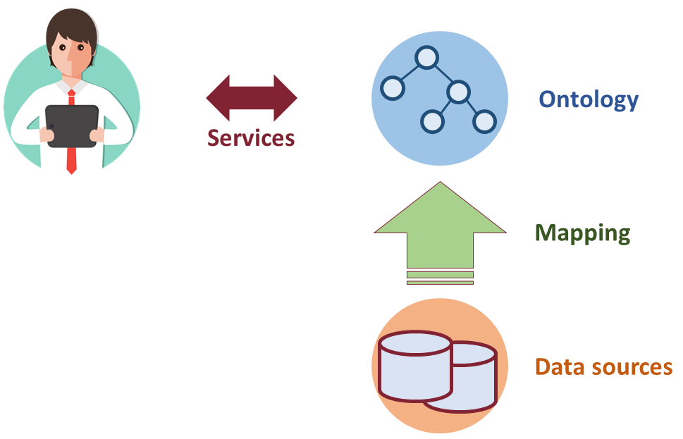
OBDM: the architecture
Based on three main components:
Ontology: a specification of the domain of interest, used as a unified, conceptual view for clients
Mapping: used to semantically link data at the sources to the ontology
Data sources: external, independent, heterogeneous, data storages

Slide 8
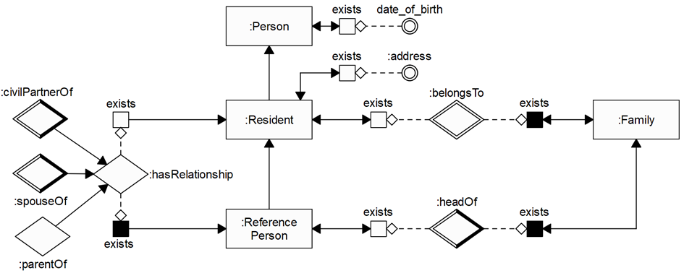
The Istat-DIAG Experience
Domain: | portion of Base Register of Individuals, Families and Cohabitations related to persons, including residential data, and their family relationships.
Ontology expressed in Graphol (http://www.obdasystems.com/graphol)

Slide 9
Mapping assertions
The data sources connected to the ontology are those containing information about persons and families.
We specified about 100 mapping assertions to link such data sources to the ontology.
Tables in the data source containing information on persons and families
- Tab_pers[idp, date_of_birth, address]
- Tab_family[idf, idp, head_flag]
Tab_pers(x,y,z) | → | Person(x)
Tab_pers(x,y,z) ∧ y ≠ null | → | date_of_birth(x,y)
Tab_pers(x,y,z) ∧ z ≠ null | → | address(x,z)
Tab_family(x,y,z) | → | Family(x)
Tab_family(x,y,z) | → | belongsTo(y,x)
Tab_family(x,y,z) ∧ z = TRUE | → | headOf(y,x)

Slide 10
Consistency
Quality dimension that measures the coherence of data
Es: | Persons belonging to the same family cannot have different residential addresses. This is expressed over the ontology by means of the following consistency constraint:
∀x,y,z,v,w | Family(x) ∧ belongsTo(y,x) ∧ address(y,v)
 | ∧ belongsTo(z,x) ∧ address(z, w) ∧ v ≠ w → ⊥

Slide 11
Accuracy
Quality dimension that measures the extent to which data accurately represents the real world
Es: | The reference person of each known family and his/her address must be known. This is expressed over the ontology by means of the following accuracy constraint:
∀x | K(Family(x)) | → ∃y,z K(headOf(y,x) ∧ address(y,z))

Slide 12
Completeness
Quality dimension that checks whether a given source contains all the relevant data about a certain phenomenon
Es: | A Person known by the ontology must be stored in the Tab_pers table (as this should contain all the known persons of the ISSR). This is expressed in the OBDM system by means of the following completeness constraint:
∀x | K(Person(x)) | → | ∃y,z Tab_pers(x,y,z)

Slide 13
Conclusions and Future Works
Our experience demonstrated that OBDM can be effectively used for quality assessments.
Next steps:
Extend ontology and mappings to the whole ISSR domain and data sources
Extend OBDM for addressing other quality dimensions such as confidentiality

Slide 14
On the Experimental Usage of Ontology-based Data Management for the Italian Integrated System of Statistical Registers: Quality Issues
Thanks!
R. M. Aracri, A.M.Bianco, R. Radini, M.Scannapieco, L.Tosco,
Italian National Institute of Statistics, (name.surname@istat.it)
F. Croce, D.F. Savo, M. Lenzerini
Sapienza University of Rome, (surname@diag.uniroma1.it )

