Slide 1
Integration of inconsistent data sources using Hidden Markov Models
Dimitris Pavlopoulos , Department of Sociology, Vrije Universiteit Amsterdam
d.pavlopoulos@vu.nl
28.06.2018
Session 23

Slide 2
Measurement error in Official Statistics
Measurement error: threat to official statistics
NSI’s deal with the problem by:
Using only the superior data source
Using the mean
Applying macro-integration
An alternative solution:
Applying latent variable modelling
latent class modelling (LCM)
Hidden Markov Models (HMMs)

Slide 3
What can Hidden Markov Models do?
Contract distribution- observed and latent
Transition rates- observed and latent
 | LFS | ER | As in Pavlopoulos and Vermunt (2015)
Permanent | 0.667 | 0.597 | 0.634
Temporary | 0.087 | 0.130 | 0.109
Other | 0.246 | 0.273 | 0.257
3 monthly transition rates from temporary to permanent employment
LFS | 0.057
ER | 0.085
As in Pavlopoulos and Vermunt (2015) | 0.032

Slide 4
What can Hidden Markov Models (HMMs) do?
Consist of:
a structural part (latent/ true)
a measurement part (observed)

Slide 5
HMMs producing official statistics?
HMMs potentially attractive tool to correct for measurement error
But….
they are complex, time consuming and expensive
in most cases they require record linkage

Slide 6
OUR research focus
Can HMMs be used to correct for measurement error in official statistics?
Feasibility of parameter re-use
Sensitivity to linkage error

Slide 7
Data
Linked dataset:
Labour Force Survey (LFS)
Employment Register (ER)
8,886 individuals aged 25 to 55
15 time points (months) per individual

Slide 8
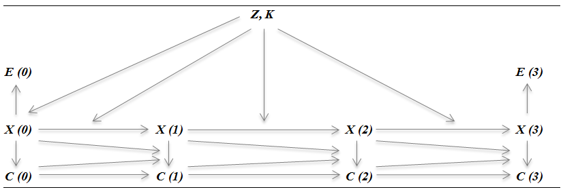
The Hidden Markov Model
An extended two-indicator HMM
Two indicators per time point
Autocorrelation of error in register
(Un)observed heterogeneity in latent initial probabilities and transitions
Heterogenous latent transitions

Slide 9
Feasibility of parameter re-use
Analysing 2009 data ‘from scratch’
compared to
Re-using error parameters based on 2007 model estimates from Pavlopoulos and Vermunt (2015)
 | 3 monthly transition rates from temporary to permanent employment
LFS | 0.058
ER | 0.073
Original analysis of 2009 | 0.017
Re-using parameters from 2007 | 0.016

Slide 10
Relative bias from linkage error
Simulations with various degrees of false-negative and false-positive linkage errors:
5, 10 and 20% of the individuals are excluded or mislinked
Probabilities are (i) random (ii) depend on covariates correlated with outcome variable
individuals selected are mislinked (i) at random (ii) based on common characteristics
HMM estimations for each scenario are compared to original (‘linkage error free’) results

Slide 11
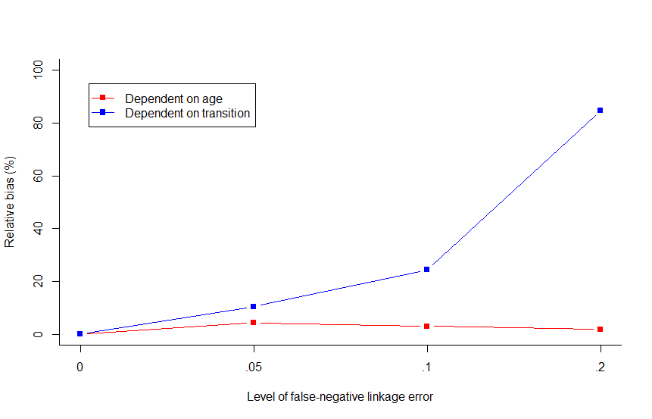
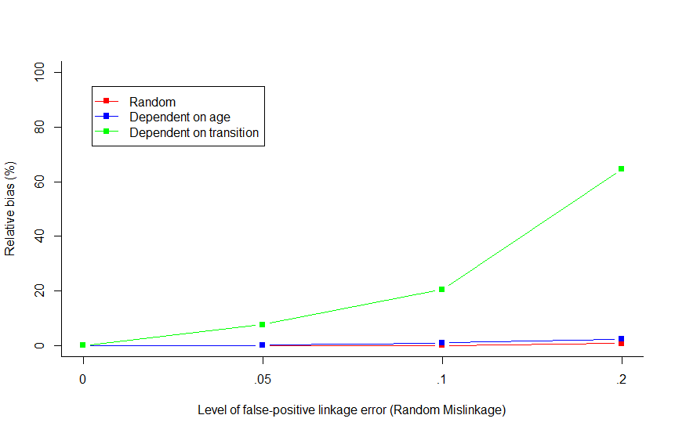
Relative bias from linkage error
False-negative
False-positive

Slide 12
Conclusions- what we know
Can HMMs be used in the production of official statistics?
Inexpensive- possible to re-use (error) parameters
Linkage error largely not a problem
mislinkage mostly corrected for

Slide 13
Next steps- what we want to know
Do the data collection processes matter?
dependent vs. independent interviewing
Clustering and sequence analysis with error correction

