Slide 1
A knowledge-based approach to the statistical production process
Stefano Menghinello, Italian National Institute for statistics (ISTAT), Rome, Italy, menghine@istat.it
Claudio Ceccarelli, ISTAT, Rome, Italy, clceccar@istat.it
Massimo Fedeli, ISTAT, Rome, Italy, massimo.fedeli@stat.it
28 June 2018
Session: 20

Slide 2
Outline of the presentation
The role of knowledge in the statistical production process
Modelling the business survey as a knowledge intensive process
Some implications of this approach for data quality
GSBPM and the knowledge-based approach
The role of IT for knowledge-intensive statistical production processes
Conclusions

Slide 3
Knowledge and the statistical production process
The conventional wisdom on statistical production process:
“An highly standardised process where the value added provided by official statisticians with respect to raw data is bounded to the codification, classification, measurement and statistical representativeness (efficient and unbiased estimates) of final figures, with little impact in terms of new knowledge added to the data”
Implications:
Organisation of the statistical production process
Criteria and methods for data quality evaluation
Approach to respondent units
Training of official statisticians

Slide 4
Knowledge and the statistical production process
Contributions from knowledge economics and knowledge management literatures:
A production process has jointly a physical and an immaterial nature, and both create the maximum possible value added
Relevance of “tacit knowledge“ (Polanyi,1958; Nonaka, 1987 and 1991), which encompasses skills, ideas and experiences that people actively engaged in a production process do effectively use on daily routines but that are not codified.
Knowledge management: a statistical production process involves complex interactions between technological, methodological and data processing routines designed and managed by the community of official statisticians
Learning processes by the interaction with data users and data providers (feedbacks from survey respondents).

Slide 5
Knowledge and the statistical production process
The four sources of knowledge in a statistical production process
Technological knowledge reflects the capability to design and implement IT infrastructures that support statistical production processes
Methodological knowledge encompasses a wide range of scientific methods, standardised tools and more recently conceptual design of production infrastructures, that can support and continuously improve the quality of data.
Thematic knowledge focuses upon different factors: the scientific knowledge on the nature and determinants of the specific phenomena under investigation, practitioners’ skills and routines, including learning process generated by intensive interaction with both data users and survey respondent units.
Data collection knowledge encompasses all techniques, methods and organisational procedures that can make large scale data collection more efficient and effective, also reducing the burden on the respondents.

Slide 6
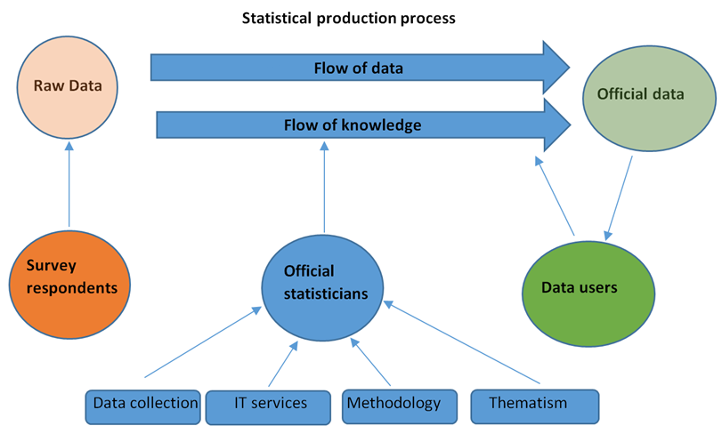
Knowledge and the statistical production process

Slide 7
Modelling the statistical production process
The distinction between a knowledge transfer and a knowledge creation process:
Q=μ D knowledge transfer
Q=f(A,L,K,D) knowledge creation process
A substantial advancement is provided by the work of Pakes and Griliches (1979,1984) and Griliches (1990) that explicitly try to model a knowledge production function (KPF) based on a Cobb-Douglas-type production function specification:
The KPF describes the relation between knowledge inputs on the one hand and knowledge output on the other.
In official statistics, knowledge inputs can be identified as the skills and capabilities of researchers and technicians devoted to the production process related to their different areas of expertise as highlighted in the previous section while the knowledge output is the value added to raw data in terms of new/better knowledge embedded in the data .

Slide 8
Some implications of this approach for data quality
The adoption of a knowledge-based approach paves the way to a more general reconsideration of the key features of a statistical production process and their link to data quality
the traditional approach in questionnaire design that tends to impose to the respondent units an highly codified questionnaire is both restrictive and burden-generating. It is restrictive since it implicitly imposes a strong limitation to the amount of knowledge that can be sourced from respondent units.
knowledge collected from respondent units and the knowledge generated by official statisticians tend to remain constrained to production process routines (tacit knowledge) and it is usually not disseminated as data or metadata to data users to enrich or at least complement the standard dissemination of official statistics

Slide 9
GSBPM and the knowledge based approach
The introduction of the GSBPM framework is of foremost interest for this paper.
All relevant sources of internal/external and tacit/explicit knowledge associated to a specific stage or task of a statistical production process could be linked to a GSBPM framework and thus be used to strengthen the knowledge-based factors.
Concrete actions to improve the relevance and quality of data will be based upon knowledge upgrading processes related to specific tasks/stages (questionnaire design, data collection strategies and operations) with a strong interaction across IT, data collection, methodology and thematic expertise and competencies within NSIs.

Slide 10
The role of IT for knowledge intensive production
Since its foundation, knowledge management (KM) has been strictly connected to IT science and operations.
By large, the knowledge-based approach to statistical production process calls for the design and implementation of IT services that are capable to manage both the physical flows of data and the immaterial flow of knowledge.
An interesting categorization in this respect distinguishes embedded knowledge of a system outside a human individual (e.g., an information system may have knowledge embedded into its design) from embodied knowledge representing a learned capability of a human being.
Learning processes based on knowledge exploitation tend to be dynamic in contrast to statistical codified rules included in standard IT procedures.
Dynamic data validation rules that allow statisticians to interact with automatized methodological procedures by incorporating revised parameters based on their data quality manual checks will support learning processes by generating feedbacks and interactions between automatic and thematic manual rules.

Slide 11
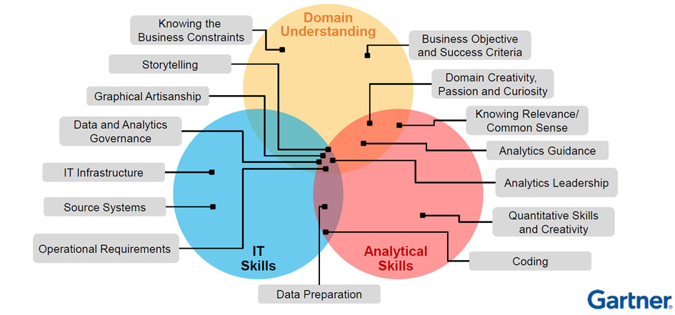
The role of IT for knowledge intensive production
Holistic approach for the knowledge management

Slide 12
Conclusions
This paper aims to stimulate an in-deepth rethinking on the nature of the statistical production process in the light of knowledge economics and management literatures.
The acknowledgement of the knowledge-intensive nature of the statistical production process has some substantial implications on:
New/upgraded criteria for data quality
Design of statistical production process (GSBPM)
Knowledge management and the key role of IT
New data collection and dissemination policies
Training and professional upgrade of official statisticians (example LCU in Business Statistics)

Slide 13
A knowledge-based approach to the statistical production process
Stefano Menghinello, Italian National Institute for statistics (ISTAT), menghine@istat.it
Claudio Ceccarelli, ISTAT, Rome, Italy, clceccar@istat.it
Massimo Fedeli, ISTAT, Rome, Italy, massimo.fedeli@stat.it

