Slide 1
An empirical study of nonresponse bias The Norwegian National Election Survey 1969-2017
Øyvin Kleven, Statistics Norway. KLE@SSB.NO
Ib Thomsen, Statistics Norway.
Li-Chun Zhang, University of Southampton & Statistics Norway. L.Zhang@soton.ac.uk or li.chun.zhang@ssb.no
26/06-2018. 08:30-10:00
Session 16

Slide 2
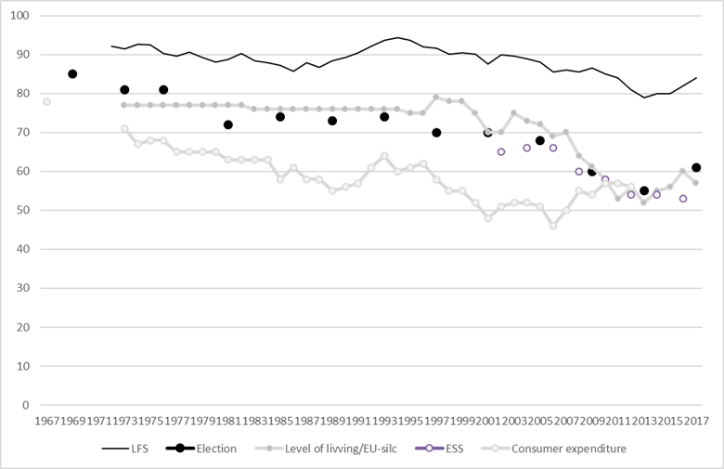
Responserates in some of Statistics Norway’s household surveys 1967-2017. %

Slide 3
Responserate in election surveys by gender and age. 1969-2017. Per cent
Source: Statistics Norway and Institute for Social Research, Norwegian National Election Surveys.

Slide 4
Bias indicator conditioning on the combination of the Xs - BIX
Source: Statistics Norway and Institute for Social Research, Norwegian National Election Surveys.

Slide 5
1969-2017. Nonresponse bias in Xs (BIXgender*age) and Y (electoral turnout).
Source: Statistics Norway and Institute for Social Research, Norwegian National Election Surveys.

Slide 6
1997-2017, bias in Xs BIXgender*age*education*urban and Y (electoral turnout).
Source: Statistics Norway and Institute for Social Research, Norwegian National Election Surveys.

Slide 7
Non response bias under different scenarios

Slide 8
Non response bias under different scenarios
Then there is the question of Norwegian immigration policy. The value 0 expresses the view that we should make it easier for immigrants to enter Norway; while the value 10 expresses the opinion that the number of immigrants coming to Norway should be restricted to an even greater extent than at present. Where would you place yourself on this scale?
 | 0 |  | 1 |  | 2 |  | 3 |  | 4 |  | 5 |  | 6 |  | 7 |  | 8 |  | 9 |  | 10 |  | 99
Should make it easier for immigrants to enter Norway |  |  |  |  |  |  |  |  |  |  |  |  |  |  |  | Stronger restrictions on immigration |  |  |  |  |  |  | DON’T KNOW

Slide 9
Non response bias under different scenarios

Slide 10
An empirical study of nonresponse bias. The Norwegian National Election Survey 1969-2017.
Øyvin Kleven, Statistics Norway. KLE@SSB.NO

