Slide 1
STAT WARS – May the force be with you!
Mária Jónyer, maria.jonyer@ksh.hu
Hungarian Central Statistical Office (HCSO)
28/06/2018
SESSION 15

Slide 2
Communication
Target groups
Secondary school students, teachers,
NSO staff
Media
Communication objectives
External
Reaching secondary school students
Contact directly with schools, teachers, students
Widening our target audience
Media coverage
Internal
Involving NSO staff
Teambuilding

Slide 3
Timing
MAY
Calls for entry
1st week of SEPTEMBER
Preliminary round
Submission deadline
3rd week of SEPTEMBER
NOVEMBER
Finals

Slide 4
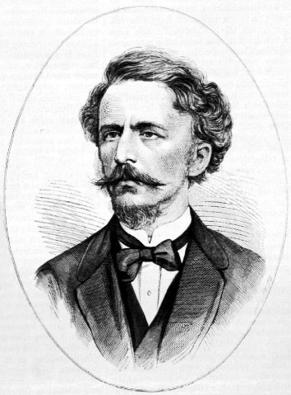
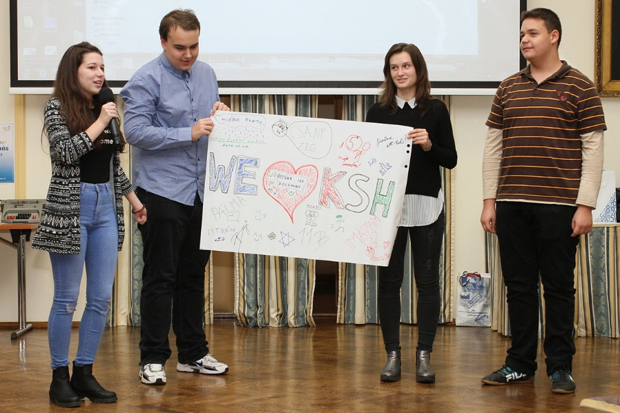
Preliminary Round – 3 weeks

Slide 5
The Finals
1 day
12 exciting missions
12 teams
1 main topic
8 minutes
32 colleagues
2-hour competition
Video session
Poster presentation
Final ceremony

Slide 6
Topics
Data collection
Time use research
Table tennis and fencing
Targeting/dispersion
Media interview
ESS topics

Slide 7
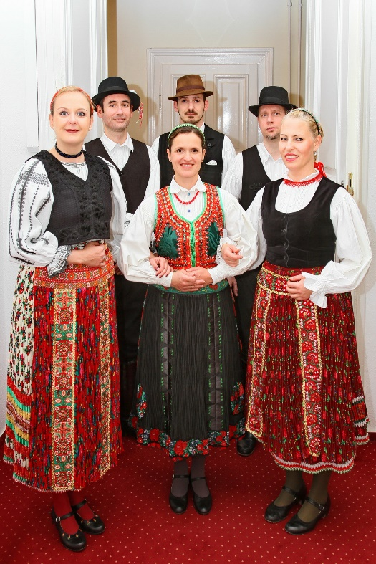
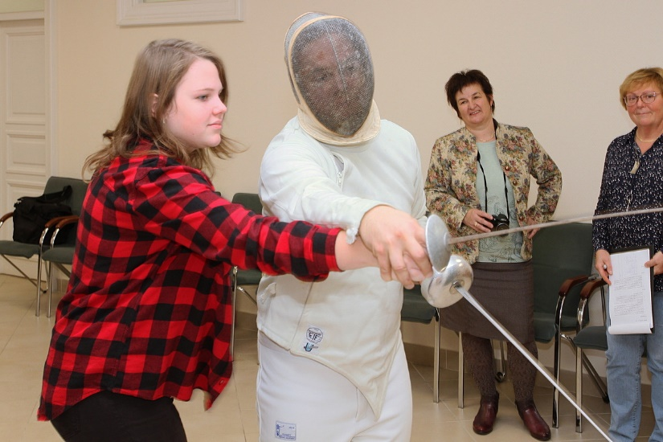
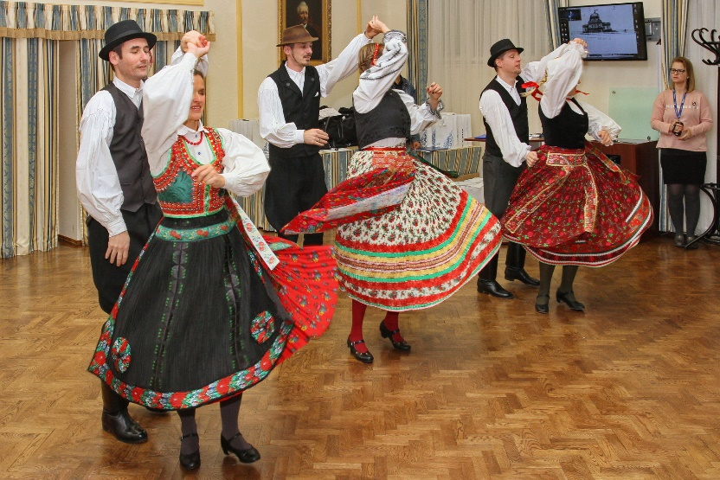
Background…

Slide 8
Preparation
5 NSO colleagues (from May until September)
32 NSO colleagues (at the final round)
2-3 colleagues at the stations (altogether 24 -28 colleagues)
Event organizers, photographer, camera man etc.

Slide 9
Goals
Giving experience related to statistics good
$x=\frac{−b±\sqrt{b^{2}−4ac}}{2a}$
Developing exact statistical literacy products
Introducing the phases of statistical data producing process
Teach students reading graphs and tables
Giving insights about the everyday life of the NSO’s

Slide 10
Communications Activities
Website
eDM
Press Release
Sharing students’ films on Social Media sites
Internal promotion (intranet)

Slide 11
Future…
Press event roadshow
Increased media coverage
Media cooperation
Improving the games
More statistics-based games
Involving more colleagues

Slide 12
STAT WARS IV. Movie

Slide 13
STAT WARS – May the force be with you! Website: https://www.ksh.hu/statwars_eng
Thank you for your attention!
Mária Jónyer, maria.jonyer@ksh.hu
Hungarian Central Statistical Office (HCSO)

