Slide 1
Collaboration with universities – a way to promote innovation and experimental culture
Faiz Alsuhail, Statistics Finland, faiz.alsuhail@stat.fi
27 June 2018
Session 13

Slide 2
How to get started?

Slide 3
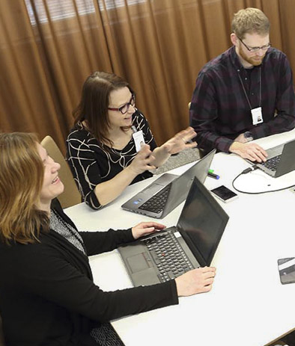
How to make it work?

Slide 4
Succes stories Seasonal adjustment
Turunen, R. (2005): Analysis of SARIMA-models and decomposition on seasonal adjusment method TRAMO/SEATS.

Slide 5
Succes stories Nowcasting
Fornaro, P. (2011): Dynamic Factor Models and Forecasting Finnish Macroeconomic Variables.

Slide 6
Succes stories Mixed mode data collection
Toivola, J. (2014): Comparison of non-response in websurveys and telephone interviews.
Vartiainen, M. (2011): Studying represenatativity in the Finnish crime victim survey.

Slide 7
Succes stories Salaries in small and large enterprises
Pehkonen, S. (2011): The effect of enterprise size on salary. Study on 2003-2009 wage structure data.

Slide 9
Collaboration with universities – a way to promote innovation and experimental culture
Thank you.
Faiz Alsuhail, Statistics Finland, faiz.alsuhail@stat.fi

