Slide 1
Confidence intervals for register-based statistics?
Johannes Gussenbauer, Alexander Kowarik, Eliane Schwerer, Christoph Waldner
Statistics Austria
27.06.2018
Session 11

Slide 2
Introduction
Administrative data as source for statistics
Cost-savings
Limit response burden
Errors in a sample data ≠ errors in adminstrative data
Challenging to measure quality of statistical figures from administrative data
Delden, Scholtus, and Burger (2015, 2016)

Slide 3
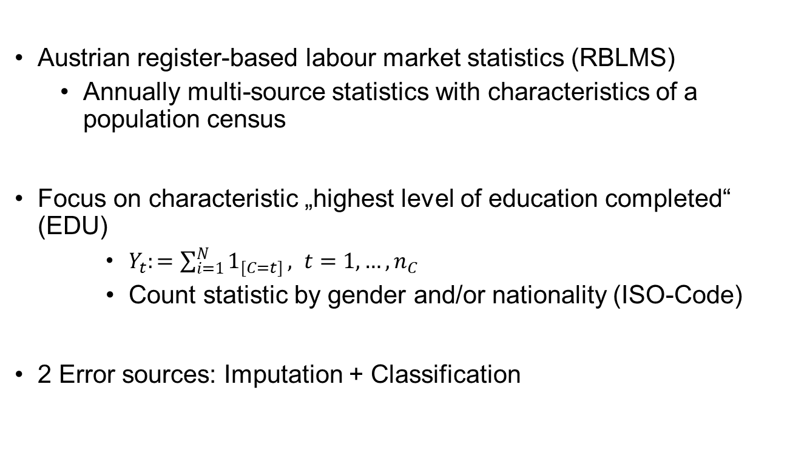
Setup – Case Study
Austrian register-based labour market statistics (RBLMS)
Annually multi-source statistics with characteristics of a population census
Focus on characteristic „highest level of education completed“ (EDU)
$Y_{t}:=\sum_{i=1}^{N}{1_{[C=t]}}, t=1,…,n_{C}$
Count statistic by gender and/or nationality (ISO-Code)
2 Error sources: Imputation + Classification

Slide 4
Error Sources
Imputation Error:
Missing at Random
Adresses only small part of the data
Classification Error:
Appears independently across units
Assum each person has an unknown true and observed value
Errors follow a transition matrix 𝐏$={\left(p_{(o,t)}^{}\right)}_{ }$
$$p_{(o,t)}^{}:=ℙ[C=o|C_{}^{∗}=t]$$

Slide 5
Bootstrap techniques
Error sources complex
Especially combination of 2 error sources
➔ Use bootstrap techniques
Modell Error sources ➔ probability matrix
Use probability matrix to create bootstrap replicates
Apply statistic on bootstrap replicates

Slide 6

Imputation
Classification
Multinomial Modell
$C \sim dem. variables$
$P_{I}≔\left(p_{(t)}^{}\right)=ℙ(C=t|𝒞_{l})$
Austrian labour force survey
Multinomial modell
$C \sim \overset{̃}{C}+ dem. variables$
$P_{C}≔\left(p_{\left(t\right)}^{}\right)=ℙ(C=o|\overset{̃}{C}=t,𝒞_{l})$

Slide 7
Overview of Method
Impute value
Calculate count statistic
Estimated „true“ value
$$P_{I}$$
$$P_{C}$$
$${\overset{^}{Y}}_{t}^{(b)}$$

Slide 8
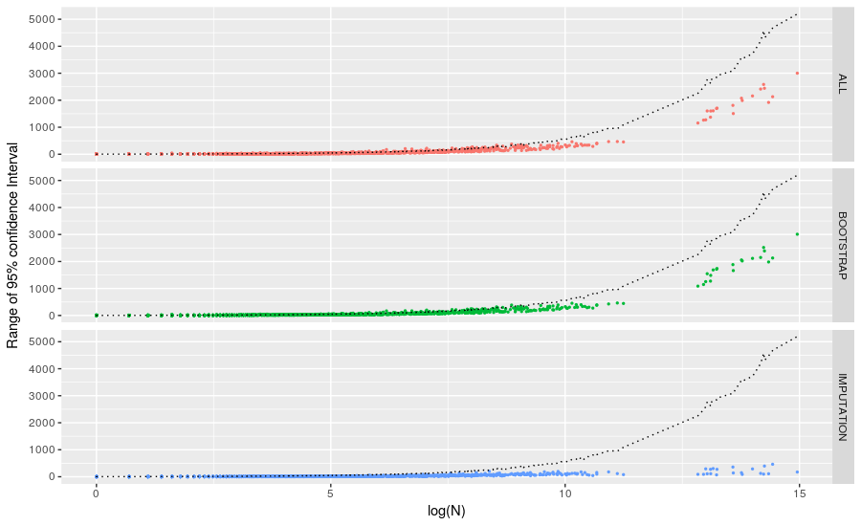
Initial Results

Slide 9
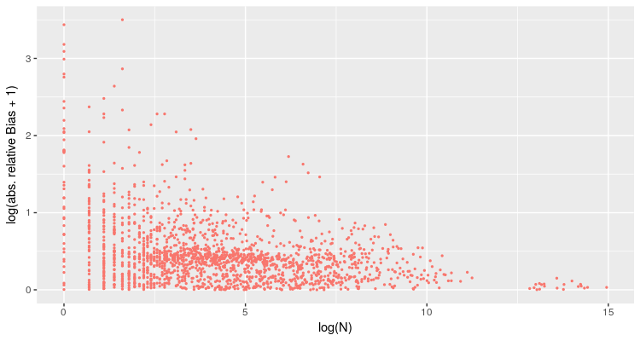
Biased Bootstrap Replicates

Slide 10
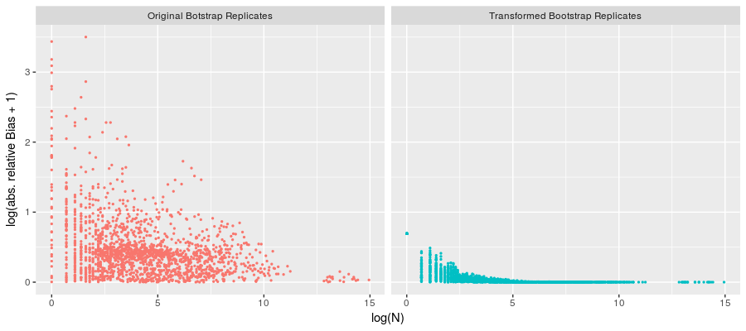
Reducing the Bias
Use inverse transition Matrix $Q_{C}:={(P}_{C}^{−1})^{T}$
${\overset{̃}{Y}}_{t}^{(b)}:=Q_{C}{\overset{^}{Y}}_{()}^{(b)}$

Slide 11
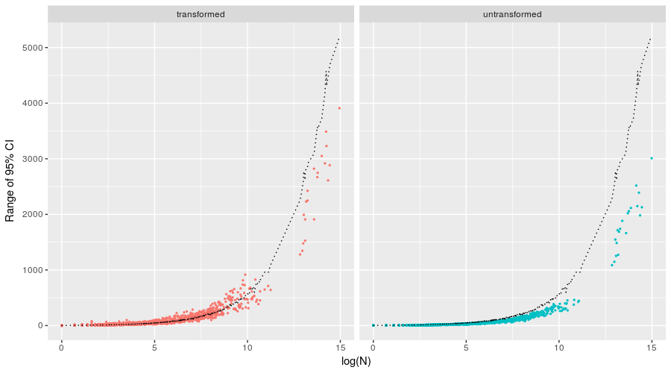
Variance Inflation

Slide 12
Possible Reasons for Variance Inflation
Condition number
$$κ(M):=||M^{−1}||⋅||M||$$
$||.||$ is a norm
Indicates how much the noise in the data is magnified by solving a system of linear equations.
Noise in data ➔ bootstrap replicates

Slide 13
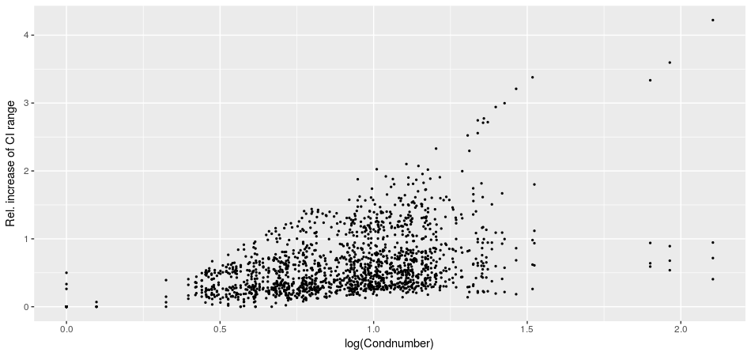
Possible Reasons for Variance Inflation

Slide 14
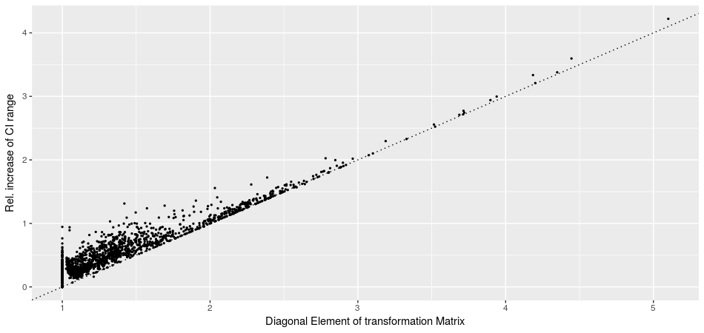
Possible Reasons for Variance Inflation

Slide 15
Propose new transformation Matrix
Tansformation matrix $U_{C}$, different to $Q_{C}$, with diagonal elements equal to 1
Has to fulfill criteria similar to${ Q}_{C}$
Sum over each column must equal $1$
${Y_{C}=(U_{C})Y}_{C}^{∗}$, with $Y_{C}^{∗}=(P_{C})^{T}Y_{C}$

Slide 16

Propose new transformation Matrix
Start with $I_{p}$ and set $i=1$
Update $q(i,.)$ and $q(.,i)$ such that condition 1. and 2. are fullfilled
If
$\sum_{j}{q_{j,i}}=1 ∀i$ and
$\sum_{j}{q_{i,j}}(Y_{C}^{∗})_{j}=(Y_{C})_{i} ∀i$ terminate
otherwise set $i=(imodp)+1$ and go to Step 2.

Slide 17
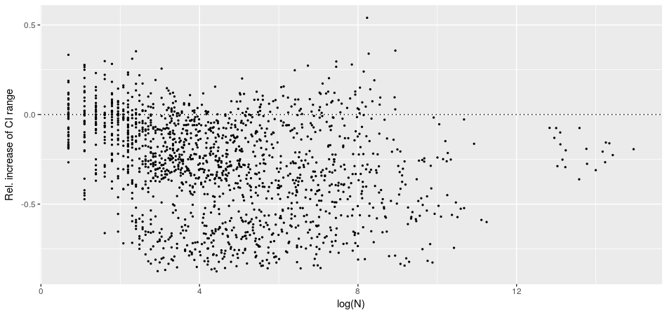
Variance decrease

Slide 18
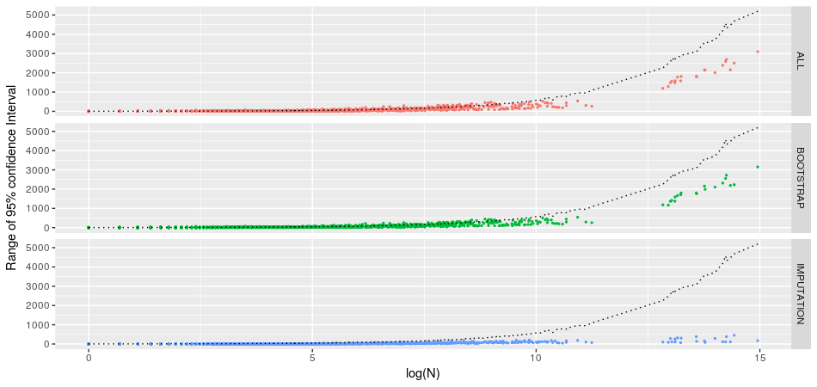
Overall Results

Slide 19
Conclusion & Outlook
Estimating confidence intervals for register data very challenging
Issues with bias and variance inflation
Proposed transformation matrix to reduce variance inflation
Needs well-grounded theoretical background (!)
Naive bootstrap procedure does yield conservative, although robust, results

Slide 20
Confidence intervals for register-based statistics?
Johannes Gussenbauer, Statistics Austria, Johannes.Gussenbauer@statistik.gv.at
Alexander Kowarik, Statistics Austria, Alexander.Kowarik@statistik.gv.at
Eliane Schwerer, Statistics Austria, Eliane.Schwerer@statistik.gv.at
Christoph Waldner, Statistics Austria, Christoph.Waldner@statistik.gv.at

