Slide 1
Why consistency matters –
The impact of the consistency debate on increased accuracy and coordination within the national accounts and between national accounts and balance of payments statistics of the EU
Robert Obrzut, Eurostat, robert.obrzut@ec.europa.eu
29 June 2018
Session 10

Slide 2
Contents
Why consistency matters – motivational introduction
  Dimensions and concepts
  Data evidence – external and internal aspects
  Causes for inconsistencies (Eurostat survey)
  Determining the critical threshold
  Major obstacles and outlook

Slide 3
Contradictory balances in the main items
Non-financial | Component a/c | BOP balance | ROW balance
Germany | Capital account | +3.5 | -1.1
France (2017) | Services | +17.9 | -14.6
Poland | Secondary income | -1.4 | +2.5
FA transactions | BOP assets | ROW liabilities | BOP liabilities | ROW assets
Denmark |  |  | +23.3 | -0.7
Finland |  |  | +21.7 | -6.1
Sweden | +8.4 | -91.0 | +24.2 | -90.1
FA stocks | IIP net assets | ROW net liabilities
Luxembourg | +22.0 | -50.0
  Balances in bill. €, by concerned Member State, 2016, Apr. 2018 (billion EUR)

Slide 4
The integrated nature of the accounts
Methodological standards BPM6 and ESA2010/SNA2008
  Fully integrated concept – full comparability
  (Theoretically) no methodological differences
  Statistical domains (non-financial & financial)
    Sector accounts, incl. ROW
    BOP
    NA main aggregates
    Government finance statistics (GFS)
  Data evidence
    External aspect: BOP-ROW
    Internal aspect: Sector accounts – main aggregates/GFS

Slide 5
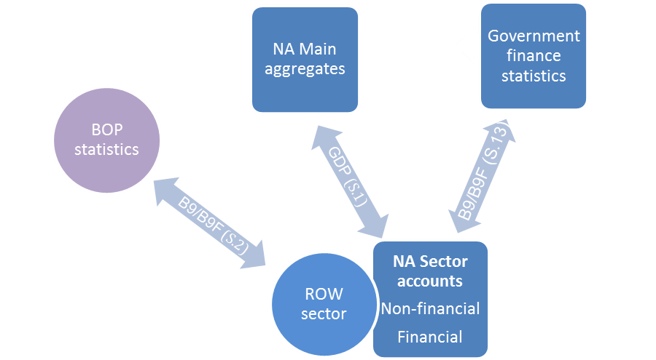
Dimensions of consistency in the accounts
Main/balancing items
GDP, B9, B9F
Sector accounts "anchor"

Slide 6
Prominence of external and internal aspects
ASA – Annual sector accounts; ANA – Annual National accounts (main aggregates); GFS – government finance statistics; Oct. 2017 (million EUR)

Slide 7
External aspect: BOP-ROW discrepancies
Non-financial accounts – 14 MS consistent
  Mean absolute percentage deviation (B9), by country, 2014-2016, Apr. 2018

Slide 8
External aspect: BOP-ROW discrepancies Component exposure in the non-financial a/c
  Absolute discrepancies, non-financial accounts, sum of EU-28, 2010-2017, Apr. 2018 (million EUR)

Slide 9
Internal aspect: cross-domain discrepancies in NA
Sector accounts – main aggregates and GFS
  Mean absolute differences, by country, 2010-2016, Oct. 2017 (million EUR)

Slide 10
Causes for inconsistent accounts
Eurostat compiler surveys 2015 and 2017
  Analysing BOP-ROW inconsistencies in the non-financial accounts
  Main causes
    Revision and vintage effects
    Methodological differences
    Organisational & management aspects
  Sequential versus twinning processes
  Integrated accounts versus autonomous production systems (cost of coordination)

Slide 11
Determining the critical threshold
  Identity of data sets versus tolerance bands (? in % of GDP)
  Mechanistic approach to NA cross-domain inconsistencies
    Sensitivity analysis for GDP and B9
      0% - max. 21 MS concerned (B9); 1% - max. 12 MS concerned (B9)
      0.3% threshold chosen
    Emphasising integrated data models and harmonised production & revision calendars
    Risk of diverging publication practices inf Eurostat and country statistics
  Organic approach to BOP-ROW inconsistencies
    Methodological differences
    Different revision practices
    Different institutional frameworks

Slide 12
Conclusions
Obstacles
Institutional autonomies (historically grown)
  Resource restrictions on human/IT capacities
  Need for flexibility in adjustment practices
  Confidentiality of micro data
  Practical ways forward
  Based on identified causes rather than symptoms
  Increasing data standardisation
    Securities reference databases from micro data (CSDB)
    Standardised enterprise identifiers (LEI)
  Mirror data comparisons (intl. services, FDI network)
  Interinstitutional technical cooperation

Slide 13
Why consistency matters
Thank you very much / Dziękuję bardzo
Robert Obrzut, Eurostat, robert.obrzut@ec.europa.eu

