Slide 1
Capabilities: Improving the Quality of Statistical Capacity Development
Steven Vale
UNECE
steven.vale@unece.org

Slide 2
Capacity development is becoming more important for all countries, particularly in the context of the SDGs

Slide 3
So what about quality?
Quality = Meeting user needs
In capacity development, beneficiaries are the most important “users”
To improve the quality of capacity development activities we need to understand exactly what they need

Slide 4
New UNECE Strategy
Modernising capacity development based on
New principles
New priority areas (demand-driven)
New tools and methods
Not just training of people – more focus on development of organisational capabilities

Slide 5
New UNECE Strategy
Modernising capacity development based on
New principles
New priority areas (demand-driven)
New tools and methods
Not just training of people – more focus on development of organisational capabilities
Endorsed by the Conference of European Statisticians last week

Slide 6
Capabilities
A capability is:
“An ability that an organisation possesses”
(Source: The Open Group Architecture Framework (TOGAF))
Just like quality, capabilities have several dimensions

Slide 7
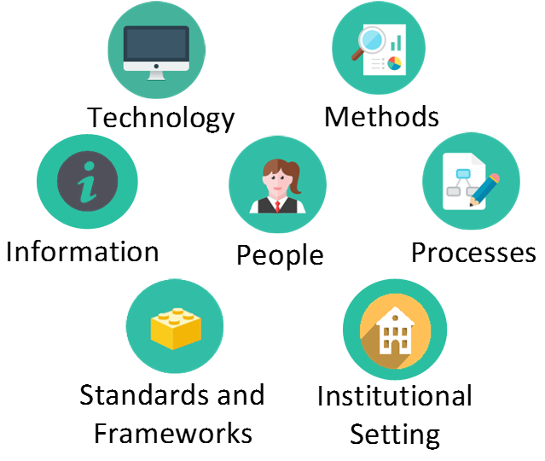
Capabilities in statistical organisations

Slide 8
Example
Seasonal adjustment requires:
People, methods, processes, technology, standards and information (i.e. data!)
In the context of the organisational setting (legislation, policy, etc.)
If we only address one of these dimensions, e.g. training people, or providing software, this will not ensure that an organisation has the capability to do seasonal adjustment!

Slide 9
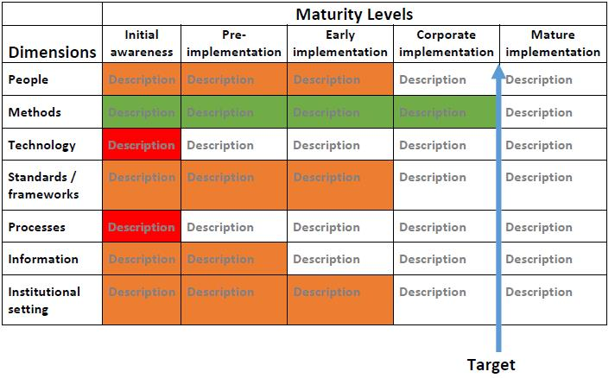
Maturity models
For each capability, assess where you are now, and where you want to be

Slide 10
Maturity models
Focus capacity development where it is most needed – more effective – better quality

Slide 11
A similar approach could be applied to quality measurement -
to determine which dimensions of quality need most attention

Slide 12
References
UNECE Statistical Capacity Development Strategy
http://www.unece.org/fileadmin/DAM/stats/documents/ece/ces/2018/CES_10_rev1__Statistical_capacity_development_strategy_rev.pdf
The Open Group Architecture Framework (TOGAF)
http://pubs.opengroup.org/architecture/togaf9-doc/arch/index.html
The Open Group Service Integration Maturity Model (OSIMM)
http://www.opengroup.org/soa/source-book/osimmv2/

