Slide 1
Coordination of National Statistical System – Experience from the Hellenic Statistical System (ELSS)
Christina Pierrakou, Organization, Methodology and International Relations Division, Hellenic Statistical Authority (ELSTAT), c.pierrakou@statistics.gr
Stamatios Theocharis, Statistical Head and Head of Internal Audit Unit of Ministry of Interior, s.theoxaris@ypes.gr
28.6.2018
6

Slide 2
Legal Framework
Coordination of Hellenic Statistical System (ELSS)
Outline
Mechanism and tools for Coordination at ELSS
The Role of Statistical Head for enhancing the quality
ONA’s Experience – The case of the Ministry of Interior
Notes:
Briefly this presentation covers:
Hellenic Statistical System (ELSS)
Statement of Principles and Procedures for Certification of ELSS Statistics
Written Evidence Questionnaire for Certification
Stages in the certification process
Main horizontal requirements

Slide 3
Legal Framework
Regulation on the Statistical Obligations of the agencies of the ELSS
Statistical Law 3832/2010
Regulation on the Operation and Administration of ELSTAT
Image Source Eurostat
Notes:
Οι όροι και οι προϋποθέσεις για την πιστοποίηση καθορίζονται στον Κανονισμό Λειτουργίας και Διαχείρισης της ΕΛΣΤΑΤ.
Στατιστικός Νόμος 3832/2010
όπως ισχύει, (Άρθρο 11, παράγραφος 6)

Slide 4
Coordination of Hellenic Statistical System (ELSS)
The ELSS is composed of ELSTAT and 20 other Agencies
8 of these are ONAs responsible for the development, production and dissemination of European Statistics ( 25% of European Statistics produced by ONAs )
ELSTAT coordinates all the activities of the other Agencies in ELSS that concern the development, production and dissemination of the official statistics and certifies as “official” statistics produced by the ELSS Agencies

Slide 5
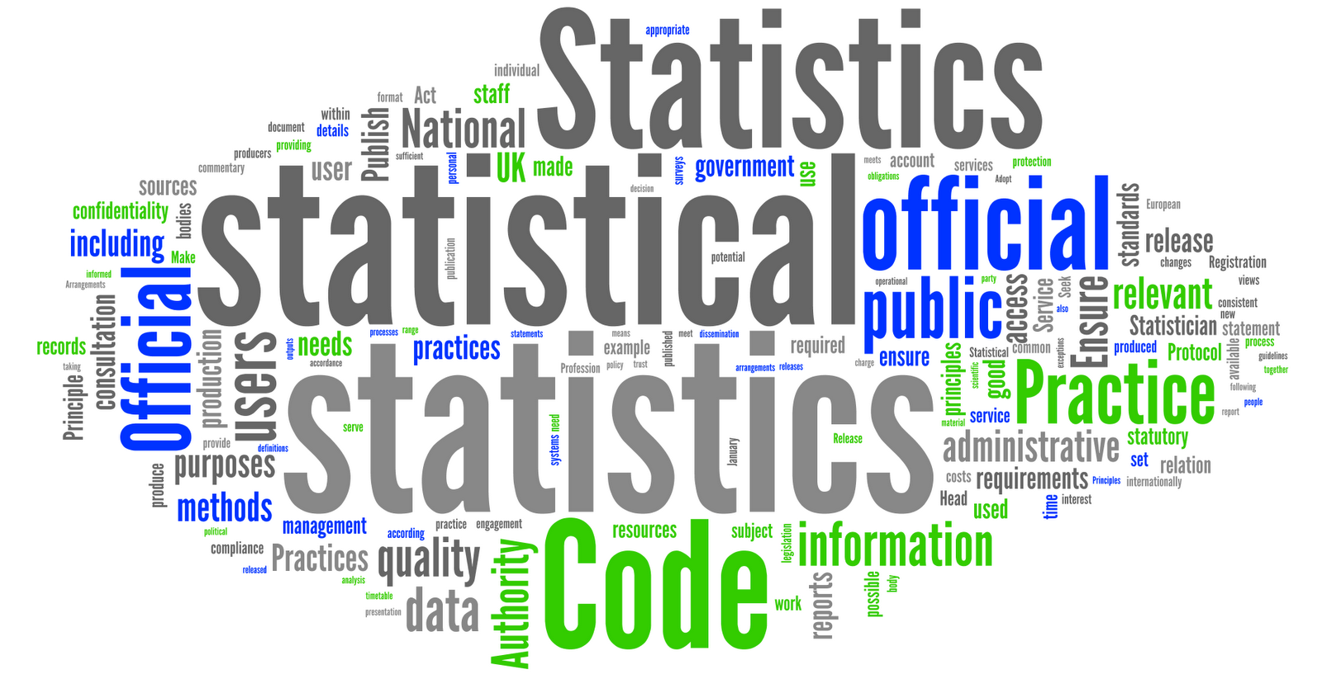
Official Statistics of ELSS
The official statistics have the following characteristics:
regular production provided for in the legal framework
availability and provision to any interested user
compliance with CoP and of the UN Fundamental Principles of Official Statistics
National legislation requires from the ELSS agencies
implement the CoP when developing, producing and disseminating all the official statistics produced by them and not only for European statistics.

Slide 6
Mechanism and tools for Coordination at ELSS
Almost all Agencies have nominated a Statistical Head (1.2, 1.3 and 1.4 of CoP)
Coordination Committee of ELSS –Members are Statistical Heads – Chaired by the President of ELSTAT
Notes:
Assessments are carried out in accordance with a published schedule of assessments by quarters, announced annually by ELSTAT.
2. The ELSS agencies fill in the Written Evidence Questionnaire for Certification, which is based on the CoP using a standard template. This questionnaire is included in the basic document used for the certification.
3. This information is supplemented by Quality Reports and any previously published reviews of the statistics, as well as information submitted by users or other stakeholders
4. Assessments of statistics take, also, account of the correspondence and discussions with the representatives of the agencies who are responsible for the statistics and ELSTAT’s observations in relation to compliance with the requirements of the European Statistics Code of Practice (CoP).

Slide 7
Certification of Statistics of ELSS
The certification of statistics is the approval provided by ELSTAT that the statistics produced by an ELSS agency shall be used as official statistics
ELSTAT assesses and determines whether the CoP has been complied with in relation to any statistics. The assessment of statistics covers all aspects of the work leading to the statistical output and its dissemination.
Prerequisite: List of all statistics under certification exercise
Statistics under assessment:
European and National statistics
First attempt to record the statistics of ELSS agencies 2017 (apart from ELSTAT) This list contains 222 statistical products which are to be certified
Notes:
Assessments are carried out in accordance with a published schedule of assessments by quarters, announced annually by ELSTAT.
2. The ELSS agencies fill in the Written Evidence Questionnaire for Certification, which is based on the CoP using a standard template. This questionnaire is included in the basic document used for the certification.
3. This information is supplemented by Quality Reports and any previously published reviews of the statistics, as well as information submitted by users or other stakeholders
4. Assessments of statistics take, also, account of the correspondence and discussions with the representatives of the agencies who are responsible for the statistics and ELSTAT’s observations in relation to compliance with the requirements of the European Statistics Code of Practice (CoP).

Slide 8
Main horizontal requirements
Annual Statistical Work Programme of the next year
Annual Report of the previous year ( 1.5)
Development of internal guidelines for ensuring the quality of the produced statistics (6.4)
Appointment of Statistical Head of the Agency (1.2, 1.3 & 1.4)
Quality Policy, Quality Guidelines and Quality Reports
System for monitoring the quality of the statistical output (4.1, 4.2, 4.3 & 4.4)
Documentation of the use of statistics and systematic recording of users’ needs (11.1)
Publication of the produced statistics and relevant metadata (15.1)
Provision of equal and simultaneous access of all users, without exception, to Agency’s statistics. Limitation, control and publication of any privileged pre-release access of users to statistics (6.7)
Notes:
The improvements actions refer to horizontal requirements concerning the agency as a whole and/or to specific statistics produced by the agency. The Certification report includes a proposed timetable for completion of these actions. It also includes, at the appropriate parts of the report, observations of users and external experts.
The draft certification report is submitted to the President of ELSTAT. Once the President agrees with its content, the agency is invited to submit written comments on the draft. The written comments are discussed between the manager of the certification team, the President of ELSTAT and any further experts or independent observers whose contribution in that process is considered useful by the President. The draft report is then revised at the discretion of the President of ELSTAT and finalized. In case of full compliance with the CoP principles, the final report does not include any improvement actions. Otherwise, improvement actions are included along with a time schedule for their completion by the agency. Designation of statistics as “Official Statistics” is only confirmed once specific improvement actions have been completed.

Slide 9
Guide to the agencies of ELSS for implementation of CoP
This Guide describes the obligations of:
a) the agencies,
b) the statistical heads of the agencies,
c) the staff of the agencies involved in the production and dissemination of statistics and
d) ELSTAT towards the agencies, in the framework of the compliance with the CoP.
Mostly concerns Indicators of COP likely to create challenges in their implementation.
Tool for ensuring quality during the various stages of the statistical production by the ELSS agencies
The guidelines are equally applicable to all the statistics of the ELSS.

Slide 10
Current Results
Notes:
Βρίσκεται επαρκώς ψηλά στην ιεραρχία, ώστε να διασφαλίζει πρόσβαση στην ανώτατη βαθμίδα της ιεραρχίας των αρχών που ασκούν δημόσια πολιτική και των φορέων της δημόσιας διοίκησης.
Έχει τα υψηλότερα δυνατά επαγγελματικά προσόντα.
Έχει την ευθύνη να εξασφαλίζει ότι οι στατιστικές του φορέα αναπτύσσονται, παράγονται και διαχέονται με ανεξάρτητο τρόπο.
Είναι ο μόνος αρμόδιος, εντός του φορέα, για τη λήψη αποφάσεων σχετικά με τις στατιστικές μεθόδους, τα πρότυπα και τις διαδικασίες, καθώς και σχετικά με το περιεχόμενο και τη χρονική στιγμή δημοσίευσης στατιστικών στοιχείων

Slide 11
The Role of Statistical Head for enhancing the quality
Opportunities
Challenges
Knowledge of the agency
Better cooperation
Cope with cases of overlapping responsibilities, discrepancies etc
Two-way contact point
Resources
Training
Monitoring the quality
Notes:
Βρίσκεται επαρκώς ψηλά στην ιεραρχία, ώστε να διασφαλίζει πρόσβαση στην ανώτατη βαθμίδα της ιεραρχίας των αρχών που ασκούν δημόσια πολιτική και των φορέων της δημόσιας διοίκησης.
Έχει τα υψηλότερα δυνατά επαγγελματικά προσόντα.
Έχει την ευθύνη να εξασφαλίζει ότι οι στατιστικές του φορέα αναπτύσσονται, παράγονται και διαχέονται με ανεξάρτητο τρόπο.
Είναι ο μόνος αρμόδιος, εντός του φορέα, για τη λήψη αποφάσεων σχετικά με τις στατιστικές μεθόδους, τα πρότυπα και τις διαδικασίες, καθώς και σχετικά με το περιεχόμενο και τη χρονική στιγμή δημοσίευσης στατιστικών στοιχείων

Slide 12
ONA’s Experience – The case of Ministry of Interior
Nomination of an independent Office of Statistical Head
Appointment of the Statistical Head and a Working Group
Benefits
Critical Issues
cooperation & coordination
Supporting & Monitoring mechanism
Influence inside the agency
Cooperative culture
Internal guidelines & quality reports
Increment of cost effectiveness and efficiency
Notes:
Βρίσκεται επαρκώς ψηλά στην ιεραρχία, ώστε να διασφαλίζει πρόσβαση στην ανώτατη βαθμίδα της ιεραρχίας των αρχών που ασκούν δημόσια πολιτική και των φορέων της δημόσιας διοίκησης.
Έχει τα υψηλότερα δυνατά επαγγελματικά προσόντα.
Έχει την ευθύνη να εξασφαλίζει ότι οι στατιστικές του φορέα αναπτύσσονται, παράγονται και διαχέονται με ανεξάρτητο τρόπο.
Είναι ο μόνος αρμόδιος, εντός του φορέα, για τη λήψη αποφάσεων σχετικά με τις στατιστικές μεθόδους, τα πρότυπα και τις διαδικασίες, καθώς και σχετικά με το περιεχόμενο και τη χρονική στιγμή δημοσίευσης στατιστικών στοιχείων

Slide 13
Coordination of National Statistical System – Experience from the Hellenic Statistical System (ELSS)
Thank you very much for your attention
Christina Pierrakou, Organization, Methodology and International Relations Division, Hellenic Statistical Authority (ELSTAT), c.pierrakou@statistics.gr
Stamatios Theocharis, Statistical Head and Head of Internal Audit Unit of Ministry of Interior, s.theoxaris@ypes.gr

