Slide 1
Assessing the quality of the geographical dimension in macro-economic statistics through mirror data
Carmen Picón Aguilar
European Central Bank
27th June 2018
Session 4

Slide 2
Asymmetries in macroeconomic statistics
Inherent to all statistics for which "mirror" data are available
Same economic phenomenon from different perspective: the purchaser and the seller
Generated by several reasons:
different coverage and time of recording
different valuation and treatment of complex transactions
different geographical identification of counterpart

Slide 3
Different levels of asymmetries analysis
In the external sector statistics, asymmetries between countries' flows and positions become evident:
in a bilateral comparison
In a regional aggregate (e.g. intra-euro area asymmetries)
Intra-euro area asymmetries in the financial account

Slide 4
Main ideas behind the proposed measures
The quality of the geographical breakdown between intra and extra euro area counterparts is essential for the euro area balance of payments
Aim is to assess where the problem lies by using a full set of mirror data in the regional group:
who?
punctual versus recurrent
How? quality quantitative measures straightforward to apply, easily interpretable
basis for further discussion and analysis

Slide 5
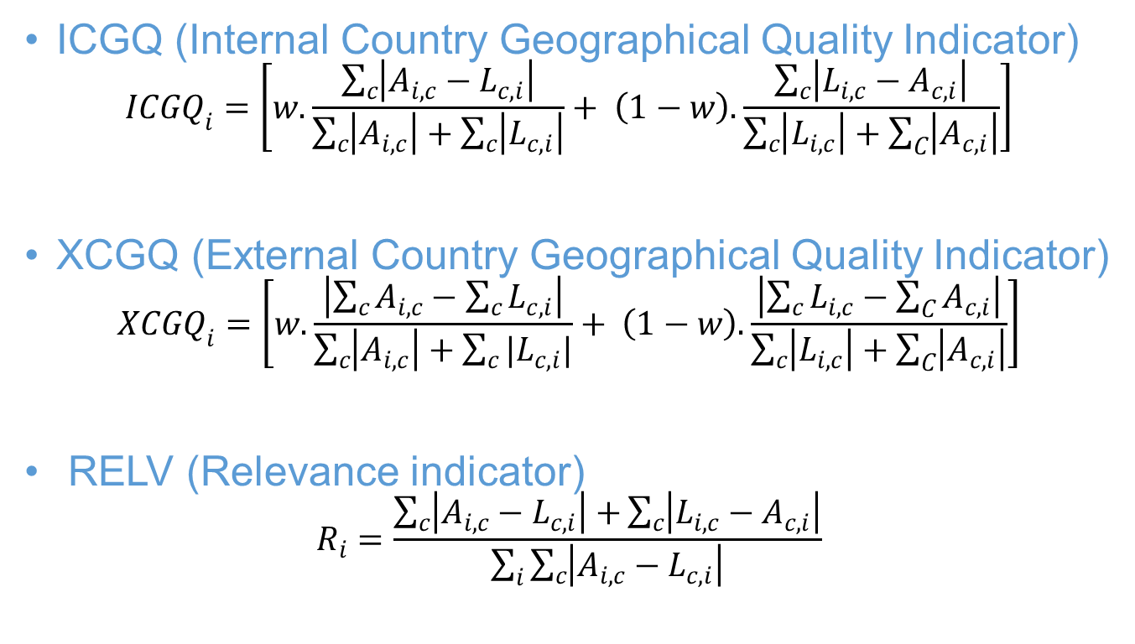
The set of synthetic indicators
ICGQ (Internal Country Geographical Quality Indicator)
$${ICGQ}_{i}=\left[w.\frac{\sum_{c}{\left|A_{i,c}−L_{c,i}\right|}}{\sum_{c}{\left|A_{i,c}\right|+\sum_{c}{\left|L_{c,i}\right|}}}+ \left(1−w\right).\frac{\sum_{c}{\left|L_{i,c}−A_{c,i}\right|}}{\sum_{c}{\left|L_{i,c}\right|+\sum_{C}{\left|A_{c,i}\right|}}}\right]$$
XCGQ (External Country Geographical Quality Indicator)
$${XCGQ}_{i}=\left[w.\frac{\left|\sum_{c}{A_{i,c}−\sum_{c}{L_{c,i}}}\right|}{\sum_{c}{\left|A_{i,c}\right|+\sum_{c}{|L_{c,i}|}}}+ \left(1−w\right).\frac{\left|\sum_{c}{L_{i,c}−\sum_{C}{A_{c,i}}}\right|}{\sum_{c}{\left|L_{i,c}\right|+\sum_{C}{\left|A_{c,i}\right|}}}\right]$$
RELV (Relevance indicator)
$$R_{i}=\frac{\sum_{c}{\left|A_{i,c}−L_{c,i}\right|+}\sum_{c}{\left|L_{i,c}−A_{c,i}\right|}}{\sum_{i}{\sum_{c}{\left|A_{i,c}−L_{c,i}\right|}}}$$

Slide 7
Summary of results for quarterly euro area transactions in Foreign Direct investment (FDI)
Generally euro area countries face difficulties in matching individual counterparties’ data (larger ICGQ)
Relatively better at matching the intra-euro area totals (lower XCGQ)
High dispersion of values across the different quarters for most countries shows the importance of punctual asymmetries
A limited number of countries concentrating large FDI transactions are disproportionately relevant to the intra-euro are FDI asymmetries (RELV)

Slide 8
Conclusion
The analysis of asymmetries is important to improve the quality of statistics based on geographical dimension
A combined interpretation of the three indicators
helps in the analysis of the different aspects of geo quality in a regional aggregate
provides info to the countries on how to improve the data quality
These indicators can be applied to any kind of statistics were bilateral data are available

Slide 9
Assessing the quality of the geographical dimension in macro-economic statistics through mirror data
Thank you
Carmen.Picon_Aguilar@ecb.europa.eu
Fausto.Pastoris@ecb.europa.eu
Tjeerd.Jellema@ecb.europa.eu

