Slide 1


Describing the Statistical Business Process using the GSBPM as a reference
Challenges in a process changing environment
Maria João Zilhão
Statistics Portugal
June 27th 2018

Slide 2
Contents
Presenting the new version of the Statistical Process Procedures Handbook produced by Statistics Portugal and describing the adopted business process model
The challenges (strong and weak points) in adapting the GSBPM to Statistics Portugal organisation
The subsequent levels of process description added to the GSBPM
(GSBPM: Generic Statistics Business Process Model – UNECE – V5)

Slide 3
Statistics Portugal and ONA
2018 Work Programme
Documenting the Statistical Business Process
Scope of statistical production
310 statistical activities
of which 274 generate statistical outputs
which will be released in 1 007 different “first” moments
684 by Statistis Portugal and 323 by the ONAs

Slide 4
Documenting the Statistical Business Process
Scope of statistical production
Statistical activities by domain for 2018 (Statistics Portugal)
Source: Statistics Portugal and ONA 2018 Work Programme

Slide 5
Documenting the Statistical Business Process
Advantages
The advantages of documenting the Statistical Business Process:
Facilitating internal and external communication (national and international) about statistical production
Promoting the standardization of specific terminology and the sharing of knowledge, data and tools along the business process
Fostering the process standardization
Supporting the planning process
Providing a map of the entire business process
Identifying all necessary documentation to be produced along the business process
Identifying all possible synergies along the process and between activities
Supporting the modernization of production systems
Providing a relevant tool for quality management – for example, in auditing processes.

Slide 6
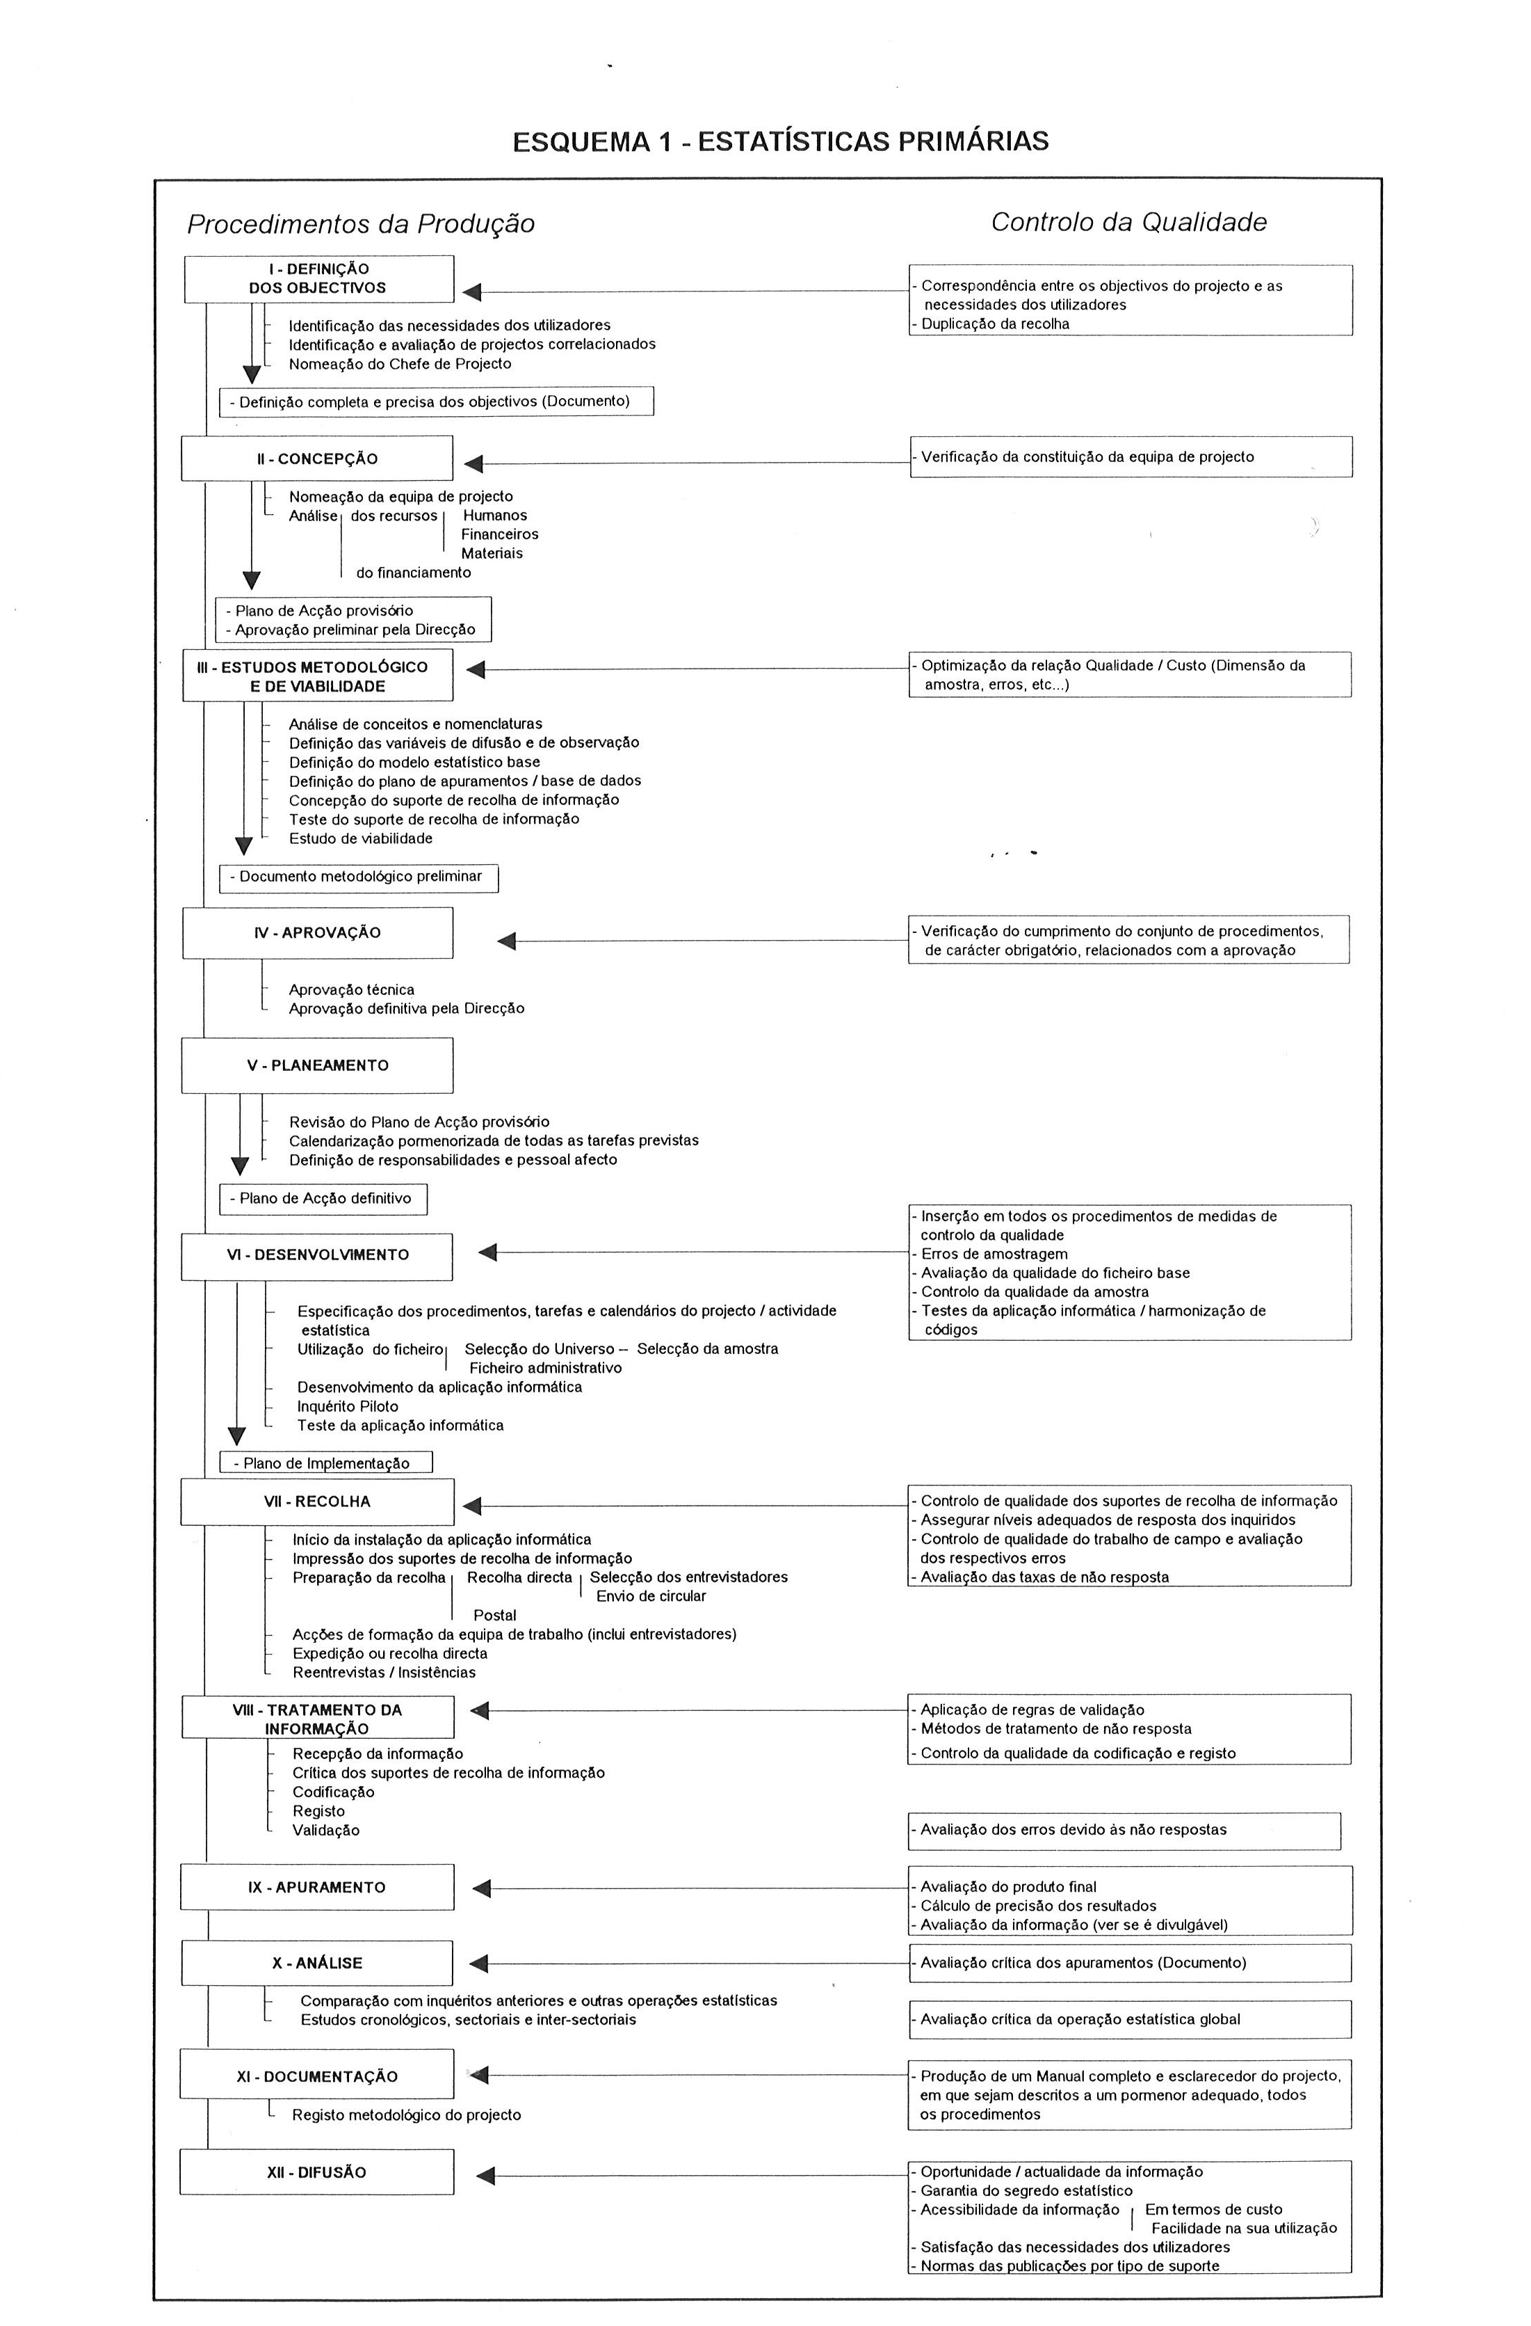
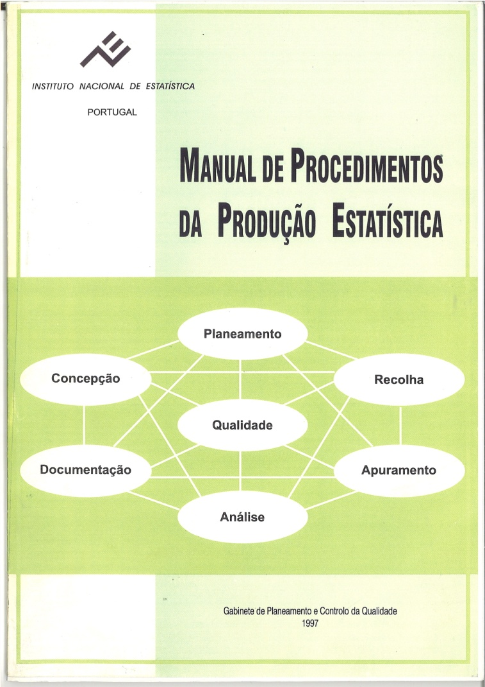
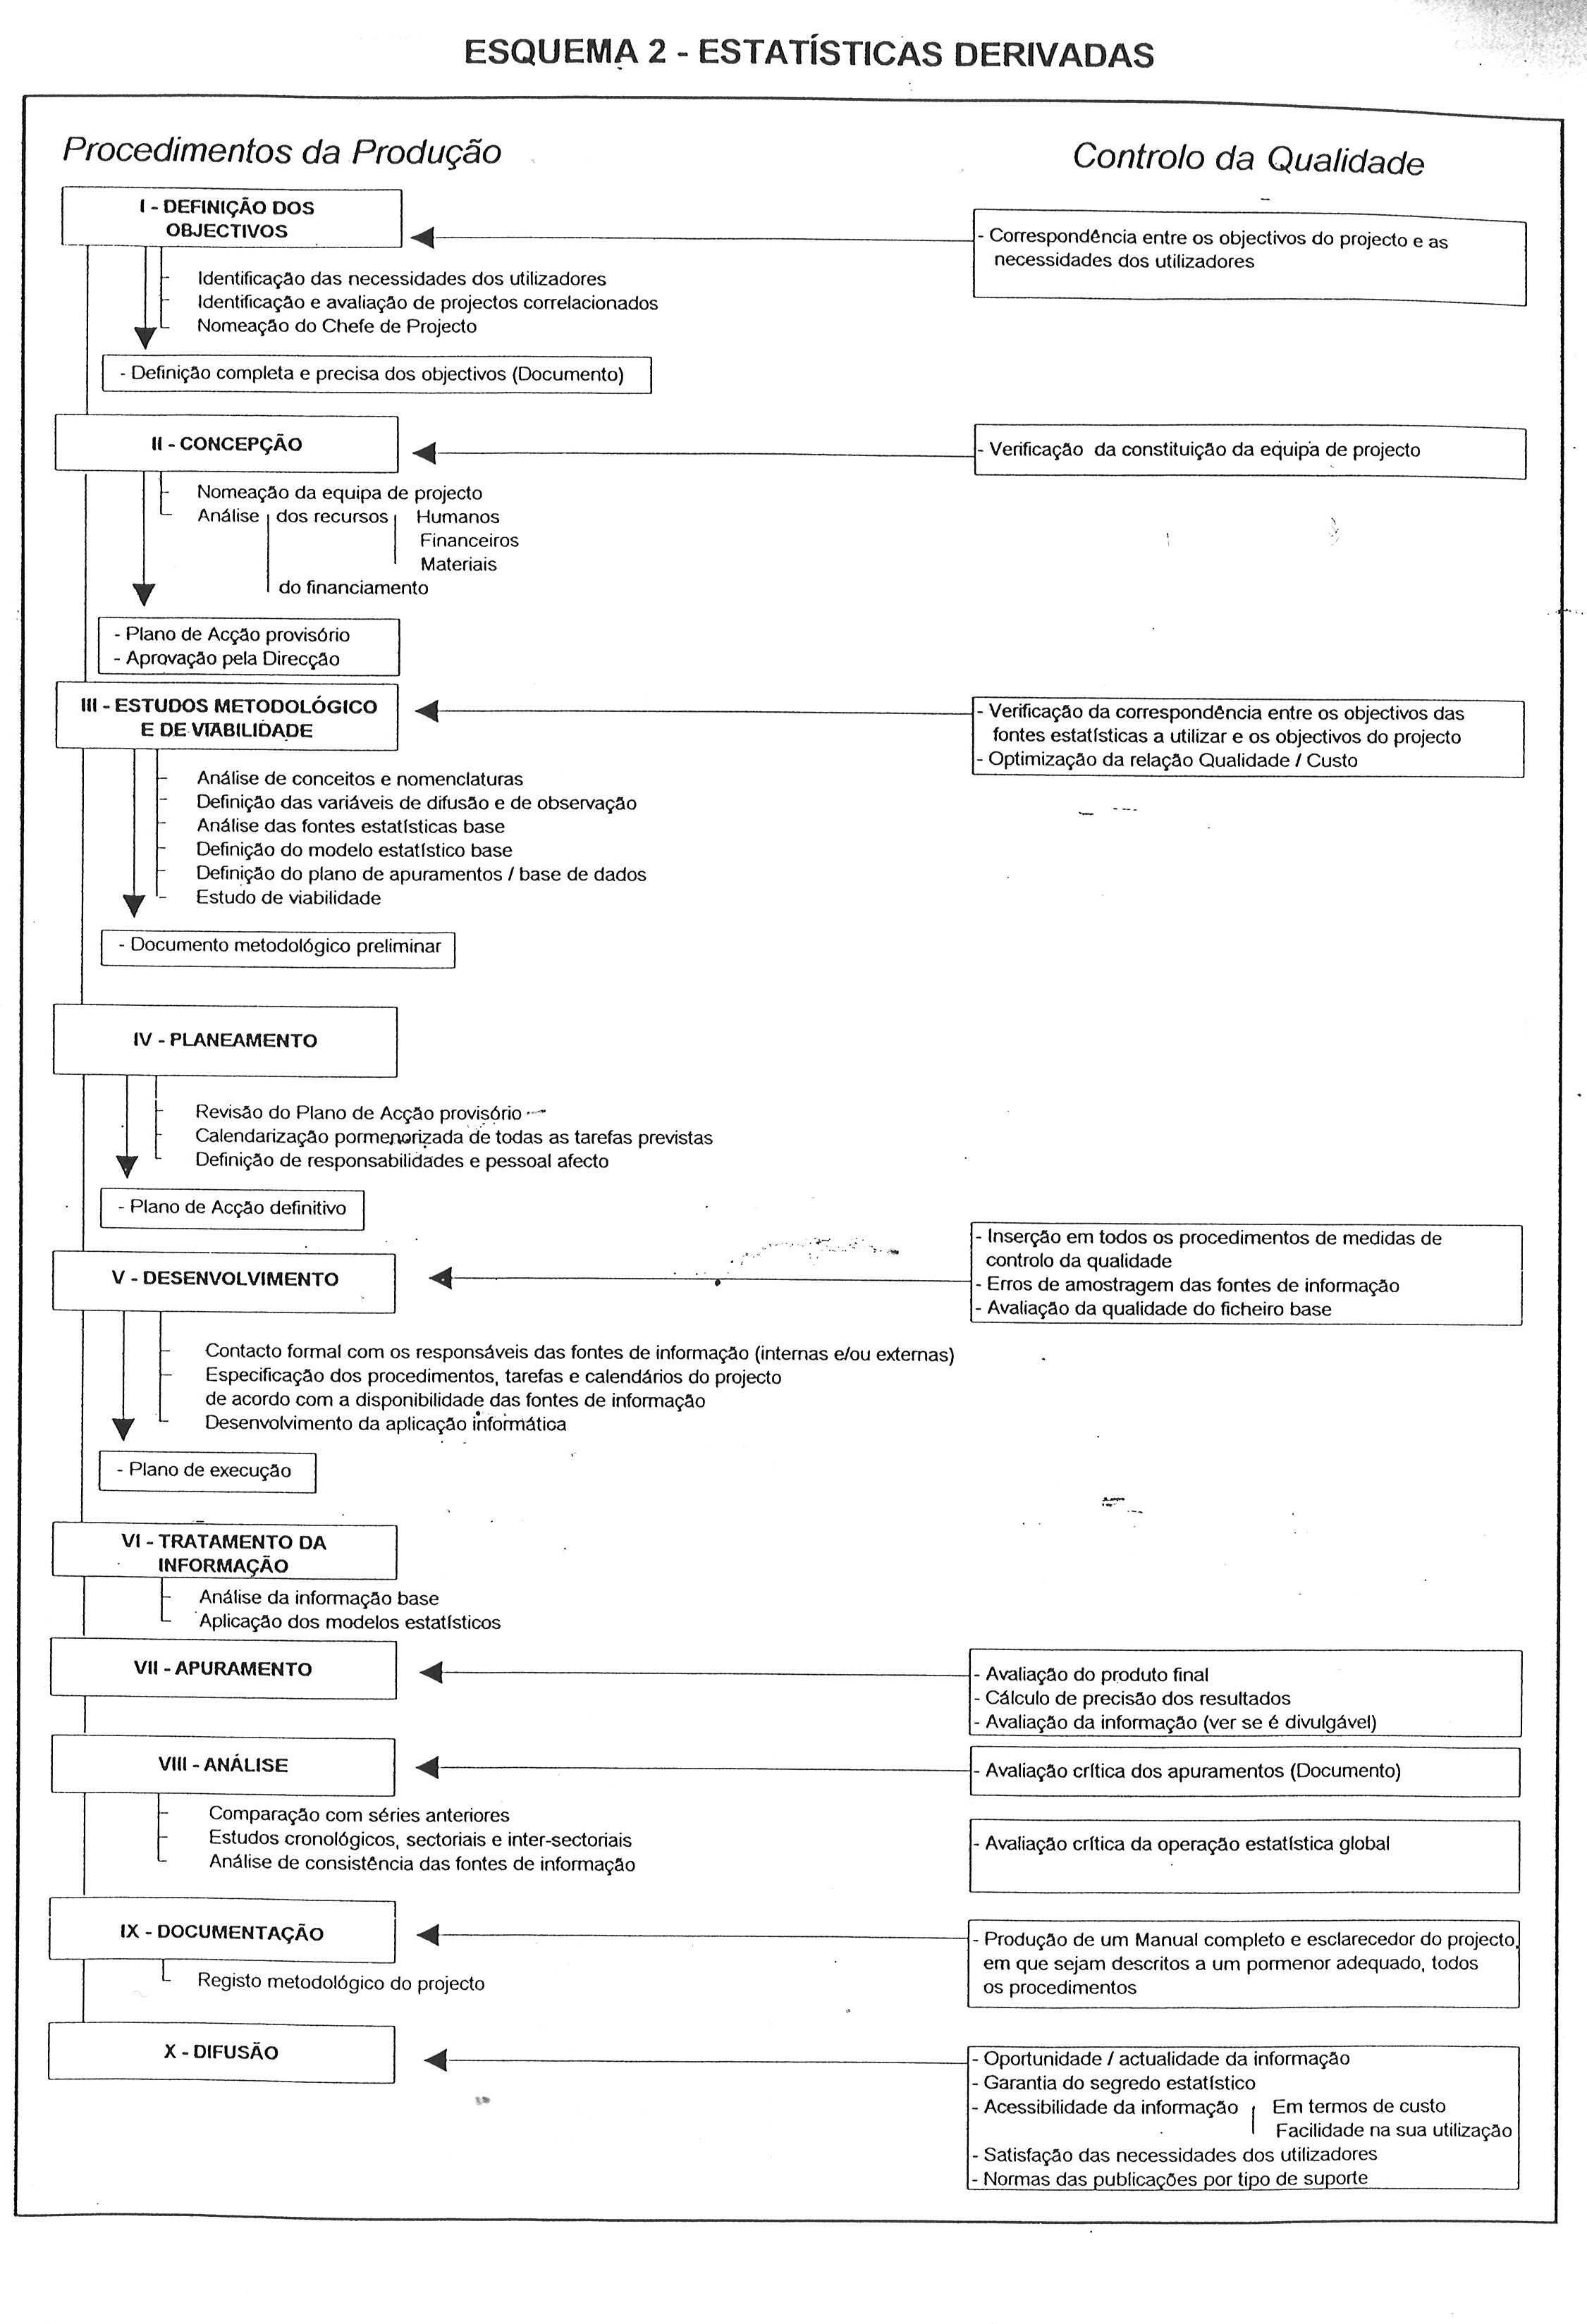
Statistical Process Procedures Handbooks
An overview (1)
Description of the Business Model
1st version (1997)
Primary statistics
Derived statistics

Slide 7
Statistical Process Procedures Handbooks
An overview (2)
2nd version (2006)
Description of the Business Model
Phases
I. Conception
II. Operation
III. Dissemination
IV. Evaluation
Processes
Processes
Process
Process
II.1. Planing and preparation of data collection
I.1. Viability Study
III.1. Dissemination
IV.1. Evaluation
I.2. Methodological Study
II.2. Data collection
I.3. Technical approval
II.3. Data treatment and analysis
Note: each process is composed by sub-processes and tasks (126 tasks)

Slide 8
SP’s Statistical Process Procedures Handbooks
An overview (3)
3rd version (2010)
General description of the Business Model
  Process design
  Definition of different phases of the process
2. Business process matrix
  Definition of responsibilities
  Definition of minimum documentation
  Handbooks are produced by pluridisciplinary teams

Slide 9
Describing the Statistical Business Process Model
Using the GSBPM - Generic Statistical Business Process Model
The conceptual model adopted by Statistics Portugal is aligned with the GSBPM (V. 5.0, 2013), with the addition of one more layer in the business process matrix.
GSBPM
Sub-processes
Adopted model
Phases
Sub-processes
Businesss process matrix Main tasks of each subprocess
Phases

Slide 10
Describing the Statistical Business Process Model
Phases and sub-processes
Statistical business process: set of activities/tasks developed in the context of statistical production, from planning to dissemination.
adapted from the GSBPM V.5

Slide 11
Describing the Statistical Business Process Model
Flexible framework
Similarly to the GSBPM, the overall model may not be followed in a strict order:
Flexible and iterative phase and sub-process sequence
Interdependence among sub-processes
Applicability of certain phases and sub-processes, depending on the type of statistical activity
E.g.: the tasks of concept and variable identification and the designing and building of the collection instrument are usually developed simultaneously, not following the specified phase and sub-process sequence

Slide 12
Describing the Statistical Business Process Model
Business Process Matrix
Statistical business process organization:
8 phases – 1st level
44 sub-processes – 2nd level
Business process matrix – 3rd level / aditional layer
≈ GSBPM
  Mapping important activities throughout the business process, resulting from the process modernization
  Defining responsabilities
  Identifying relevant reference documentation and expected outputs
  Demonstrate the applicability of the business process model regardless of the type of statistical activity
  Composed by 150 Tasks

Slide 13
Describing the Statistical Business Process Model
Business Process Matrix
Business process matrix – 3rd level:
  Main tasks composing each subprocess.

Slide 14
Describing the Statistical Business Process Model
Business Process Matrix
Business process matrix – 3rd level:
  Tasks follow the usual sequence of statistical production, are organized by the stages of statistical production and are linked to the model’s phases and sub-processes.

Slide 15
Describing the Statistical Business Process Model
Business Process Matrix
Business process matrix – 3rd level:
  Responsible department for each activity and other participants.

Slide 16
Describing the Statistical Business Process Model
Business Process Matrix
Business process matrix – 3rd level:
  Applicability of tasks according to the span of statistical activity (new or ongoing), its type (primary or derived) and data source (survey or administrative records).

Slide 17
Describing the Statistical Business Process Model
Business Process Matrix
Business process matrix – 3rd level:
  Documentation to be produced in the context of each phase/sub-process/task;
  Reference documentation in the context of each phase/sub-process/ task;
  Link to the internal planning and management IT system (SIGINE) – main tasks relevant to the planning process.

Slide 18
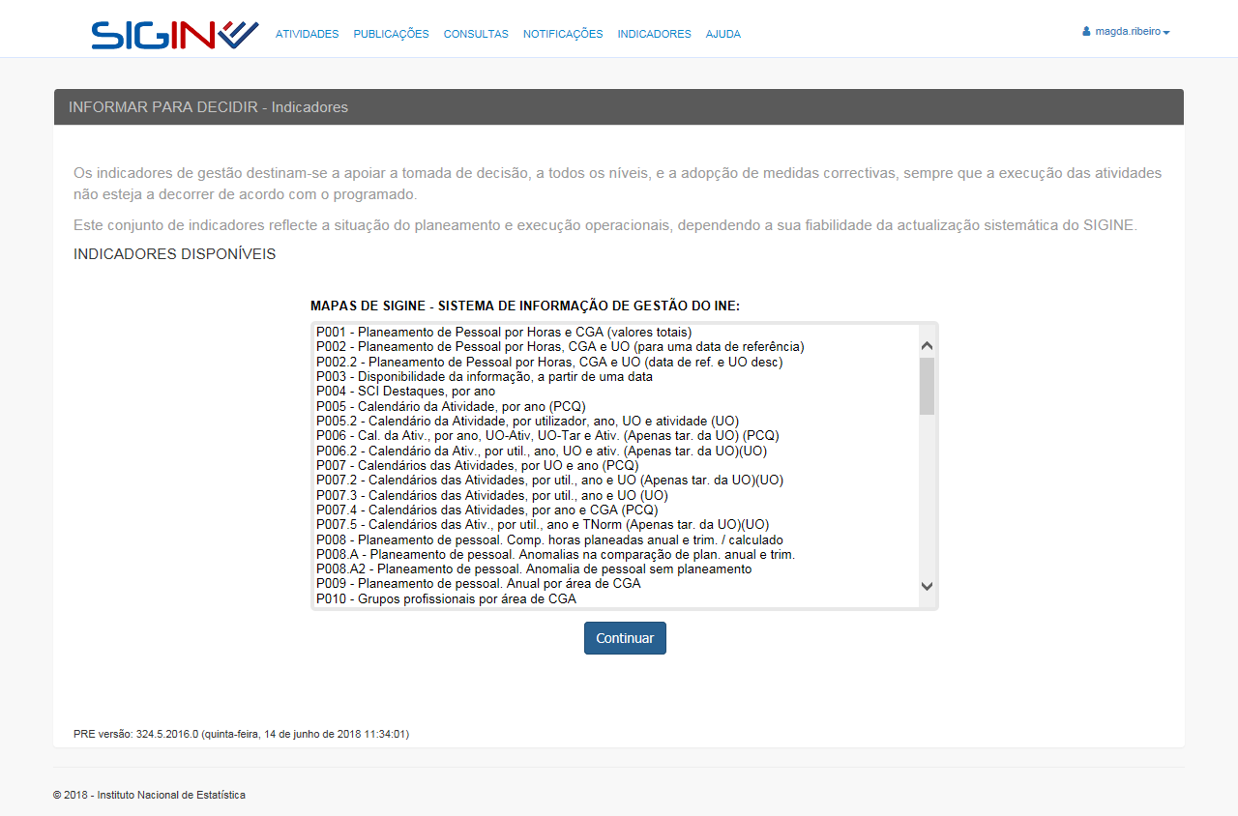
Describing the Statistical Business Process Model
Internal planning and management IT system

Slide 19
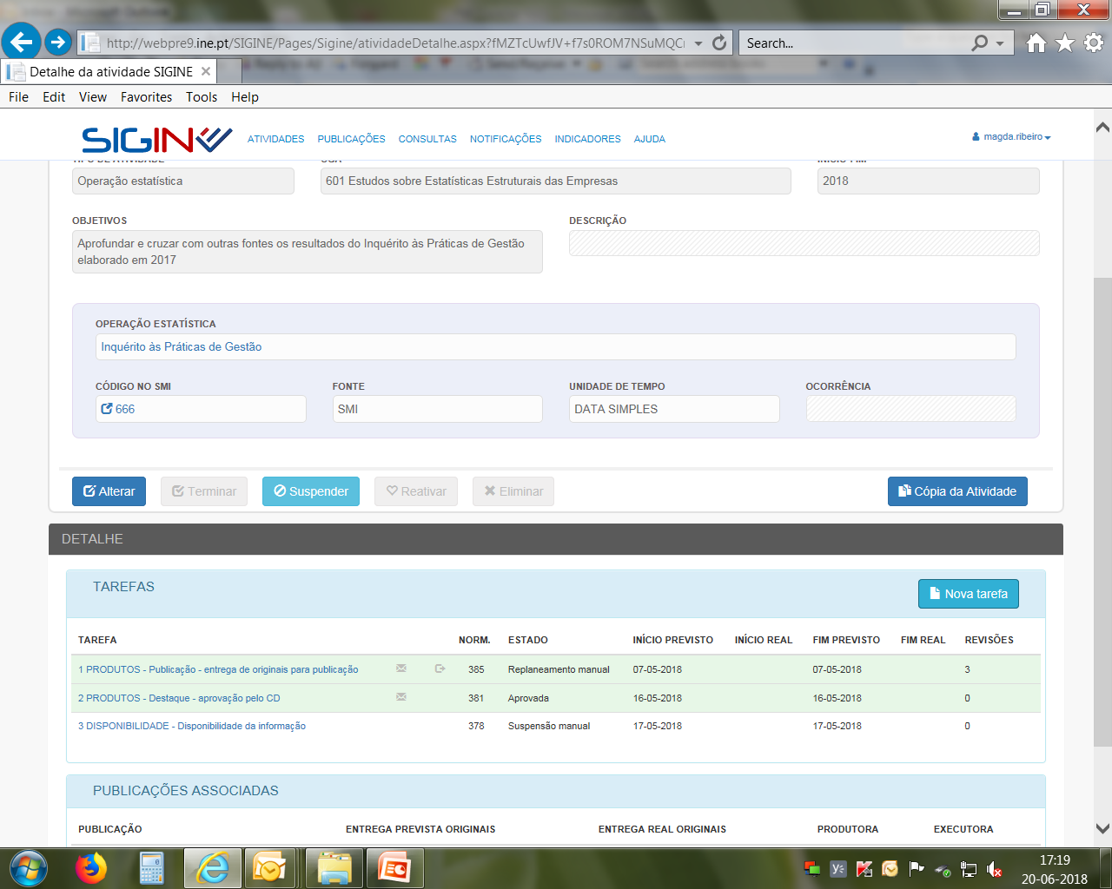
Describing the Statistical Business Process Model
Internal planning and management IT system
Tasks in the context of a given statistical activity

Slide 20
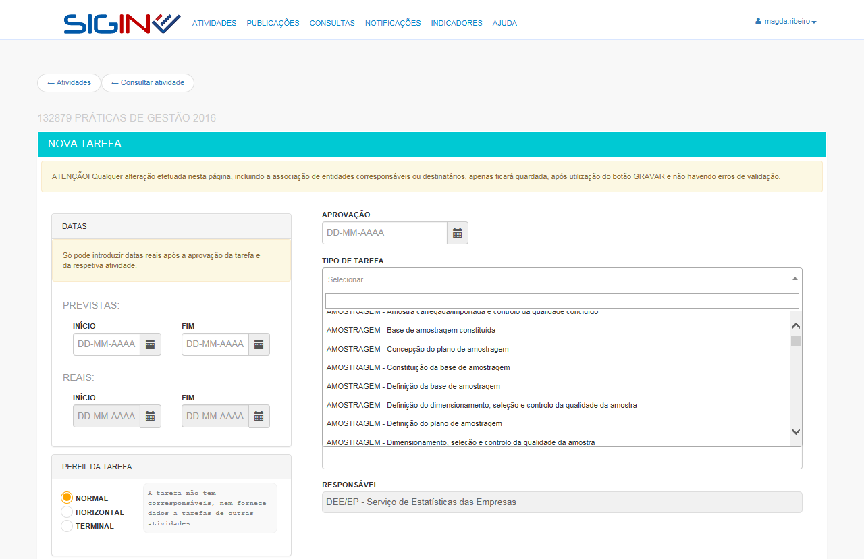
Describing the Statistical Business Process Model
Internal planning and management IT system
Creating a new task
Tasks to choose from
(short description of tasks contemplated in the Business Process Model)
Calendar

Slide 21
Describing the Statistical Business Process Model
Business Process Matrix

Slide 22
GEOSPATIAL
Describing the Statistical Business Process Model
Mapping the role of the spatial data infrastructure
  13 tasks in total;
  In this case, the tasks provide further detail to the role of the spatial information infrastructure in the business process, which is not explicitly contemplated in the GSBPM phase and sub-process description.

Slide 23
Next steps
Regular updates to the description of the business process are expected, following the streamlining of procedures
Contributes to model simplification are deemed useful, specifically in what concerns the more detailed levels (matrix)
Expanding the mapping of documentation to be produced in the context of each task
Producing and standardizing reference documentation central to the business process (work instructions, guidelines, templates)
Describing and standardizing over-arching processes with a statistical component (e.g.: quality management, metadata management)

Slide 24
Thank you for your attention!
Acknowledgements
Magda Ribeiro (Statistics Portugal)
David Sousa (Statistics Portugal)

