Slide 1
Quality and Risk Management in the CSB of Latvia
Jolanta Minkevica, Ieva Pauļuka
The CSB of Latvia, oficiala.statistika@csb.gov.lv
27.06.2018.
Session 1

Slide 2
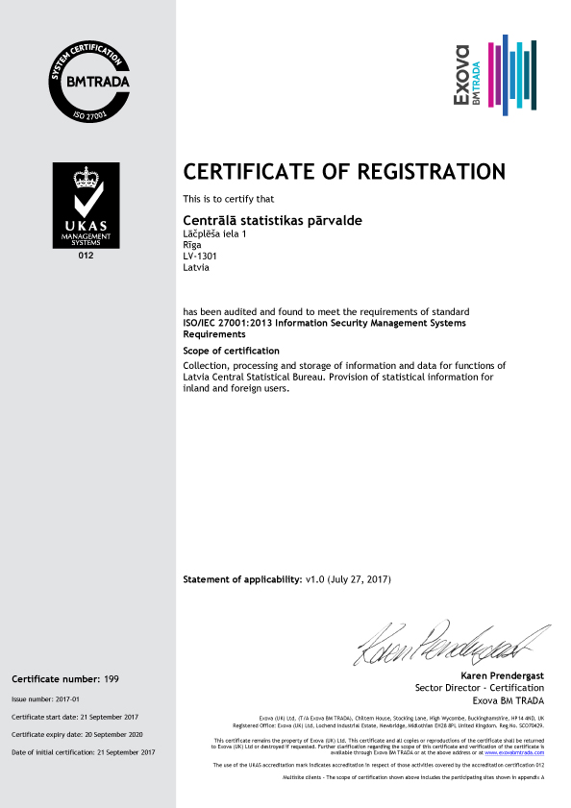
In 2017
the Central Statistical Bureau
of Latvia (CSB)
acquired ISO 27001:2013 certificate

Slide 3

In 2018
we are heading for
ISO 9001:2015
certificate

Slide 4
WHAT DO WE HAVE?
Risk
Management
Quality
Management

Slide 5
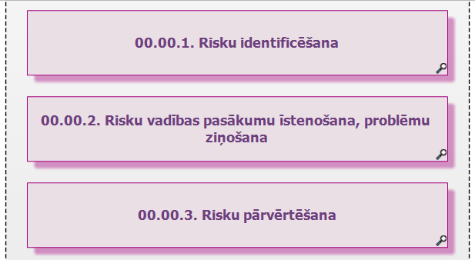
RISK MANAGEMENT
Risk Management process
(in QMS)
Risks’ register
0.2. Risk Management
0.2.1. Identification of risks
0.2.2. Reporting and management
of risks
0.2.3. Re-evaluation of risks

Slide 6
The CSB QMS
ALL PROCESSES ARE MAPPED

Slide 7
STATISTICAL PRODUCTION PROCESSES ARE STANDARDISED
4.4.1. Business statistics
4.4.2. Social statistics
4.4.3. Consumer price statistics
4.4.4. Administrative sources
4.4.5. Other CSB products

Slide 8
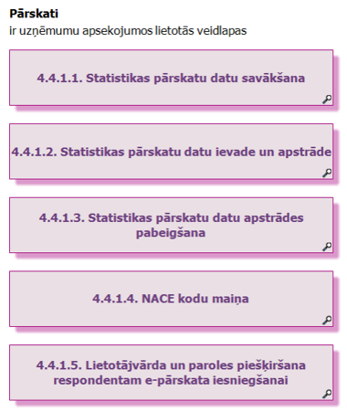
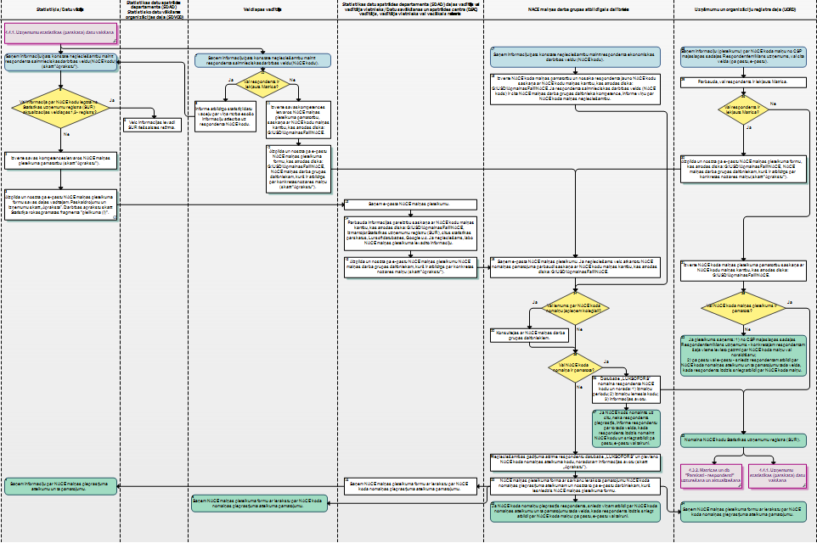
SOME PROCESSES ARE DESCRIBED ON VERY DETAILED LEVEL
(A DECISION OF A PROCESS OWNER)
4.4.1. Business statistics
4.4.2. Social statistics
4.4.3. Consumer price statistics
4.4.4. Administrative sources
4.4.5. Other CSB products

Slide 9


REQUIREMENTS and RISKS
ARE DESCRIBED IN PROCESSES
EXAMPLE
REQUIREMENT
(NEGATIVE) RISK
European Statistics Code of Practice
9.4: Administrative sources are used whenever possible to avoid duplicating requests for information
Existing administrative data are not used

Slide 10
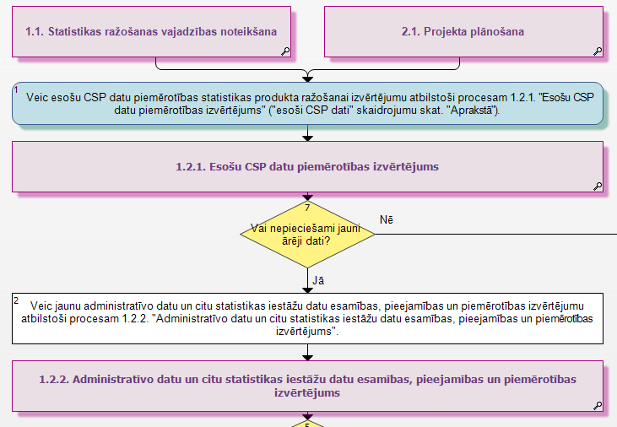
PROJECT PLANNING PROCESS
(OBLIGATORY PROCESS STEPS)

Slide 11

REQUIREMENTS and RISKS
ARE DESCRIBED IN PROCESSES
EXAMPLE
REQUIREMENT
(NEGATIVE) RISK
RISK OPPORTUNITY
European Statistics Code of Practice
9.4: Administrative sources are used whenever possible to avoid duplicating requests for information
Existing administrative data are not used
Existing administrative data are always used

Slide 12
STATISTICS LAW
ARTICLE 13
(2) the statistical institution shall use administrative data sources for the production of official statistics, with the exception of the following cases:
1) definition of statistical unit used in the administrative data sources does not comply with the definition of statistical unit used by the statistical institution;
2) administrative data source indicators do not comply with the definition of indicator used by the statistical institution;
3) administrative data sources use classifications, that are not compatible with the standard classifications or classifications laid down in the legal act, for the classification of data;
4) data from administrative data sources cannot be obtained for production of official statistics within the laid down processing and publishing time periods;
5) administrative data sources are inaccurate, faulty, or they do not contain the data necessary for the production of official statistics;
6) in the cases laid down in the laws and regulations the State institution or legal person governed by private law or an association of such persons are not entitled to provide the requested data to the statistical institution.
(3) If the statistical institution does not use administrative data sources in cases laid down in Paragraph two of this Section, it shall request data from respondents in accordance with Section 14, Paragraph one of this Law.

Slide 13

REQUIREMENTS and RISKS
ARE DESCRIBED IN PROCESSES
EXAMPLE
RISK
(IN A RISK REGISTER)
REQUIREMENT
(ISO 9001:2015)
Insufficient identification or misunderstanding of users needs
8.3.4 b) reviews are conducted to evaluate the ability of the results of design and development to meet requirements

Slide 14
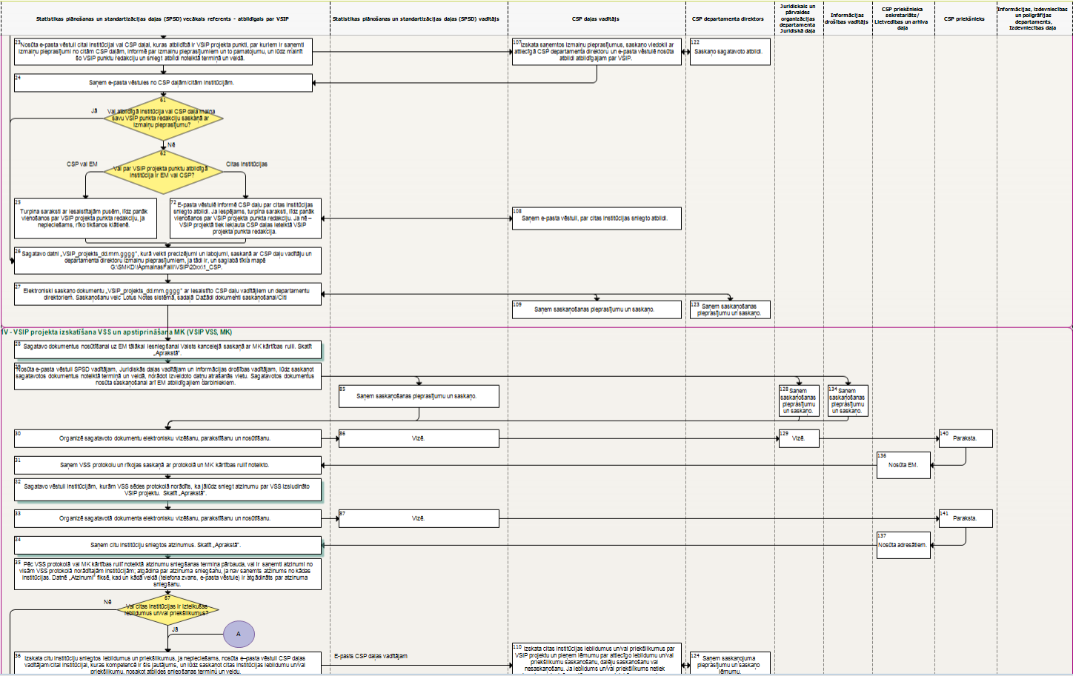
1.3. Official Statistics Programme
Get agreement of the customer, in writing or at the meeting

Slide 15
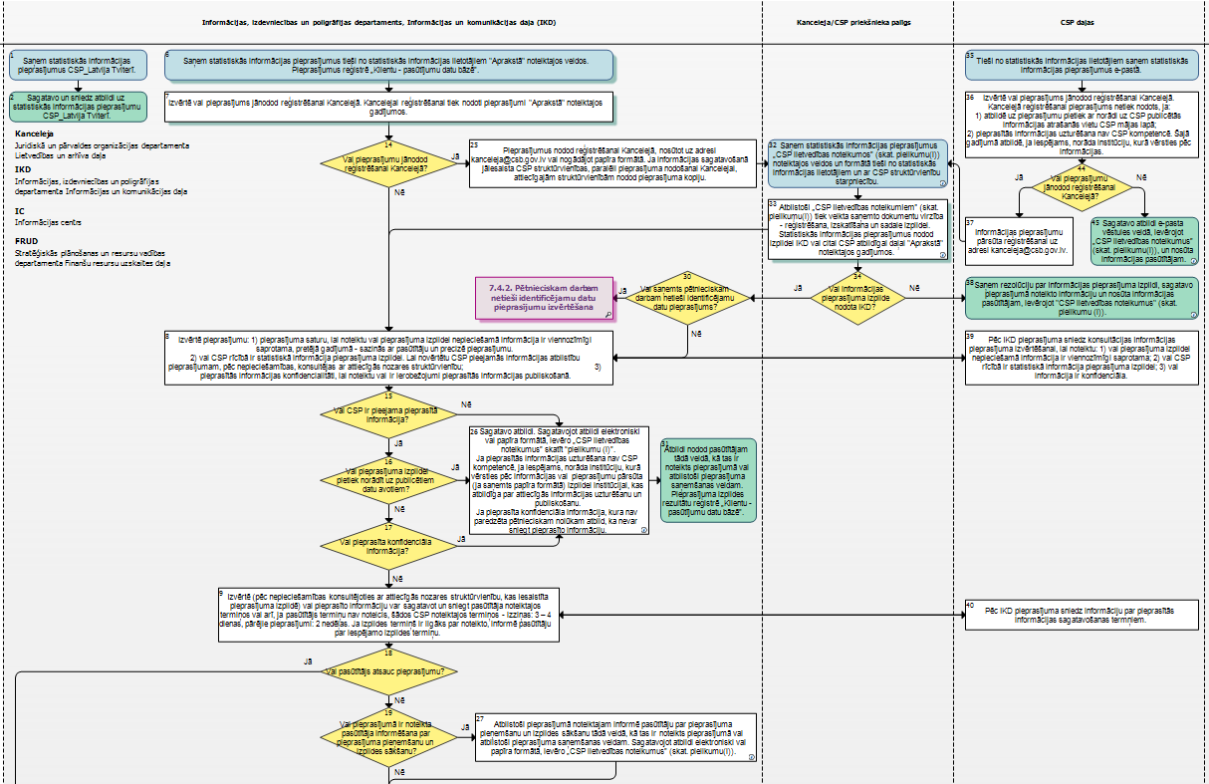
7.4. Processing of user requests (custom made statistics)
If necessary, clarify the request
If necessary, agree on deadline
Inform the customer about acceptance of a request and start of execution

Slide 16
QMS
ACCESSIBLE ONLINE 24/7
ALWAYS UPDATED VERSION
KNOWLEGDE BASE

Slide 17

CHALLENGE
Integrated,
simple
and user friendly
system

Slide 18
Quality and Risk Management in the CSB of Latvia
Thanks
Jolanta Minkevica, Ieva Pauļuka
The CSB of Latvia, oficiala.statistika@csb.gov.lv

